Slide 1

Taking pictures of Earth from the International Space Station
An interview with British ESA astronaut Tim Peake
ESA/NASA/Tim Peake
Notes:
Image: The Nile by night
Photo link: https://www.flickr.com/photos/timpeake/27550621276

Slide 2
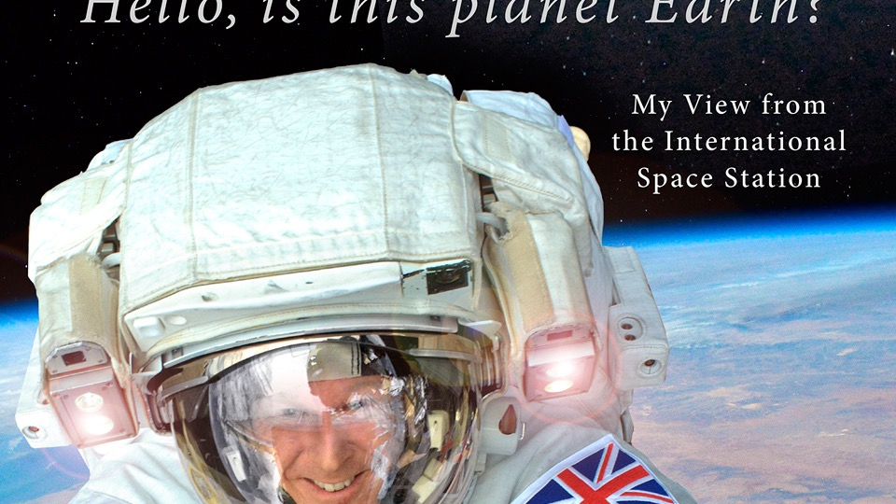

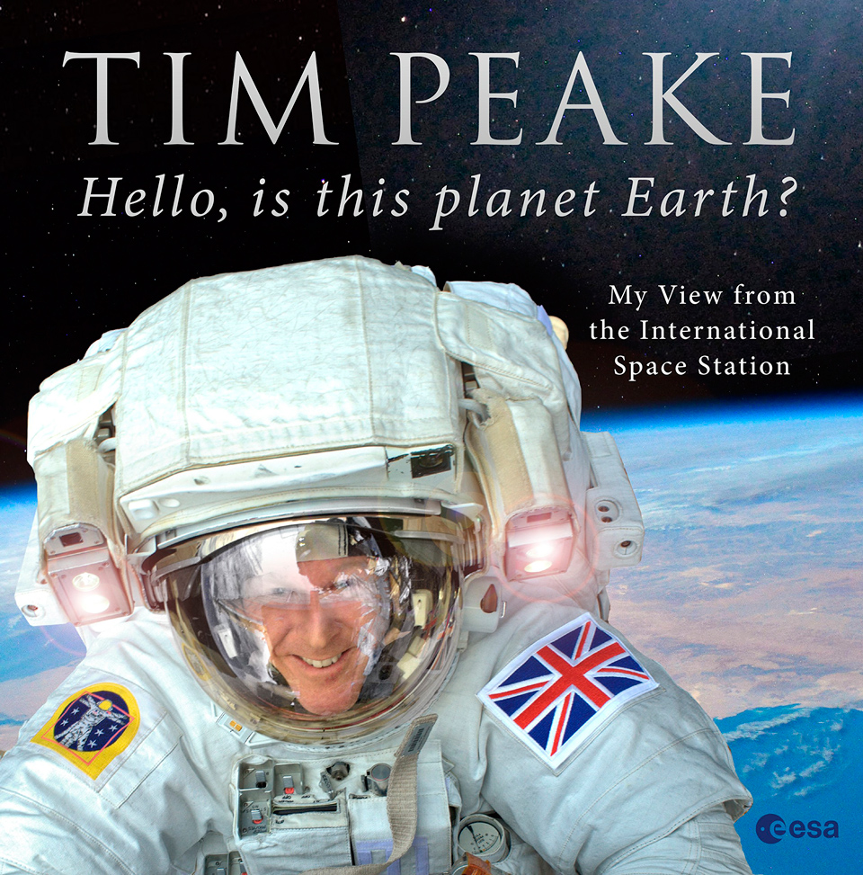

Notes:
We all enjoyed your tweets and pictures and now enjoying the book.
Some astronauts don’t take (or at least don’t use social media to share) their photographs.
Why did you choose to do so?
Images: Cover of Hello, is this Planet Earth by Tim Peake, logo of the Principia mission

Slide 3
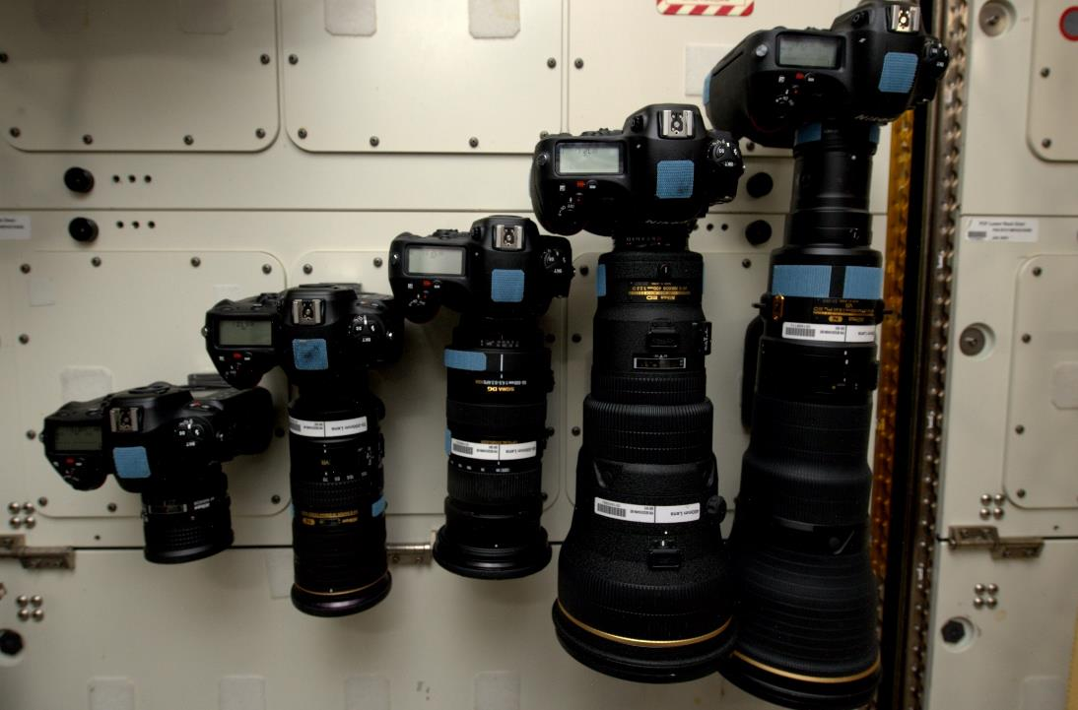
ESA/NASA/Tim Peake
Notes:
Some of these cameras have very long lenses, but no longer than you might see on a sports reporter’s camera.
Are they modified in any way for taking pictures of the Earth from Space?
Image: The camera store on the ISS
Photo link: https://www.flickr.com/photos/timpeake/26721236693

Slide 4
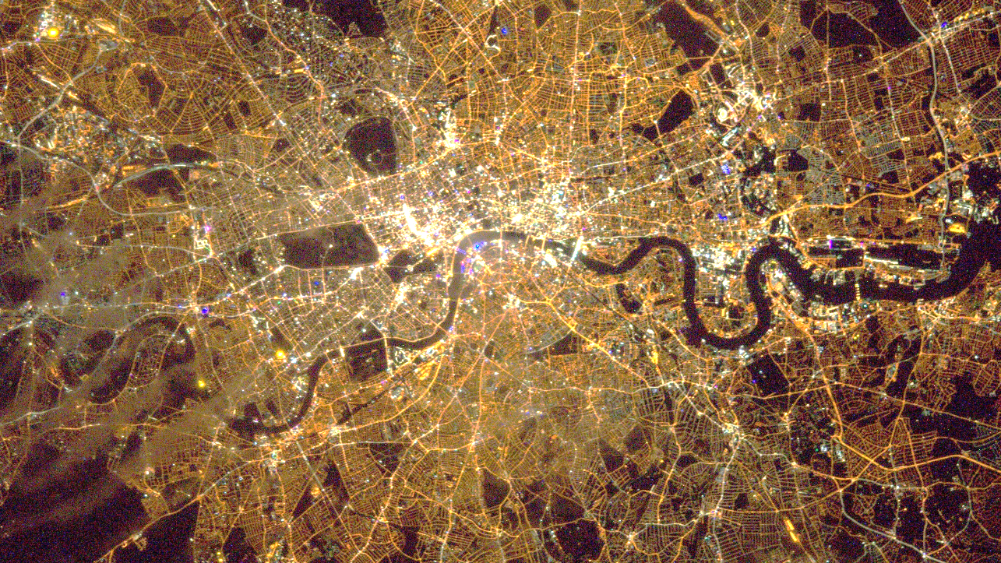
ESA/NASA/Tim Peake
Notes:
What about the settings you use? Shutter speed, aperture, ISO?
Image: London by night
Photo link: https://www.flickr.com/photos/timpeake/24608274142

Slide 5
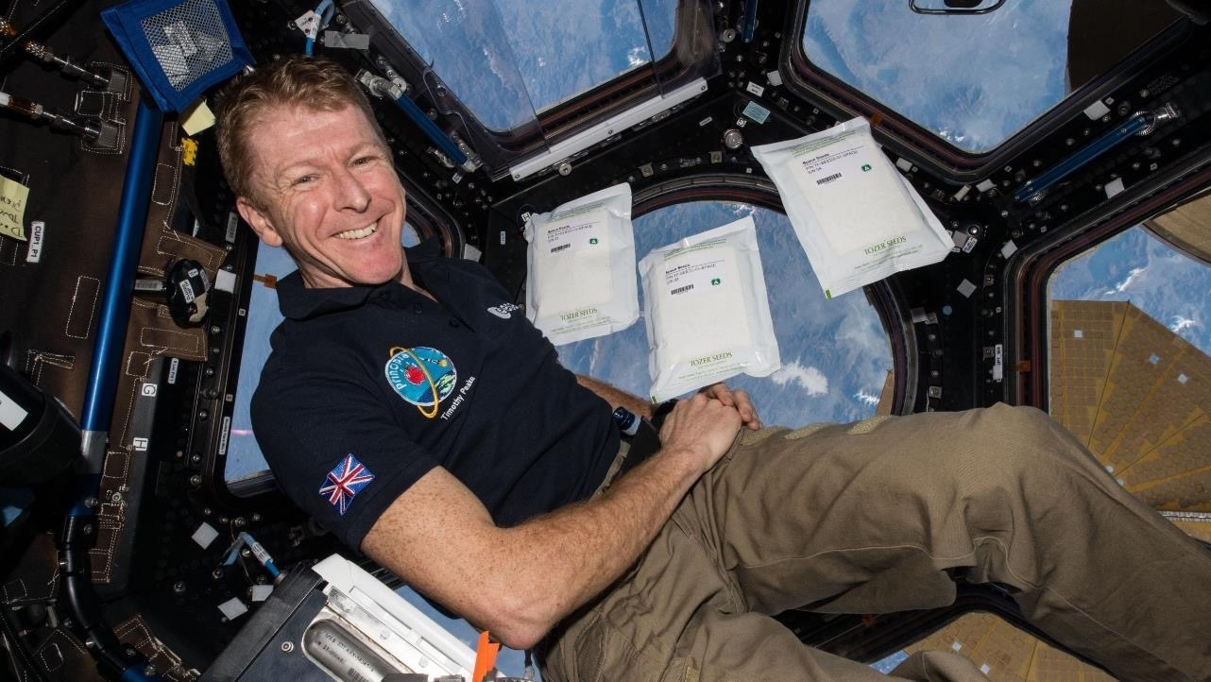
ESA/NASA/Tim Peake
Notes:
When we ask visitors to our stand at events what they think might make it difficult to take a picture of the Earth from space difficult, they nearly always say ‘no gravity.’
What are the actual problems?
Image: Tim in the cupola of the ISS
Photo link: https://www.esa.int/ESA_Multimedia/Images/2018/09/Tim_Peake_on_the_ISS

Slide 6
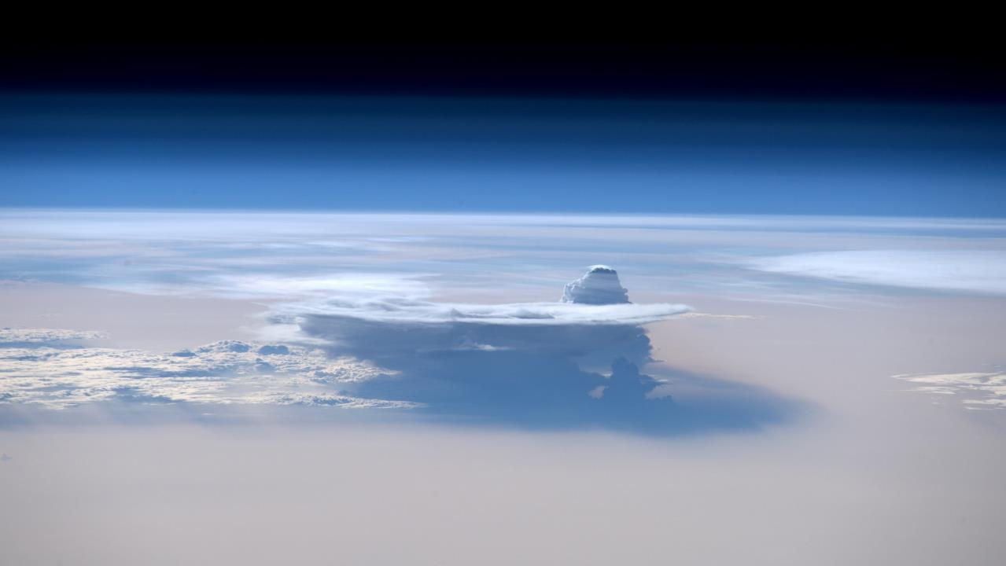
ESA/NASA/Tim Peake
Notes:
Obviously cloud cover affects the photos you can take – although they make spectacular images in their own right – but
what other things can make it difficult to get a photograph of a particular target?
Image: High cloud
Photo link: https://www.flickr.com/photos/timpeake/27282110722

Slide 7
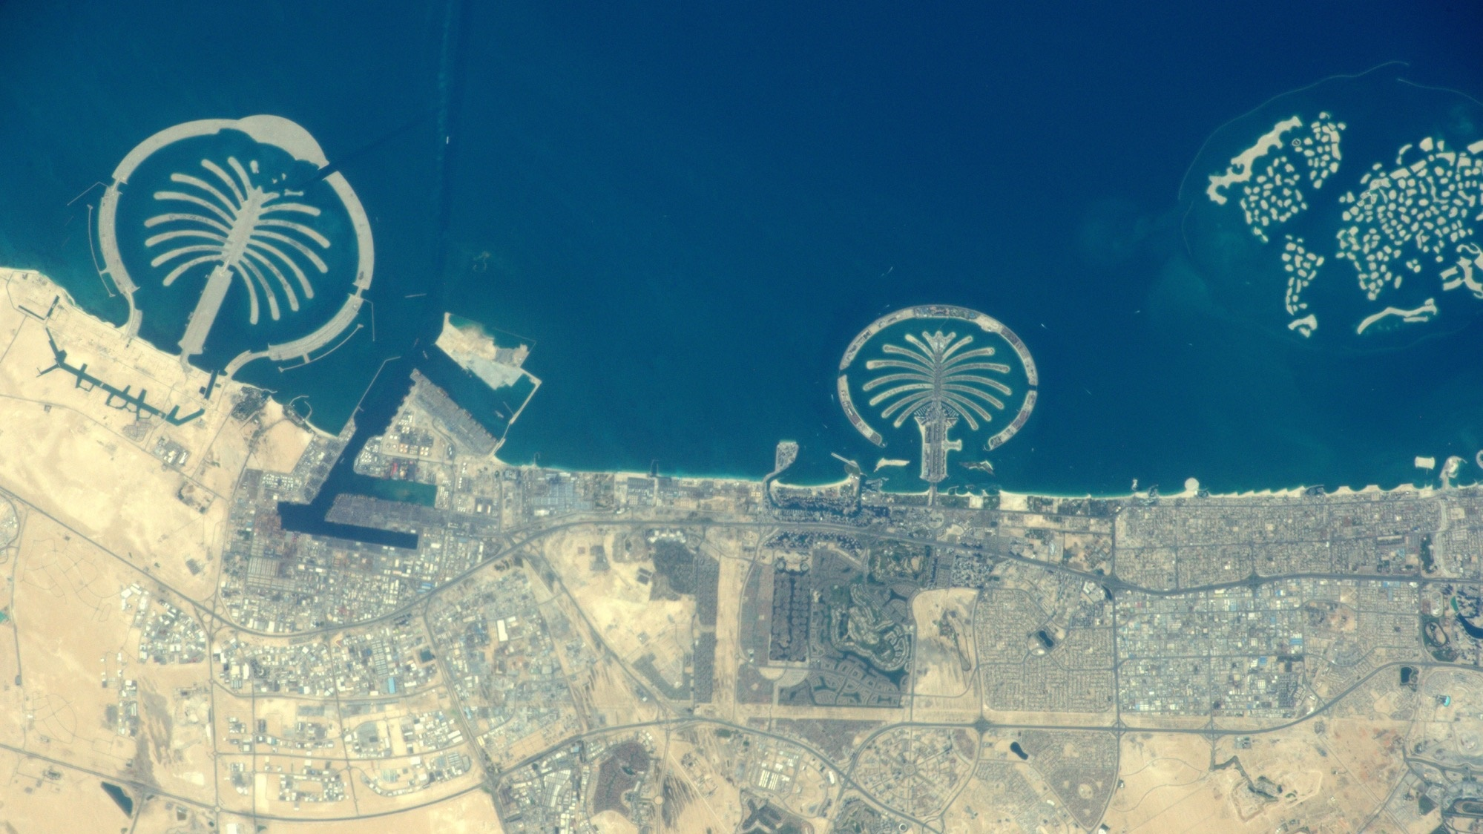
ESA/NASA/Tim Peake
Notes:
If there’s something you particularly want to photograph,
can you sneak away from work to do it – or get it built into your timetable in some way?
Or do you just have to hope that you have some free time that corresponds to a good pass?
Image: Dubai showing artificial resort islands
Photo link: https://www.flickr.com/photos/timpeake/25766177983

Slide 8
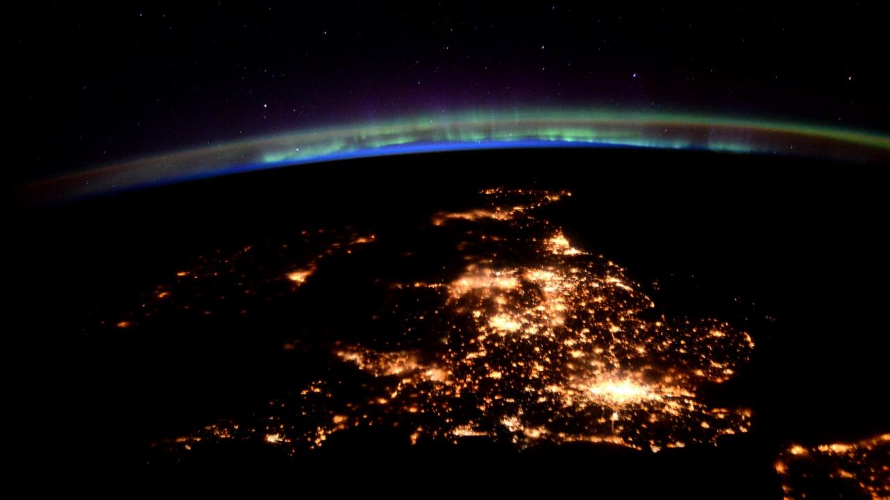
ESA/NASA/Tim Peake
Notes:
Which of your photographs of the Earth is your favourite? Why?
Image: British Isles under an aurora
Photo link: https://www.flickr.com/photos/timpeake/26003241950

Slide 9
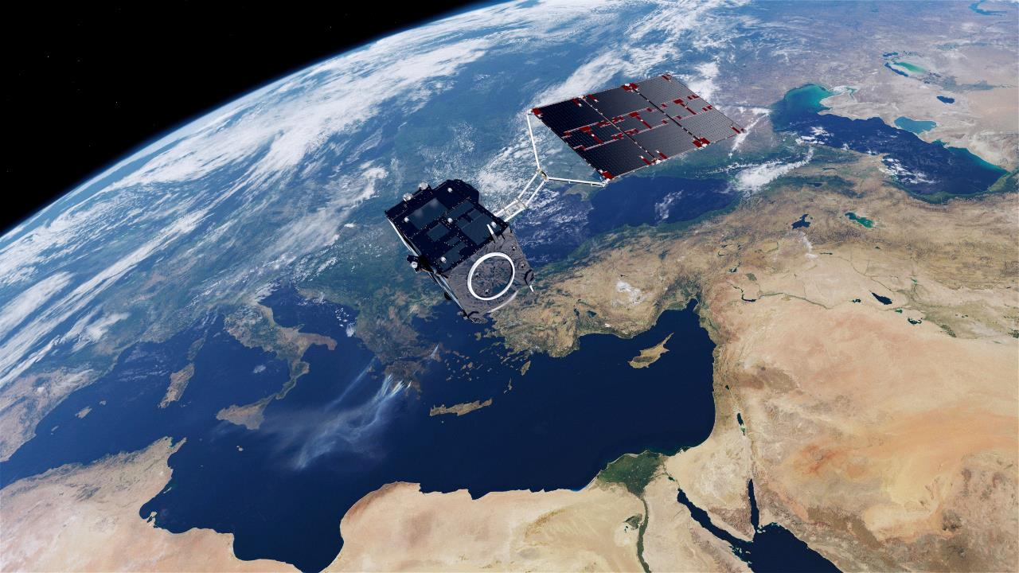
Sentinel 3 Artist impersonation
ESA/ATG media lab
Notes:
We tend to think about EO in terms of satellites, like the ESA Copernicus Sentinels and American Landsat, but there is an ISS EO program too – it’s how we were able to submit the requests of our competition winners.
When/why do scientists want ISS pictures rather than or as well as satellite images?
Image: Copernicus Sentinel 3 – an EO satellite
Photo link: https://www.esa.int/ESA_Multimedia/Images/2016/01/Feeling_the_heat

Slide 10
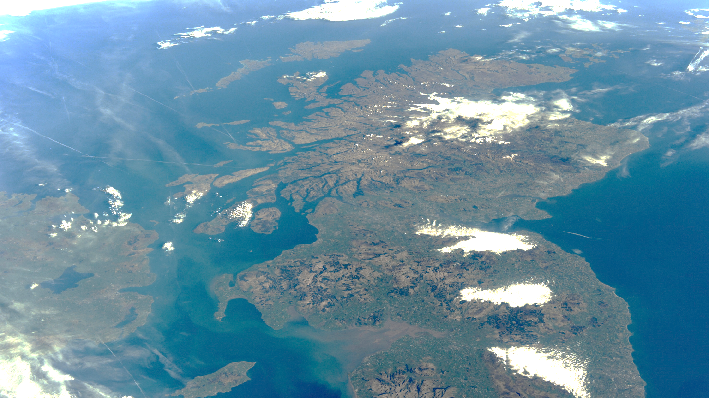
ESA/NASA/Tim Peake
Notes:
How is taking these pictures different to taking those you take for fun?
Image: Scotland and Northern Ireland
Photo link: https://www.flickr.com/photos/timpeake/26308188144

Slide 11
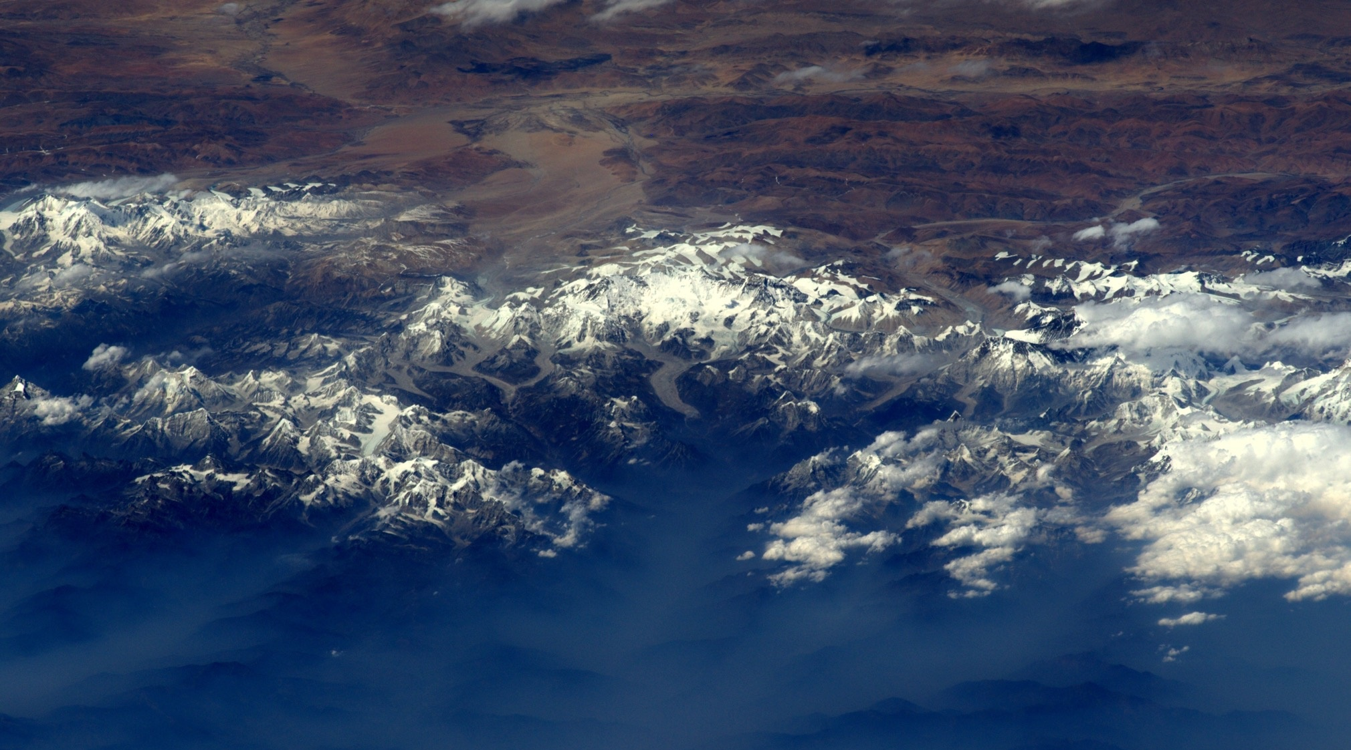
ESA/NASA/Tim Peake
Notes:
What support do you get from the ground when taking these?
(Precise time details? Maps? Weather forecasts?)
Image: Mount Everest
Photo link: https://www.flickr.com/photos/timpeake/25876212454

Slide 12
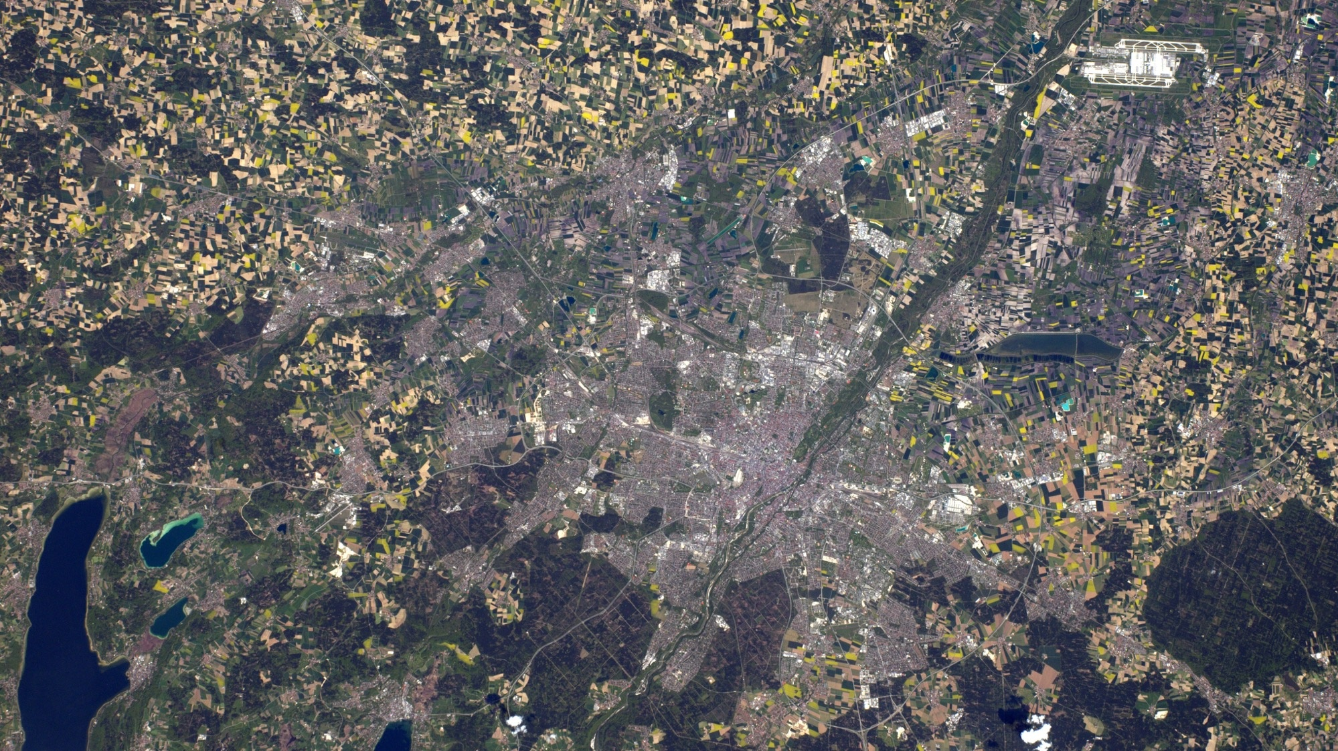
ESA/NASA/Tim Peake
Notes:
Your internet connection is rather slow, I believe.
How are all of those on the Gateway, or a sequence used for time-lapse, sent back?
Is there a separate channel? Do they have to go overnight or what?
Image: Munich
Photo link: https://www.flickr.com/photos/timpeake/27225801116

Slide 13
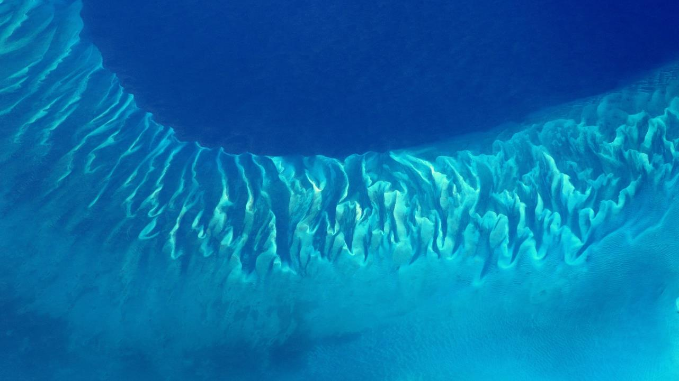
ESA/NASA/Tim Peake
Notes:
Some spectacular images of natural formations.
Was there natural feature or environment that took you by surprise? Why?
Image: A reef edge in the Bahamas
Photo link: https://www.flickr.com/photos/timpeake/26194524890

Slide 14
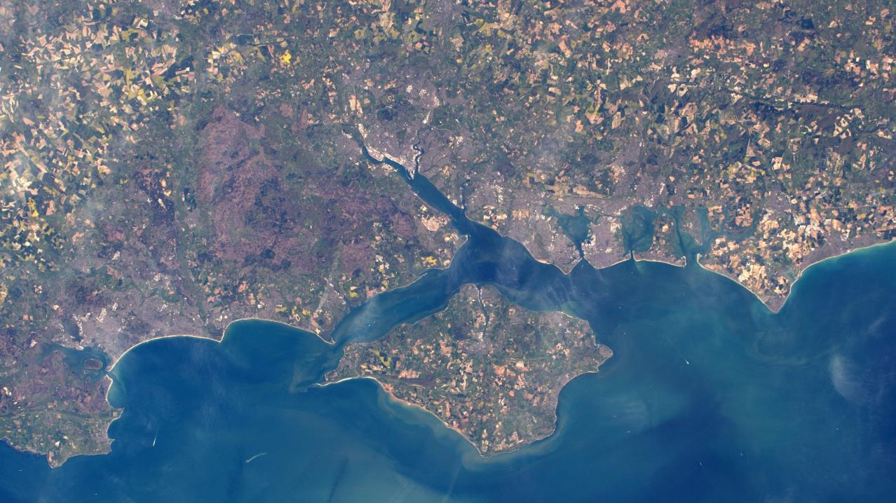
ESA/NASA/Tim Peake
Notes:
You mentioned being able to tell spring was coming.
Was that a kind of general colour change or were there some specifics that pointed it out?
Image: The Isle of Wight and Southern England
Photo link: https://www.flickr.com/photos/timpeake/26817438581

Slide 15
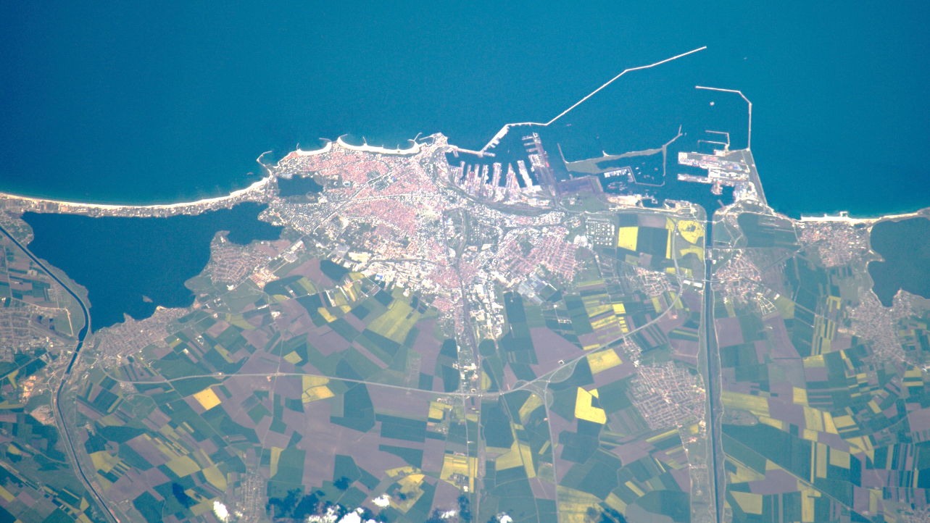
ESA/NASA/Tim Peake
Notes:
We’ve used this picture to talk about how it’s sometimes easy to recognise a particular crop from space.
Were there any other agricultural things that you were able to recognise?
Image: Constanta, an ancient city in Romania
Photo link: https://www.flickr.com/photos/timpeake/26719983336

Slide 16
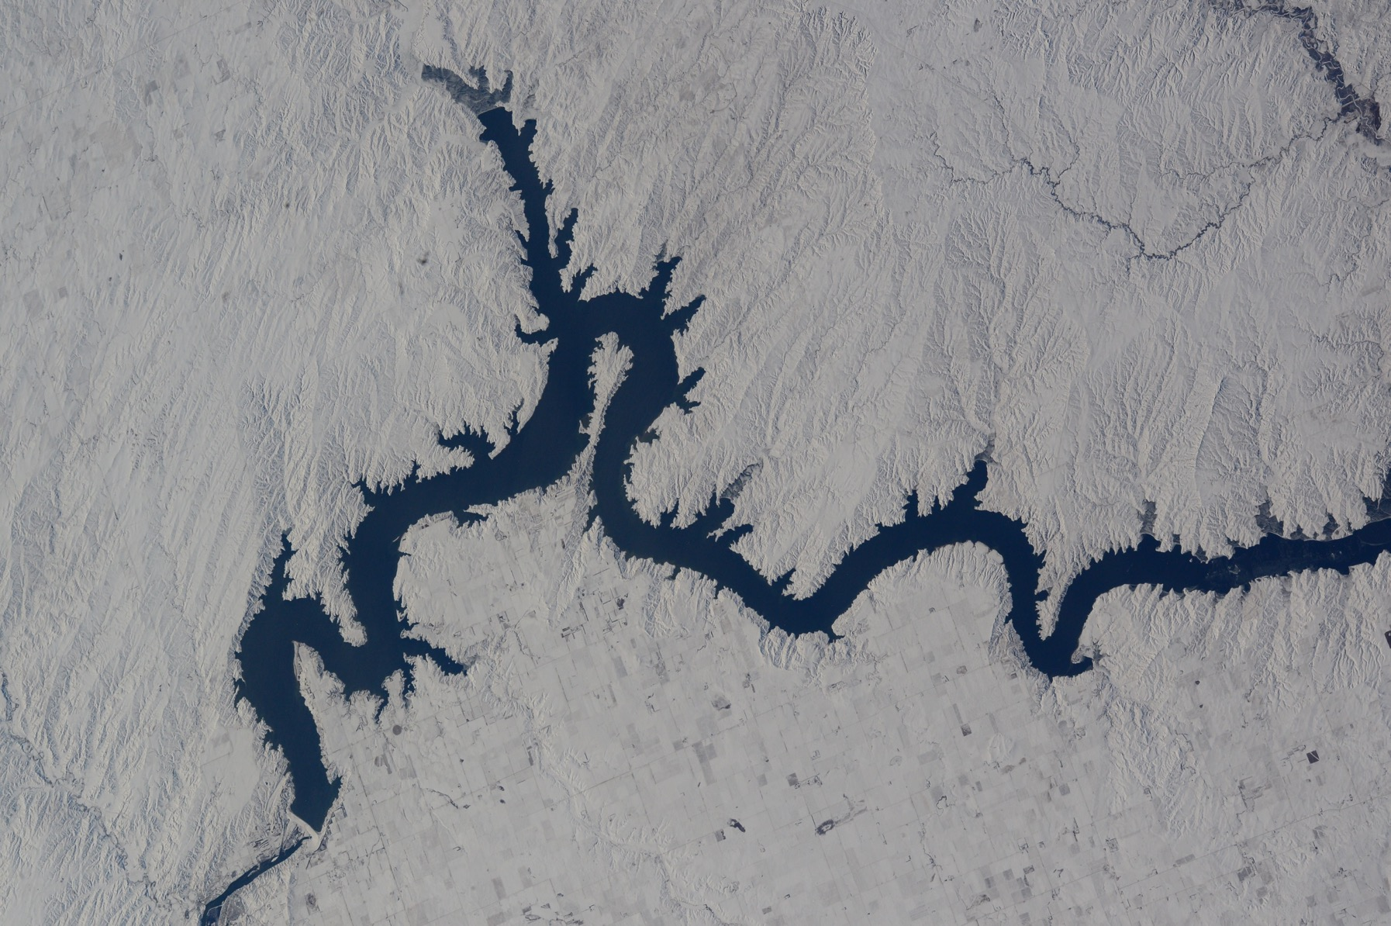
ESA/NASA/Tim Peake
Notes:
What about other human impacts on the environment?
Were there any that particularly shocked or surprised you – either by how visible or invisible they were?
Image: Lake Oahe, South Dakota
Photo link: https://www.flickr.com/photos/timpeake/24115852989

Slide 17
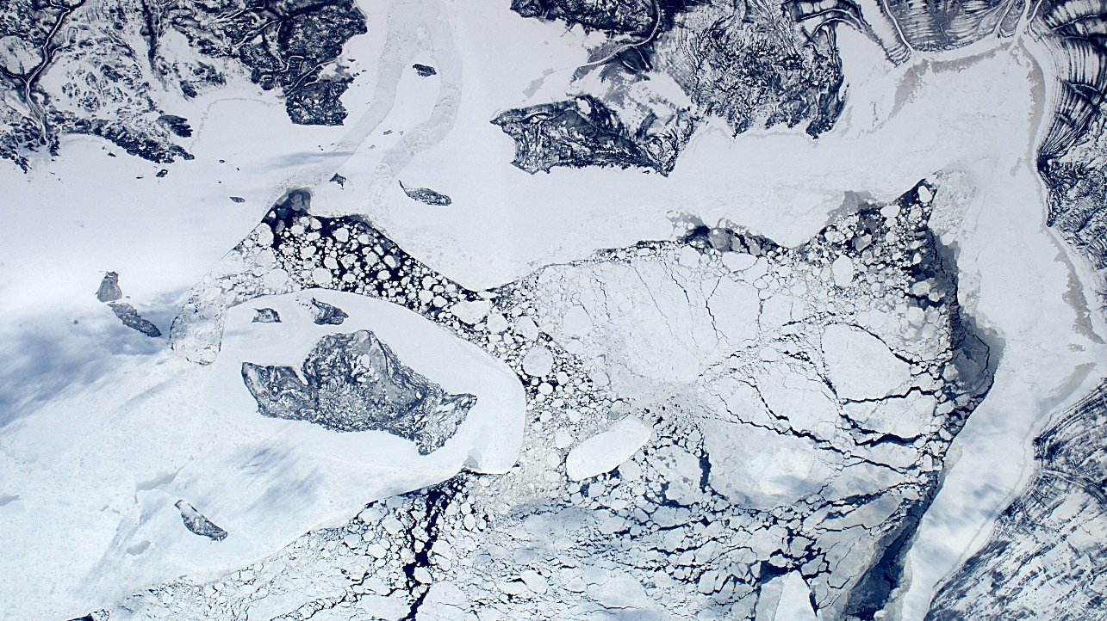
ESA/NASA/Tim Peake
Notes:
Now we have over 30 years of more or less continuous satellite imagery of the earth, it is very helpful for monitoring change. You were only there for a short period of time, but
did you see any evidence of changes – natural or man-made – that stood out? (even if only weather systems!)
Image: James Bay, Canada
Photo link: https://www.flickr.com/photos/timpeake/25330501814

Slide 18
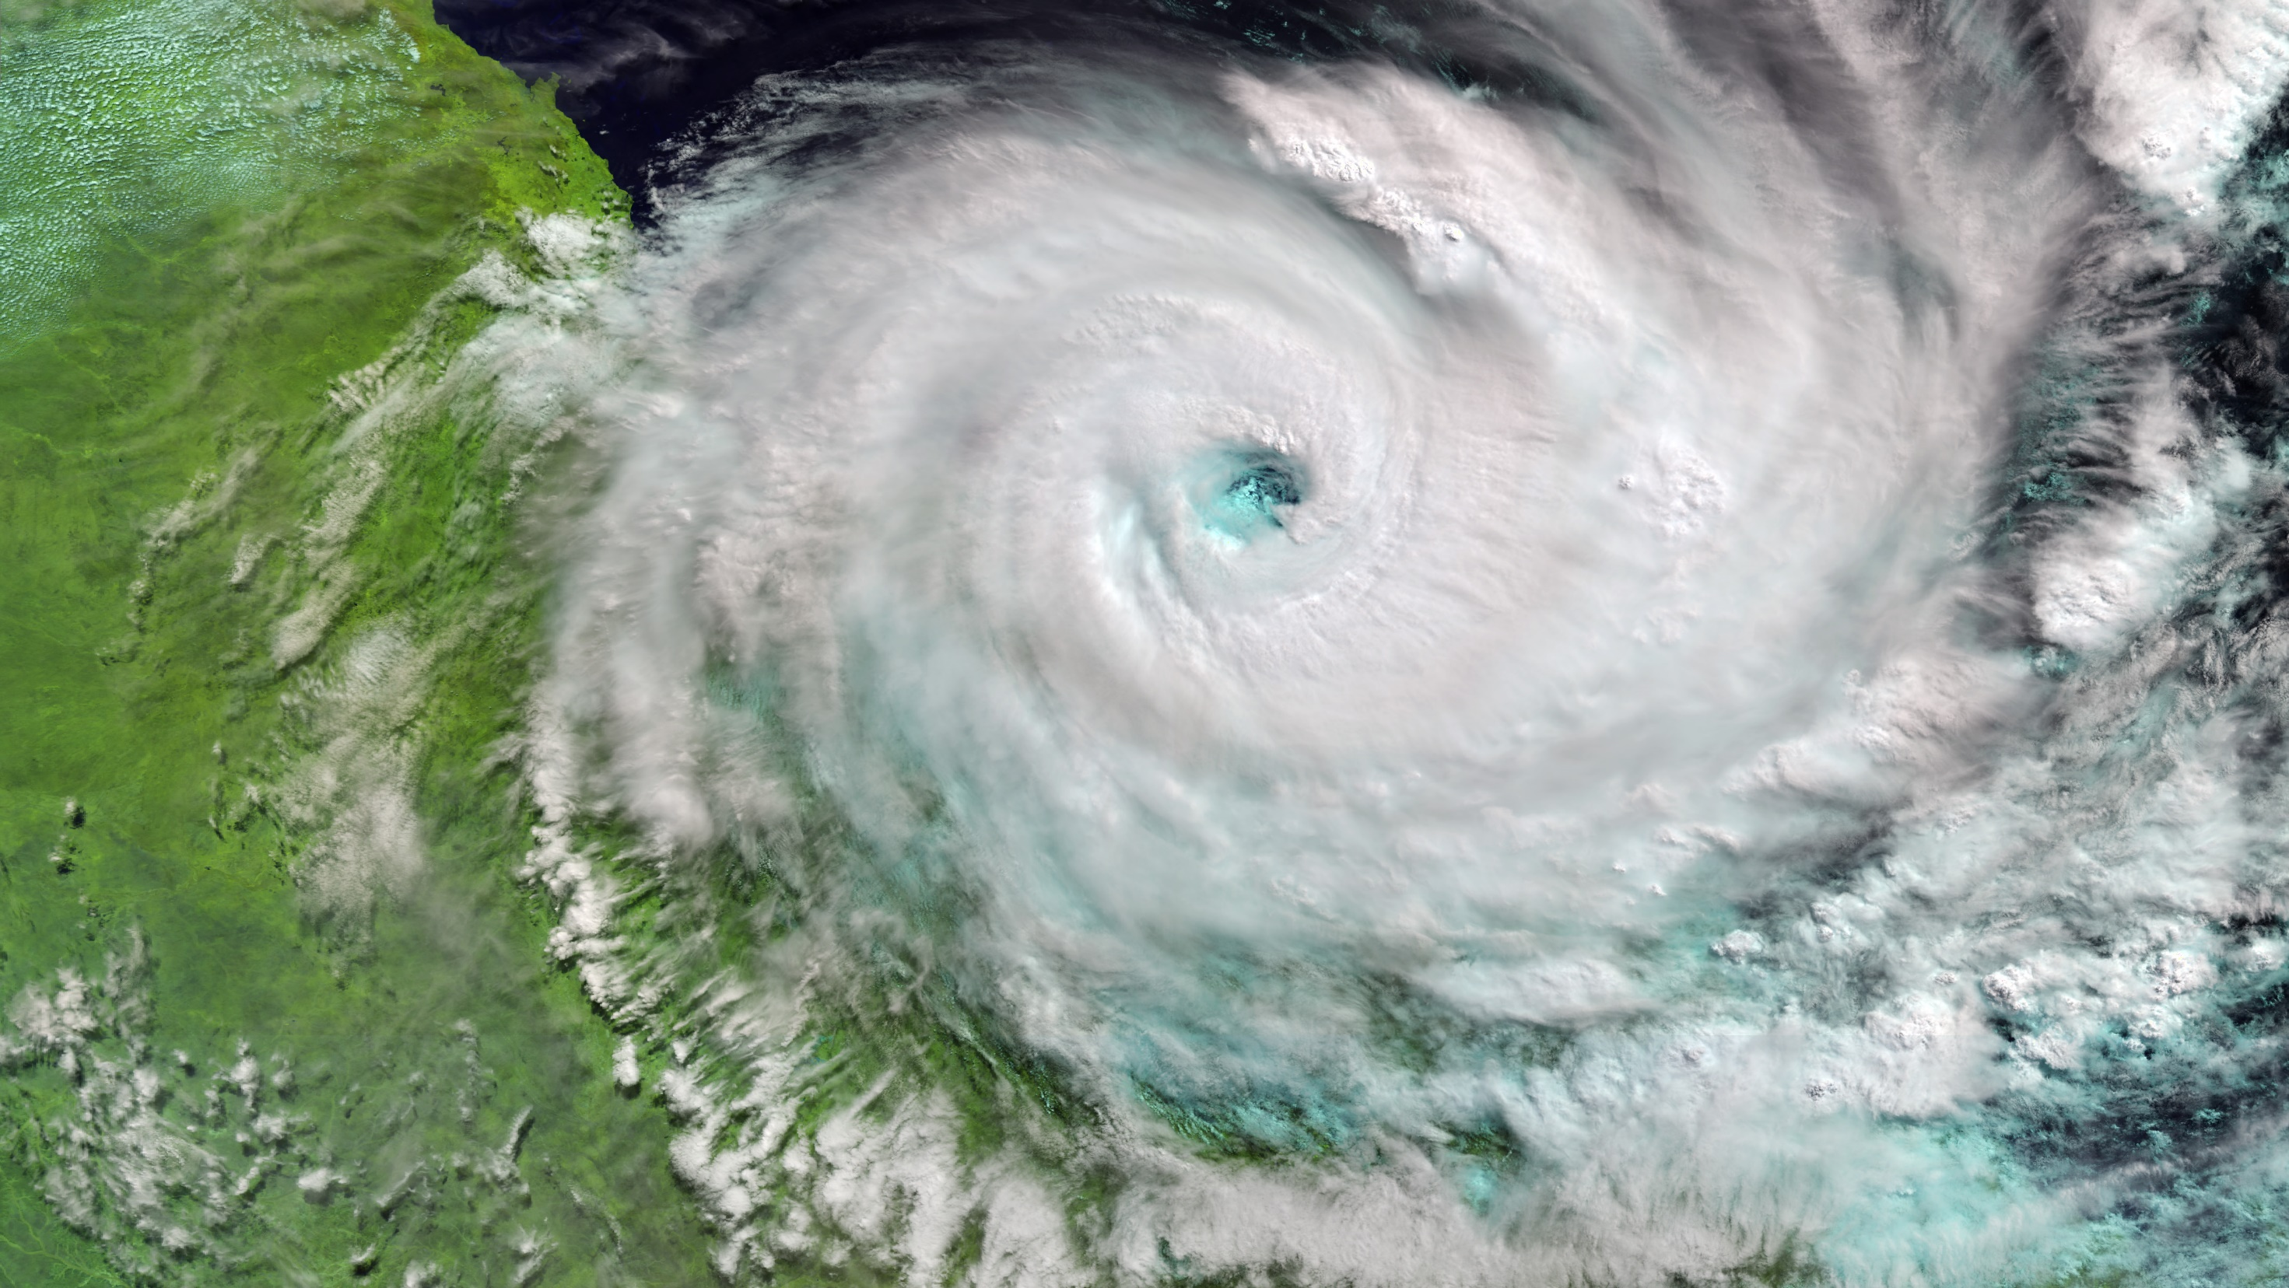
contains modified Copernicus Sentinel data (2017), processed by ESA
Notes:
What about weather systems? Were you able to watch those develop?
Image: Cyclone Debbie from the OCLI instrument on Copernicus Sentinel 3 (some artificial colours)
Photo link: https://www.esa.int/ESA_Multimedia/Images/2017/03/Cyclone_Debbie

Slide 19
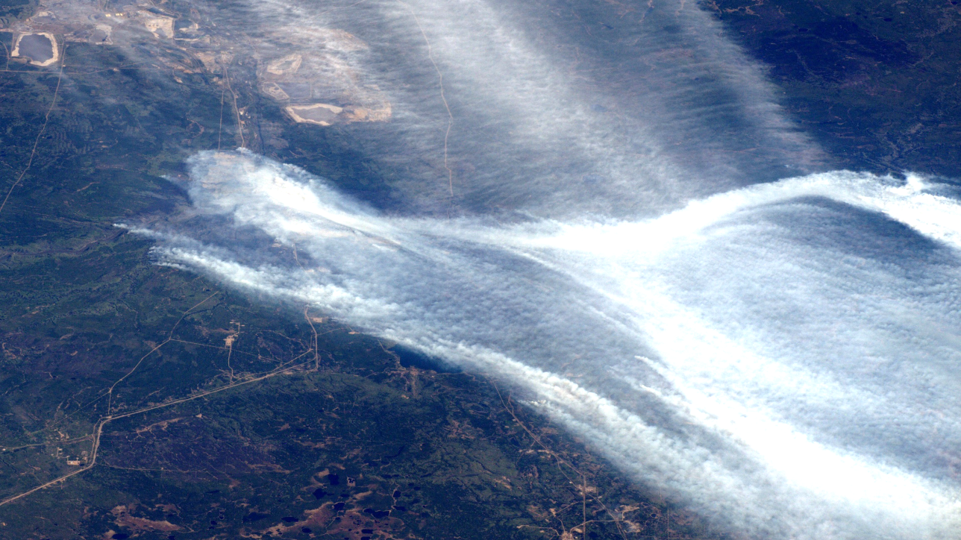
ESA/NASA/Tim Peake
Notes:
EO is used for disaster prevention and response: flood management or monitoring fires for example. You shared pictures of floods in the North of England and a huge fire in Canada, as well as Etna having a cheeky smoke – pretty cool comment that one!
How does it feel watching something like that unfold from space rather than reading about it or seeing it on the news?
Image: Wildfire, Fort McMurray, Canada
Photo link: https://www.flickr.com/photos/timpeake/26804235402

Slide 20
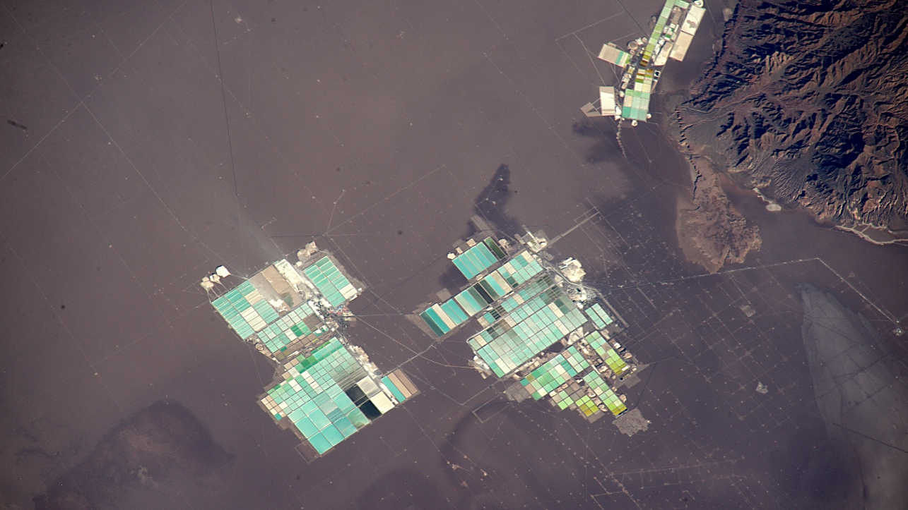
ESA/NASA/Tim Peake
Notes:
Which of the photos you took do you think is the most revealing/useful/important? Why?
Image: Brine ponds for producing lithium, Atacama Desert
Photo link: https://www.flickr.com/photos/timpeake/25129234634

Slide 21
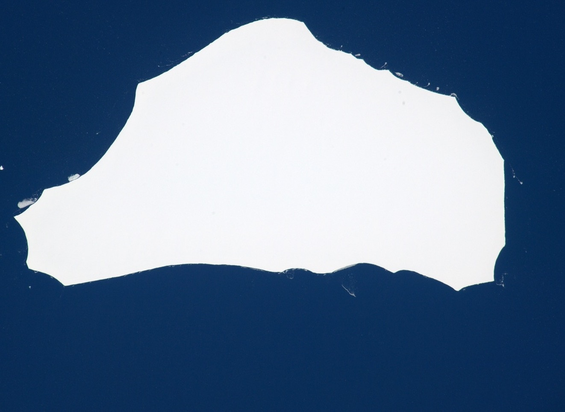
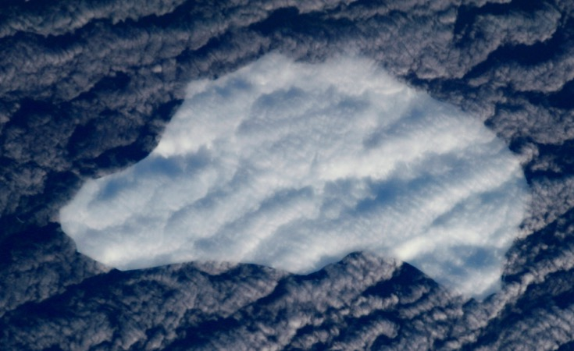
ESA/NASA/Tim Peake
Notes:
Tell us about the iceberg.
Were you expecting to see it again?
Were you certain it was the same one straight away, or did you have to go back and look at the old pic?
Image: Two views of iceberg A56 (Bonus: you can see the path it took in this animation https://www.youtube.com/watch?v=6yeZmeULesA)
Photo links: https://www.flickr.com/photos/timpeake/26935119663 and https://www.flickr.com/photos/timpeake/26017552382

Slide 22
ESA/NASA/Tim Peake
Notes:
Thomas jokes about his #pyramidfail.
Is there anywhere you hoped to see/snap that you didn’t catch?
Image: The Great Pyramids of Giza
Photo link: https://www.flickr.com/photos/timpeake/25920283704

Slide 23
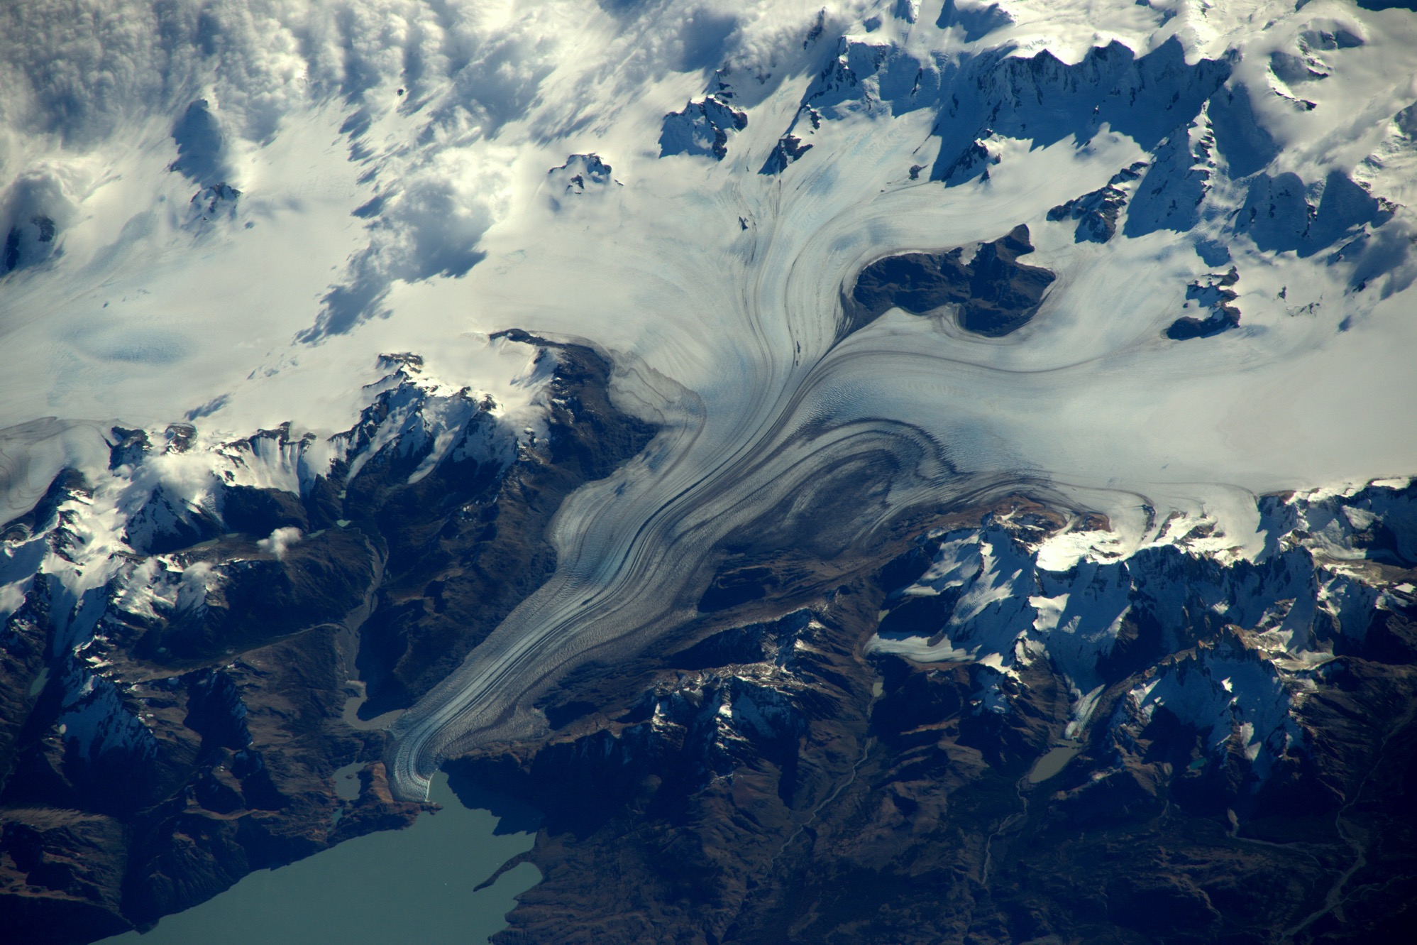
ESA/NASA/Tim Peake
Notes:
You’ve said Patagonia is a place you enjoyed photographing – why?
Image: A Patagonian glacier
Photo link: https://www.flickr.com/photos/timpeake/25445400054/

Slide 24
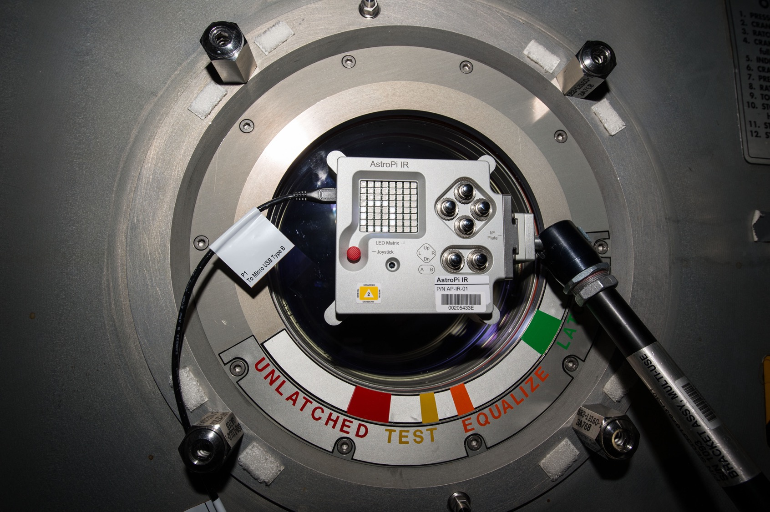
ESA/NASA/Tim Peake
Notes:
What about Eddie and Izzy, the Astro Pis – did you get to see any of their photographs?
Image: An Astro Pi looking out of one of the EO windows
Photo link: https://www.flickr.com/photos/timpeake/24812578293

Slide 25
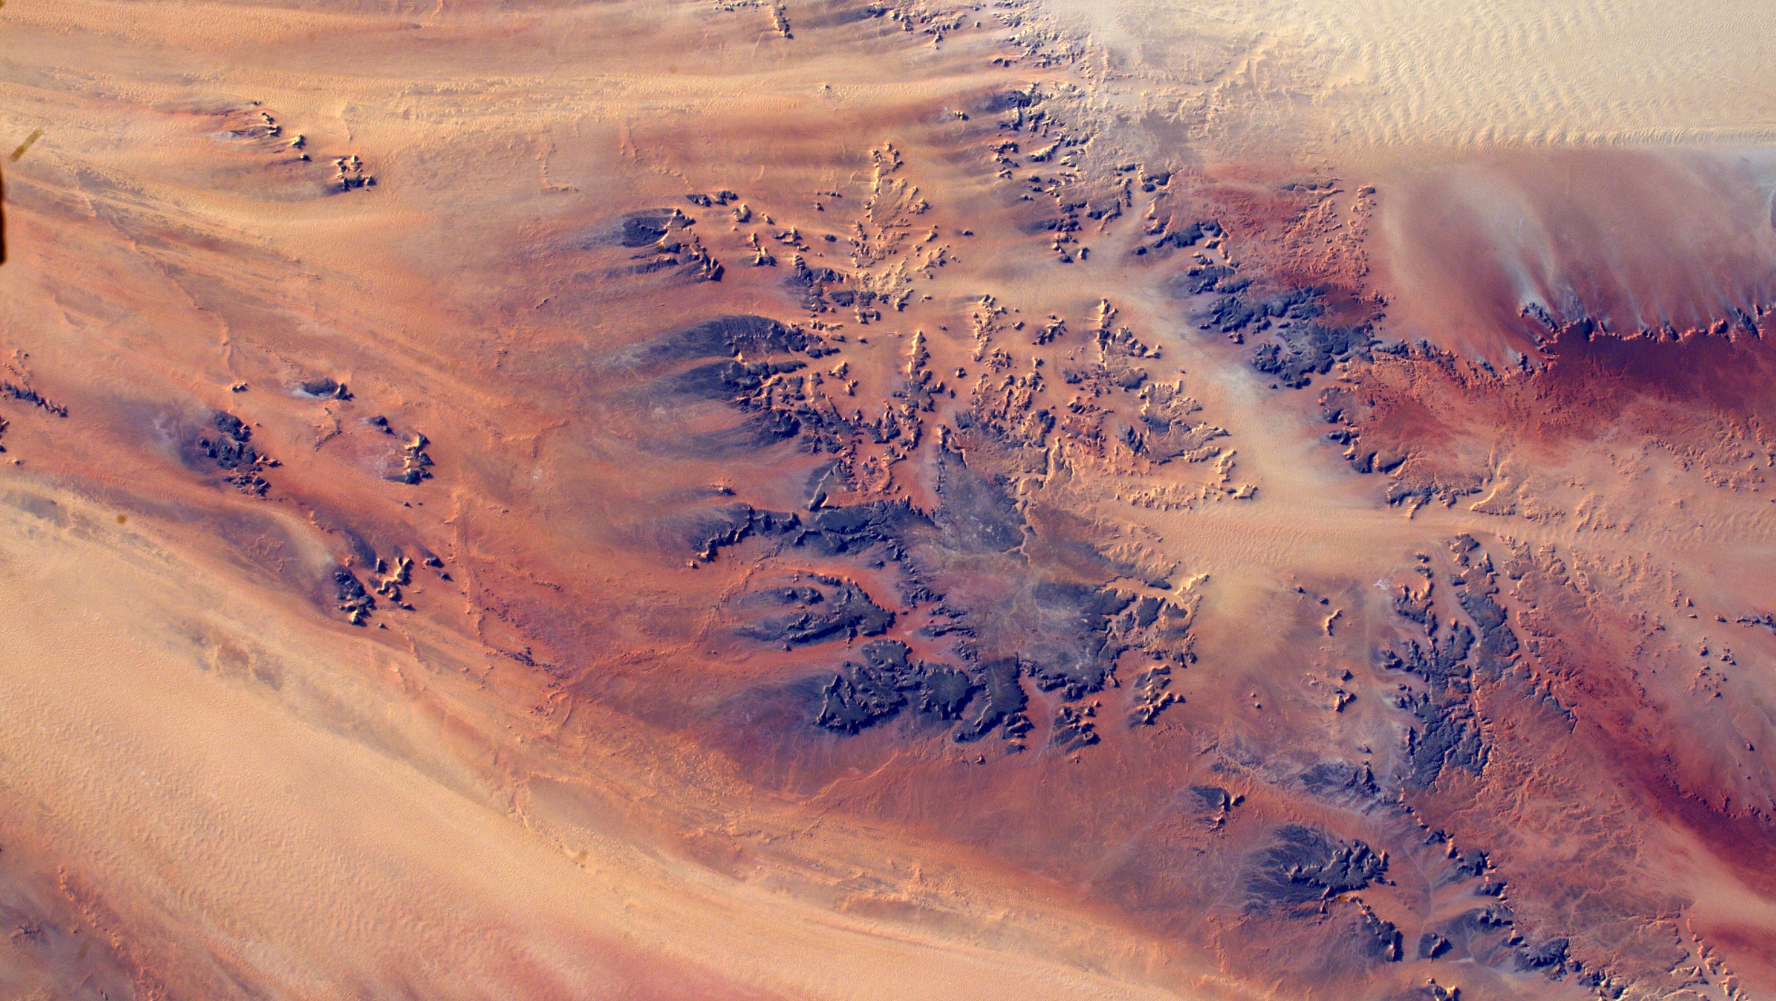
ESA/NASA/Tim Peake
Notes:
And has your geography improved?
Image: Desert near Ennedi, Chad
Photo link: https://www.flickr.com/photos/timpeake/24994663143

Slide 26
Thank you to:
NCEO/University of Leicester Rosie Leigh, Sophie Hebden
John Remedios, Jane Hull
NCEO/King's College London Martin Wooster
UK Space Agency Susan Buckle, Jeremy Curtis
Libby Jackson
ESA Lorraine Conroy, Margherita Buoso
and, of course, Tim Peake
University of Leicester Colette Godfrey
King's College London Fenner Holman, Ben Gridley
Francis O'Shea
ESA/NASA/Tim Peake

