Slide 1
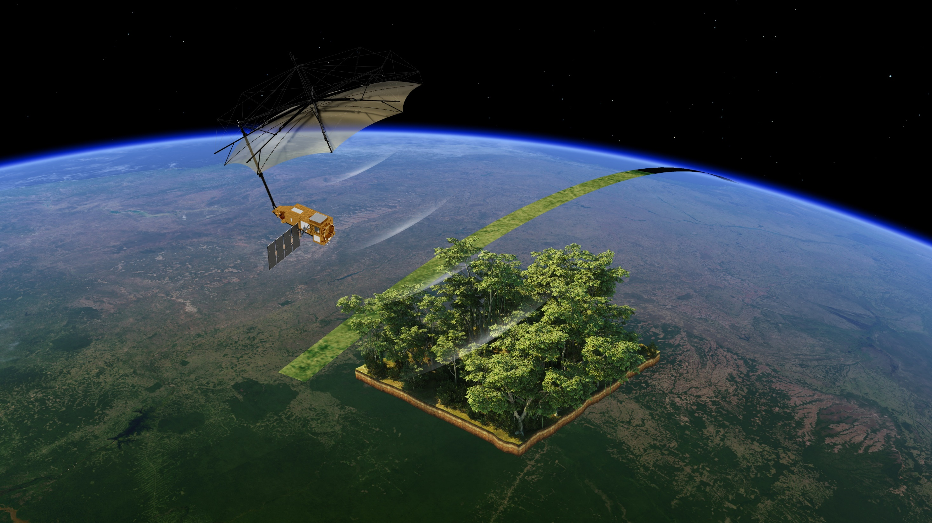


Measuring trees
How much wood is in a forest?
ESA/ATG medialab

Slide 2


Describe the role of trees in the carbon cycle.
Measure the approximate volume of a tree.
Evaluate the method(s) you used to do this.
Describe how active sensors are used to measure trees.
List some advantages and disadvantages of various methods of assessing forest biomass.
Notes:
Lesson outcomes slide.
Title is blank so you can add the wording used in your school if you wish to share these at the start or/and end of the lesson.
Some of these are optional, and you may wish to add appropriate maths-focused ones, particularly if you are focussing on a single method.

Slide 3


carbon sink
biomass
volume
circumference
area
passive sensor
active sensor
satellite
proportionality
Pythagoras’ theorem
clinometer
scale
tangent
reflection
lidar
radar
Notes:
Key words slide.
Title is blank so you can add the wording used in your school if you wish to share these at the start or/and end of the lesson.

Slide 4
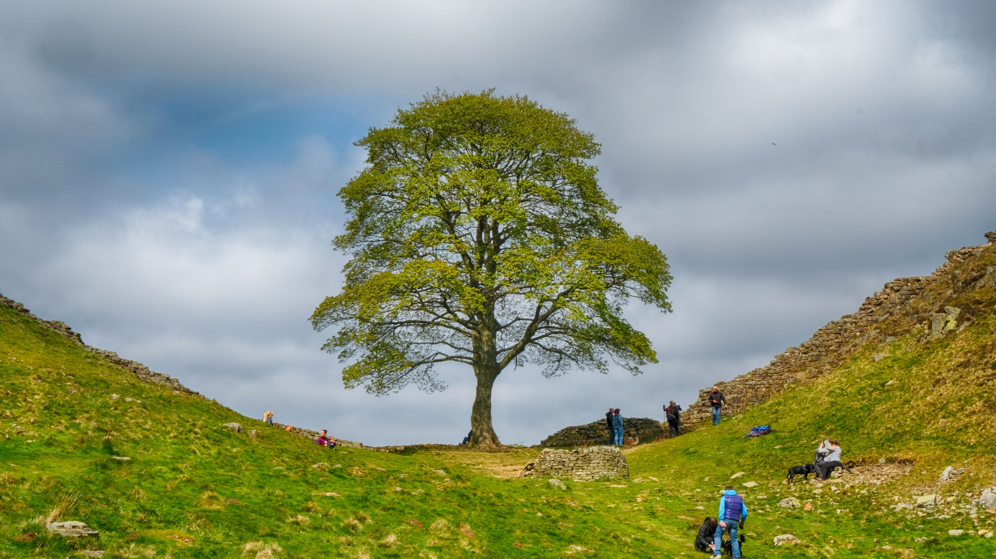
Photosynthesis
CO₂ absorbed Glucose produced
Carbon storage
Glucose converted to starch and other carbon compounds stored in /forms plant tissues
Respiration
Glucose broken down
CO₂ released
Tim Withnall on flickr
Notes:
Text and arrows appear on clicks in following order: photosynthesis text, respiration text, photosynthesis arrow, respiration arrow, carbon storage text and arrow – transition to next slide makes arrow disappear.

Slide 5

Photosynthesis
CO₂ absorbed Glucose produced
Carbon storage
Glucose converted to starch and other carbon compounds stored in /forms plant tissues
Respiration
Glucose broken down
CO₂ released
Tim Withnall on flickr

Slide 6
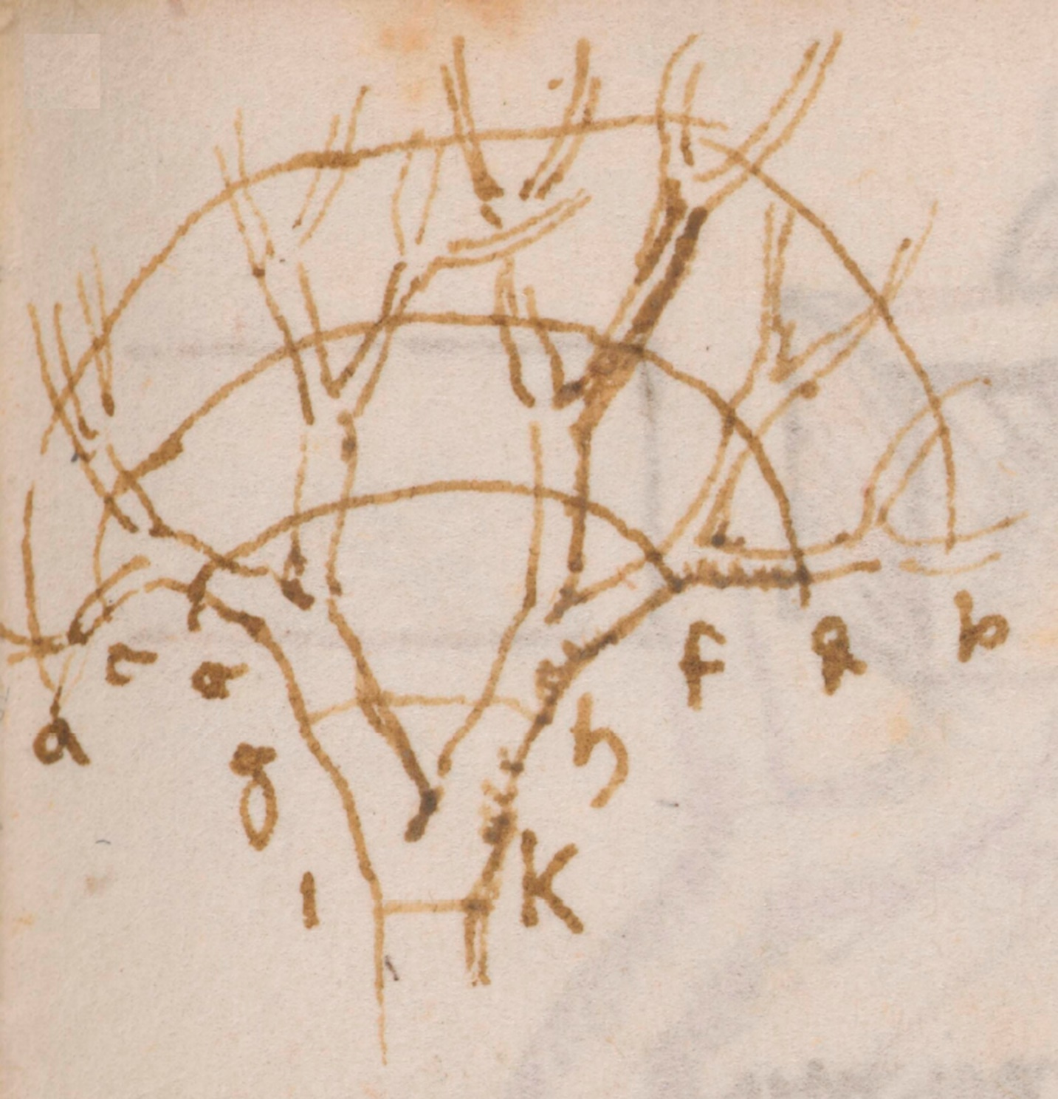
Institut de France Manuscript M, p. 78v as used in Gao and Newberry (2025) Fig 1a
Notes:
da Vinci’s sketch of a tree illustrates the principle that combined thickness is preserved at different stages of ramification

Slide 7
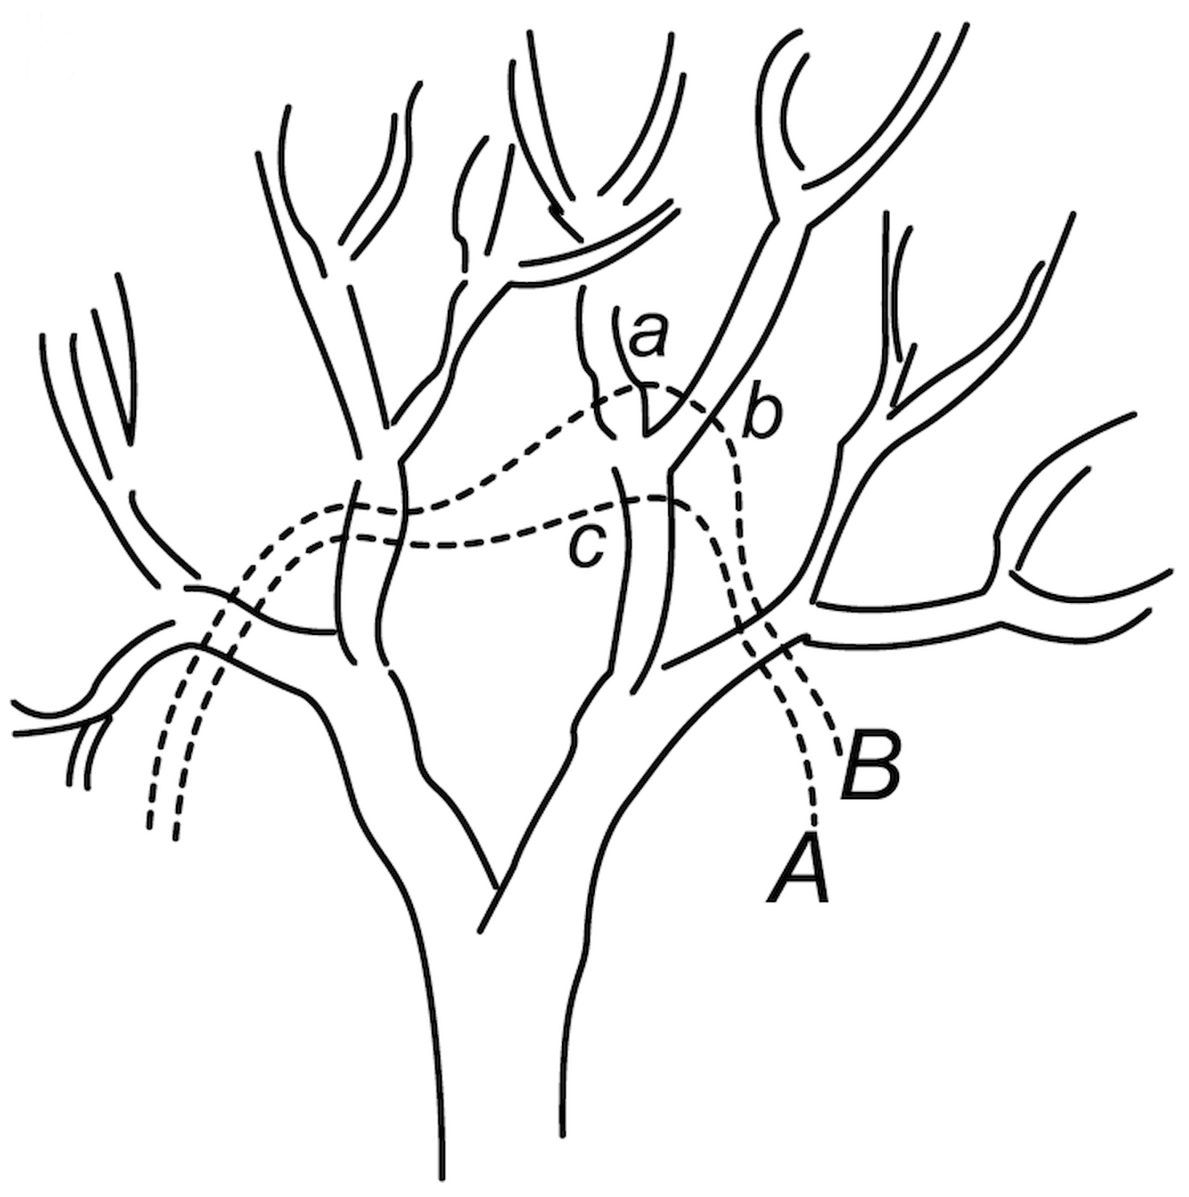
Gao and Newberry (2025) Fig 1b
Notes:
The combined thickness of all branches along line A is the same as the combined thickness of all branches along line B.
So (thickness of limb c) = (thickness of limb a) + (thickness of limb b)
What do we mean by ‘thickness’?

Slide 8
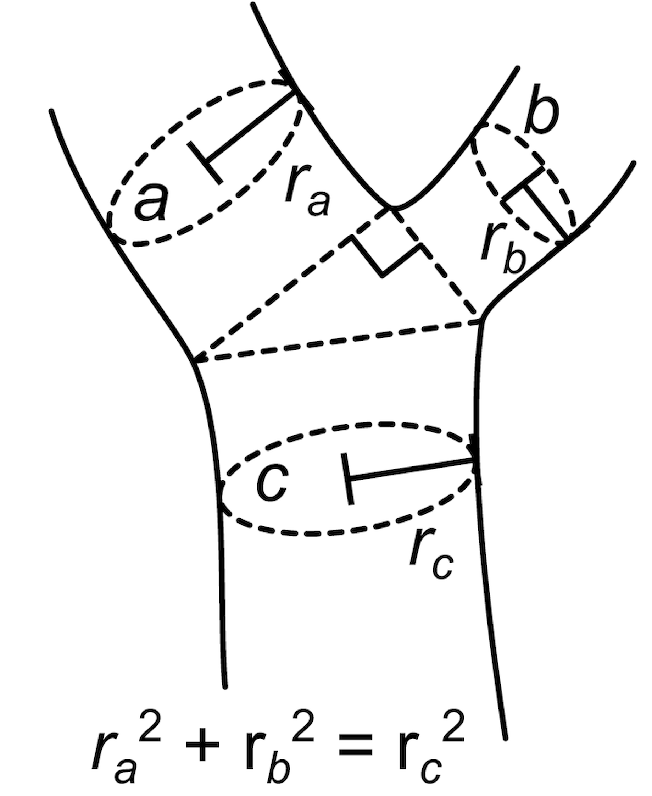
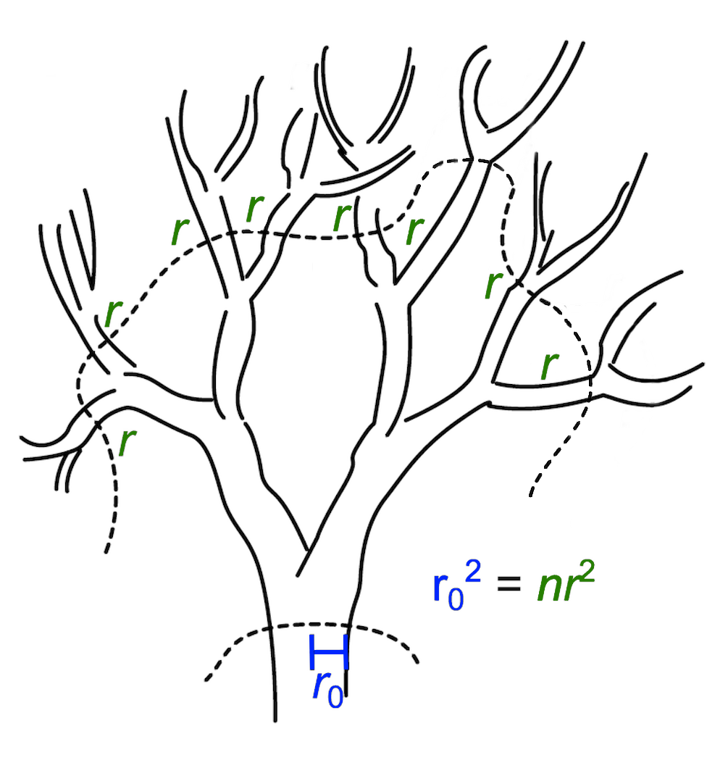
Gao and Newberry (2025) Fig 1c & 1d
Notes:
Generally considered to be cross-sectional area. Here for branches a, b c as on previous slide but can generalise to situation shown in this second image (appears on click)

Slide 9
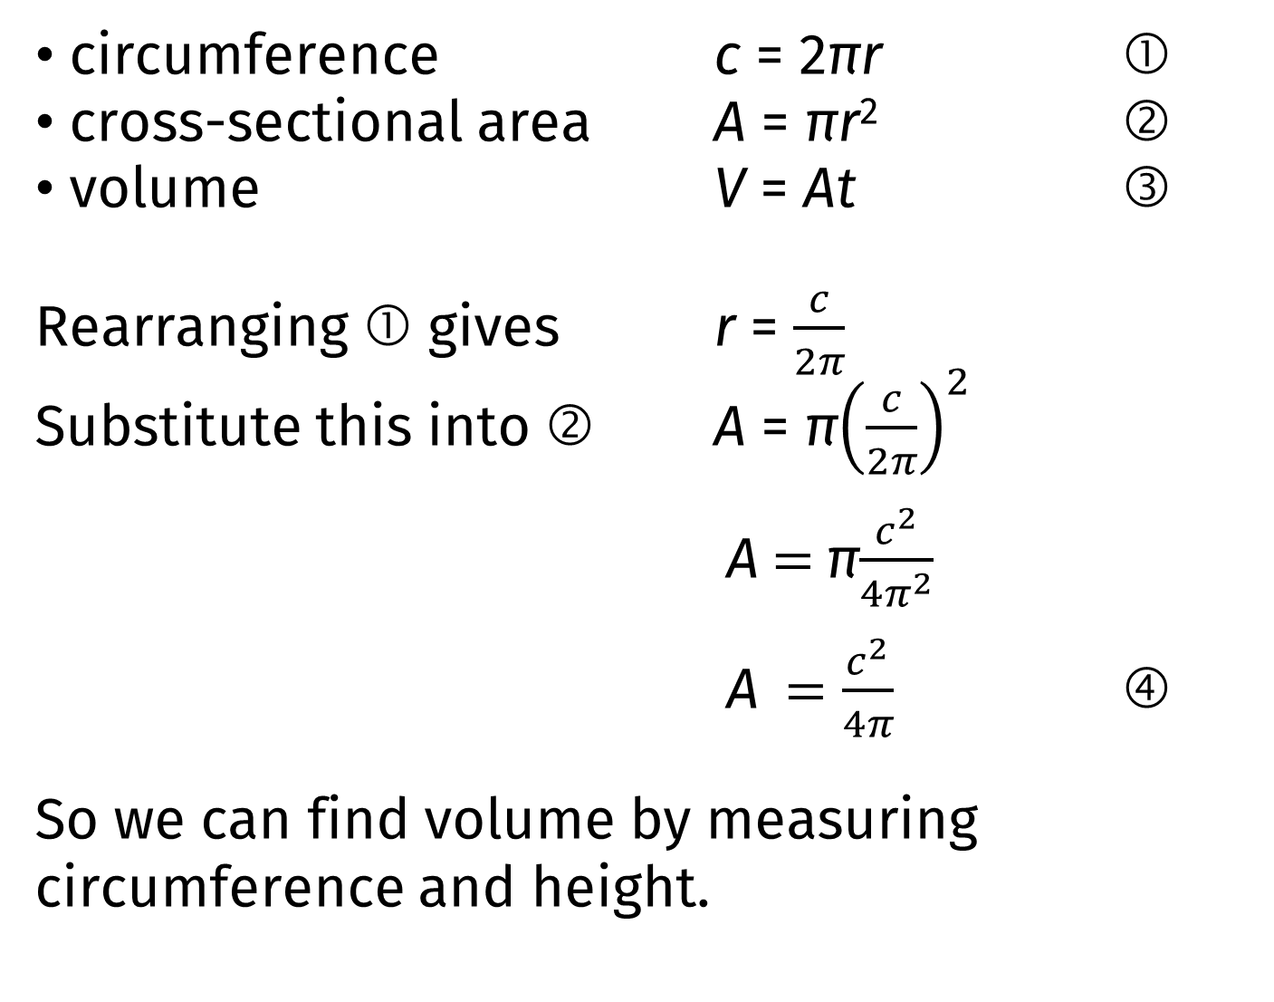
circumference c = 2πr ①
cross-sectional area A = πr² ②
volume V = At ③
Rearranging ① gives r = $\frac{c}{2π}$
Substitute this into ② A = π${\left(\frac{c}{2π}\right)}^{2}$
A $=$π$\frac{c^{2}}{4π^{2}}$
A $=\frac{c^{2}}{4π}$ ④
So we can find volume by measuring circumference and height.
Modelling a tree as a cylinder of radius r height t
Notes:
Each line after the first appears on a click.

Slide 10
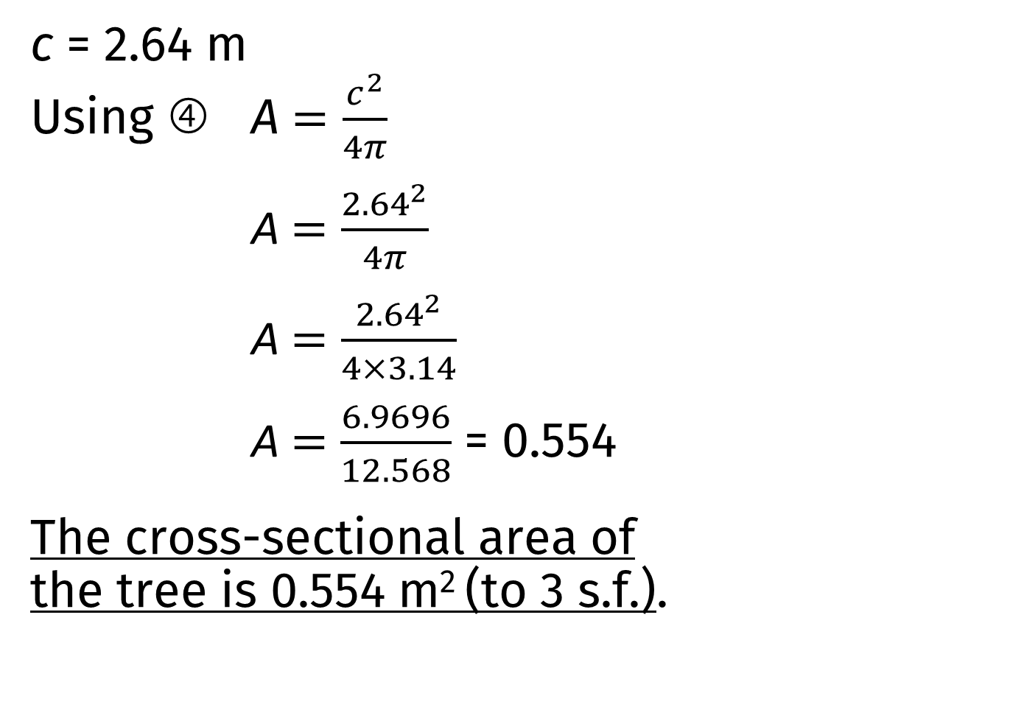
c = 2.64 m
Using ④ A $=\frac{c^{2}}{4π}$
A $=\frac{{2.64}^{2}}{4π}$
A $=\frac{{2.64}^{2}}{4×3.14}$
A$=\frac{6.9696}{12.568}$ = 0.554
The cross-sectional area of the tree is 0.554 m² (to 3 s.f.).
Calculating cross-sectional area from circumference: worked example
Notes:
Each line after the first appears on a click.

Slide 11
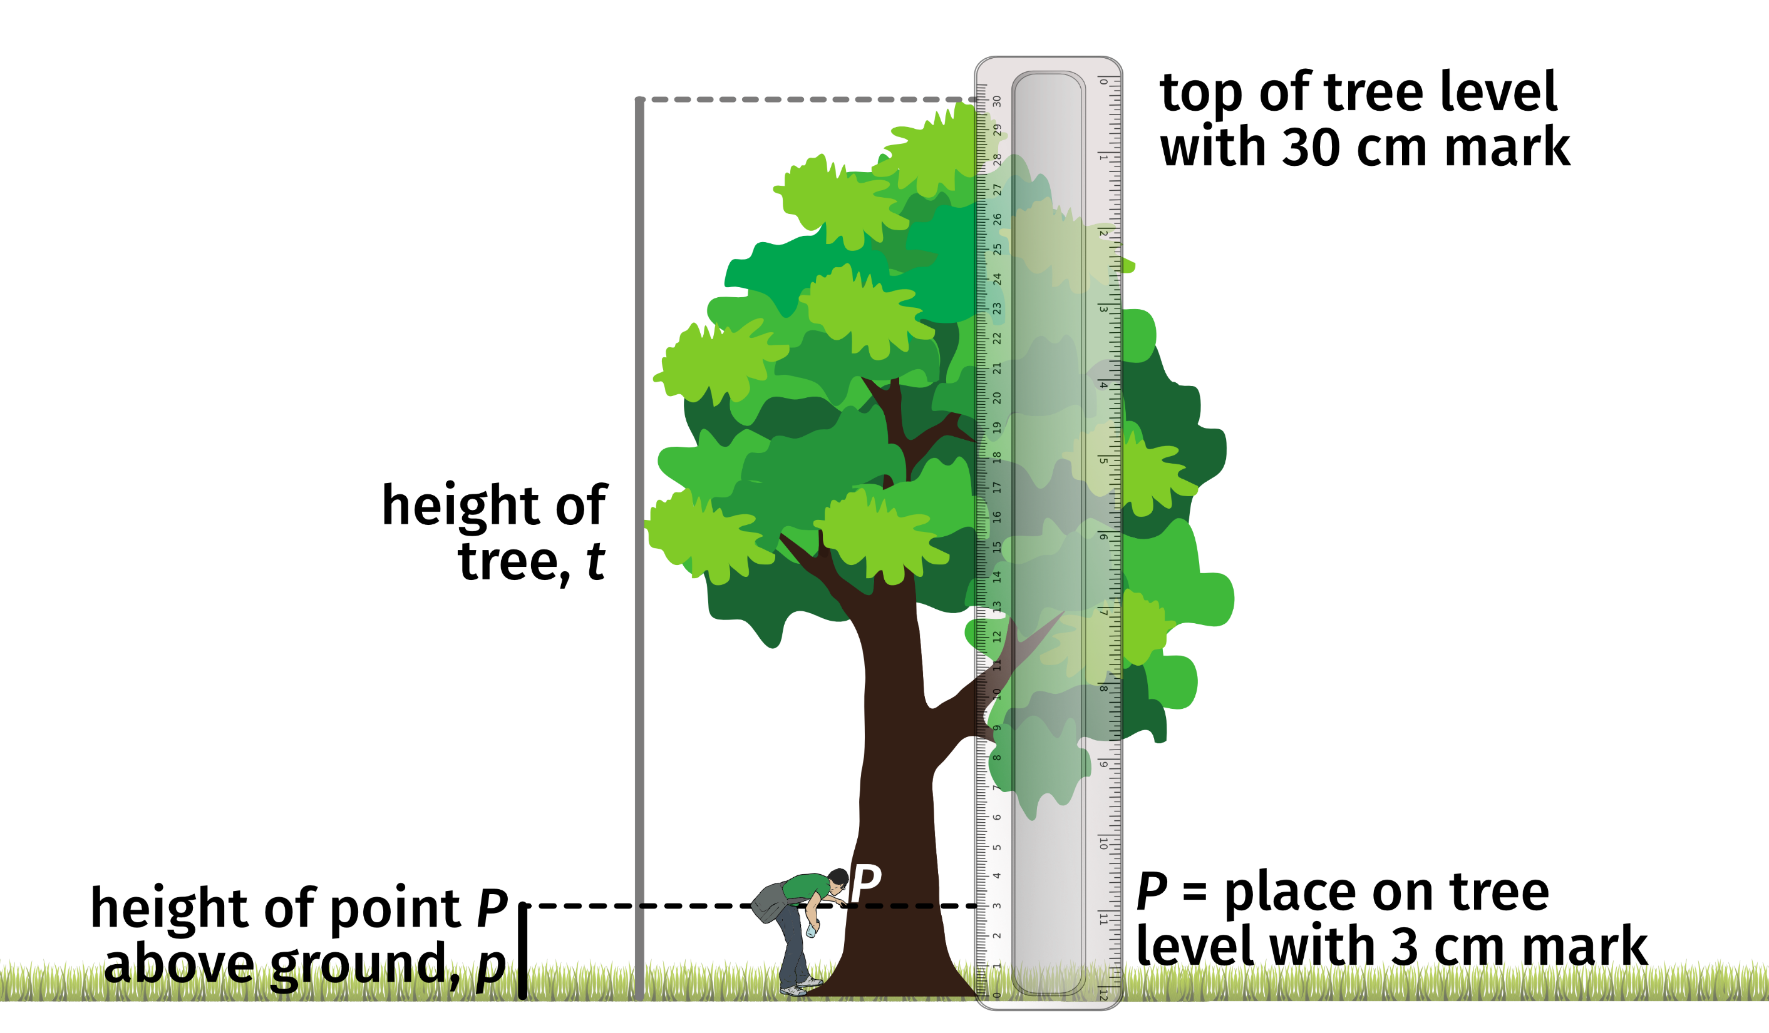
CAF (NCEO) using graphics by Divyansh Kumar, Clker-Free-Vector-Images and Georges Tsukaïmah from Pixabay
Notes:
Method 1
Person 1: Stand by the tree with the metre rule.
Person 2: Stand a few metres away from the tree. Hold the 30 cm ruler at right angles to the ground. Move the ruler until the bottom of the tree seems to be at the 0 cm mark and the top of the tree at the 30 cm mark. You might need to move to a different distance from the tree.

Slide 12
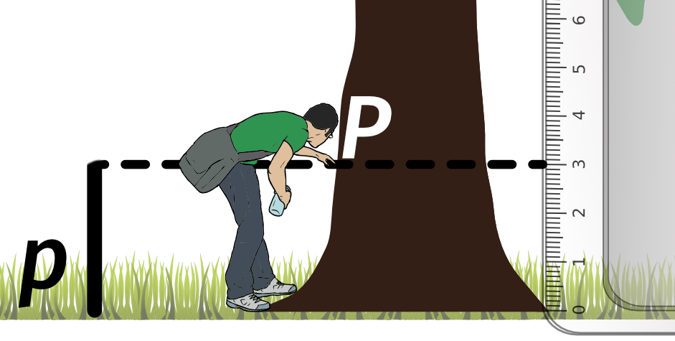
CAF (NCEO) using graphics by Divyansh Kumar, Clker-Free-Vector-Images and Georges Tsukaïmah from Pixabay
Notes:
Method 1
Person 1: Point to somewhere on the trunk of the tree.
Person 2: Tell Person 1 to move their hand up or down slowly. Ask them to stop when their hand is level with the 3 cm mark* on the ruler.
Person 1: Use the metre rule to measure the distance between this point and the ground.
*You could use another point – 2 cm or 5 cm, say. If you do, look carefully at how to calculate the height: you will need to change the figures in red.

Slide 13
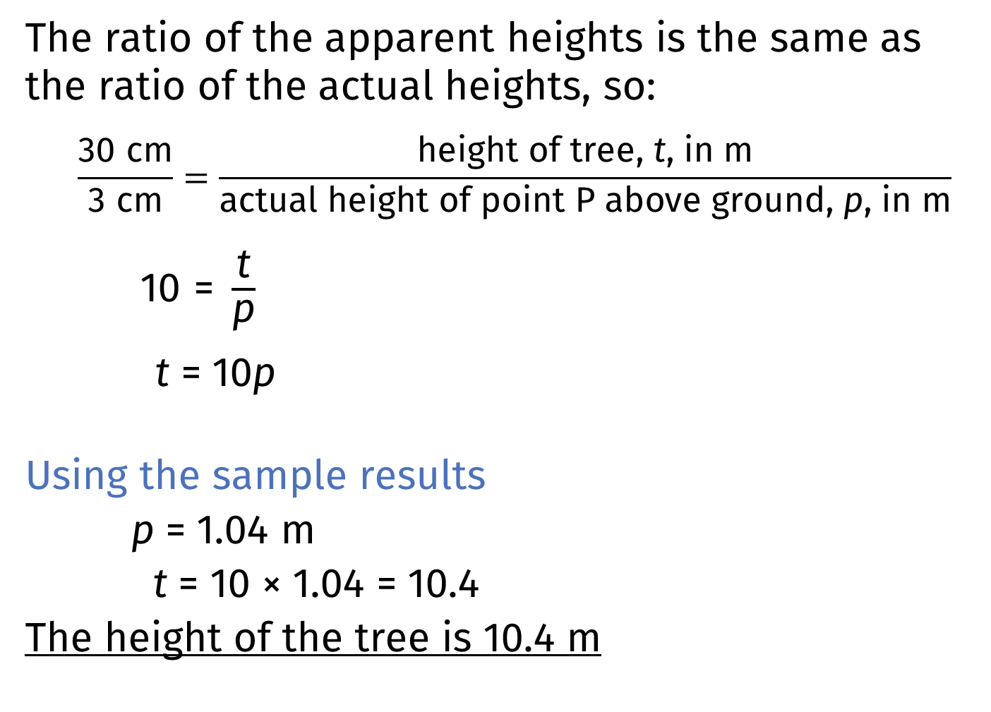
The ratio of the apparent heights is the same as the ratio of the actual heights, so:
$$\frac{\text{30 }\text{cm}}{\text{3 }\text{cm}}=\frac{\text{height} \text{of} \text{tree}\text{, }\text{t}\text{, }\text{in} \text{m}}{\text{actual} \text{height} \text{of} \text{point} \text{P} \text{above} \text{ground}\text{, }\text{p}\text{, }\text{in} \text{m}}$$
$\text{10 = }\frac{\text{t}}{\text{p}}$
t = 10p
Using the sample results
p = 1.04 m
t = 10 × 1.04 = 10.4
The height of the tree is 10.4 m
Calculating height using proportionality
Notes:
Method 1 sample results
Each line after the first appears on a click.

Slide 14
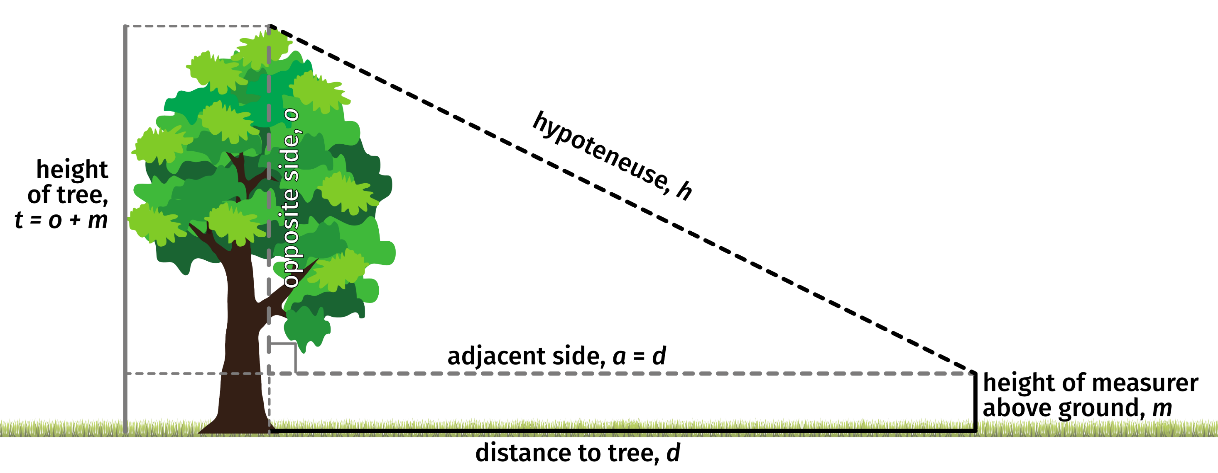
CAF (NCEO) using graphics by Divyansh Kumarand and Georges Tsukaïmah from Pixabay
Notes:
Method 2
1. Stand several metres from the tree. Measure the distance to the tree, d.
2. Hold the laser measure at a comfortable height. Measure the distance between this position and the ground, m. (You might want to use a metre rule instead of the tape for this.)
3. Use the laser measure to find the distance to the top of the tree. You will probably need a bit of practice to get consistent readings. Record this as distance h.

Slide 15
Most of the tree makes one side of a right-angled triangle with side lengths h (hypotenuse), o and a.
From Pythagoras’ theorem h² = o² + a²
But a = d, the distance to the tree, so h² = o² + d²
We can rewrite this as o² = h² − d²
so o = h² − d²
but t = m + o
So t = m + h² − d²
Calculating height using Pythagoras’ theorem
Notes:
Method 2 sample results
Each line after the first appears on a click.

Slide 16
Using the sample results
m = 1.23 m h = 10.57 m d = 6.00 m
t = m + h² − d²
t = 1.23 + 10.57² − 6.00²
t = 1.23 + 111.7249 − 36
t = 1.23 + 75.7249
t = 1.23 + 8.70200… = 9.93200…
The height of the tree is 9.93 m (to the nearest cm).
Calculating height using Pythagoras’ theorem
Notes:
Each line after the first appears on a click.

Slide 17
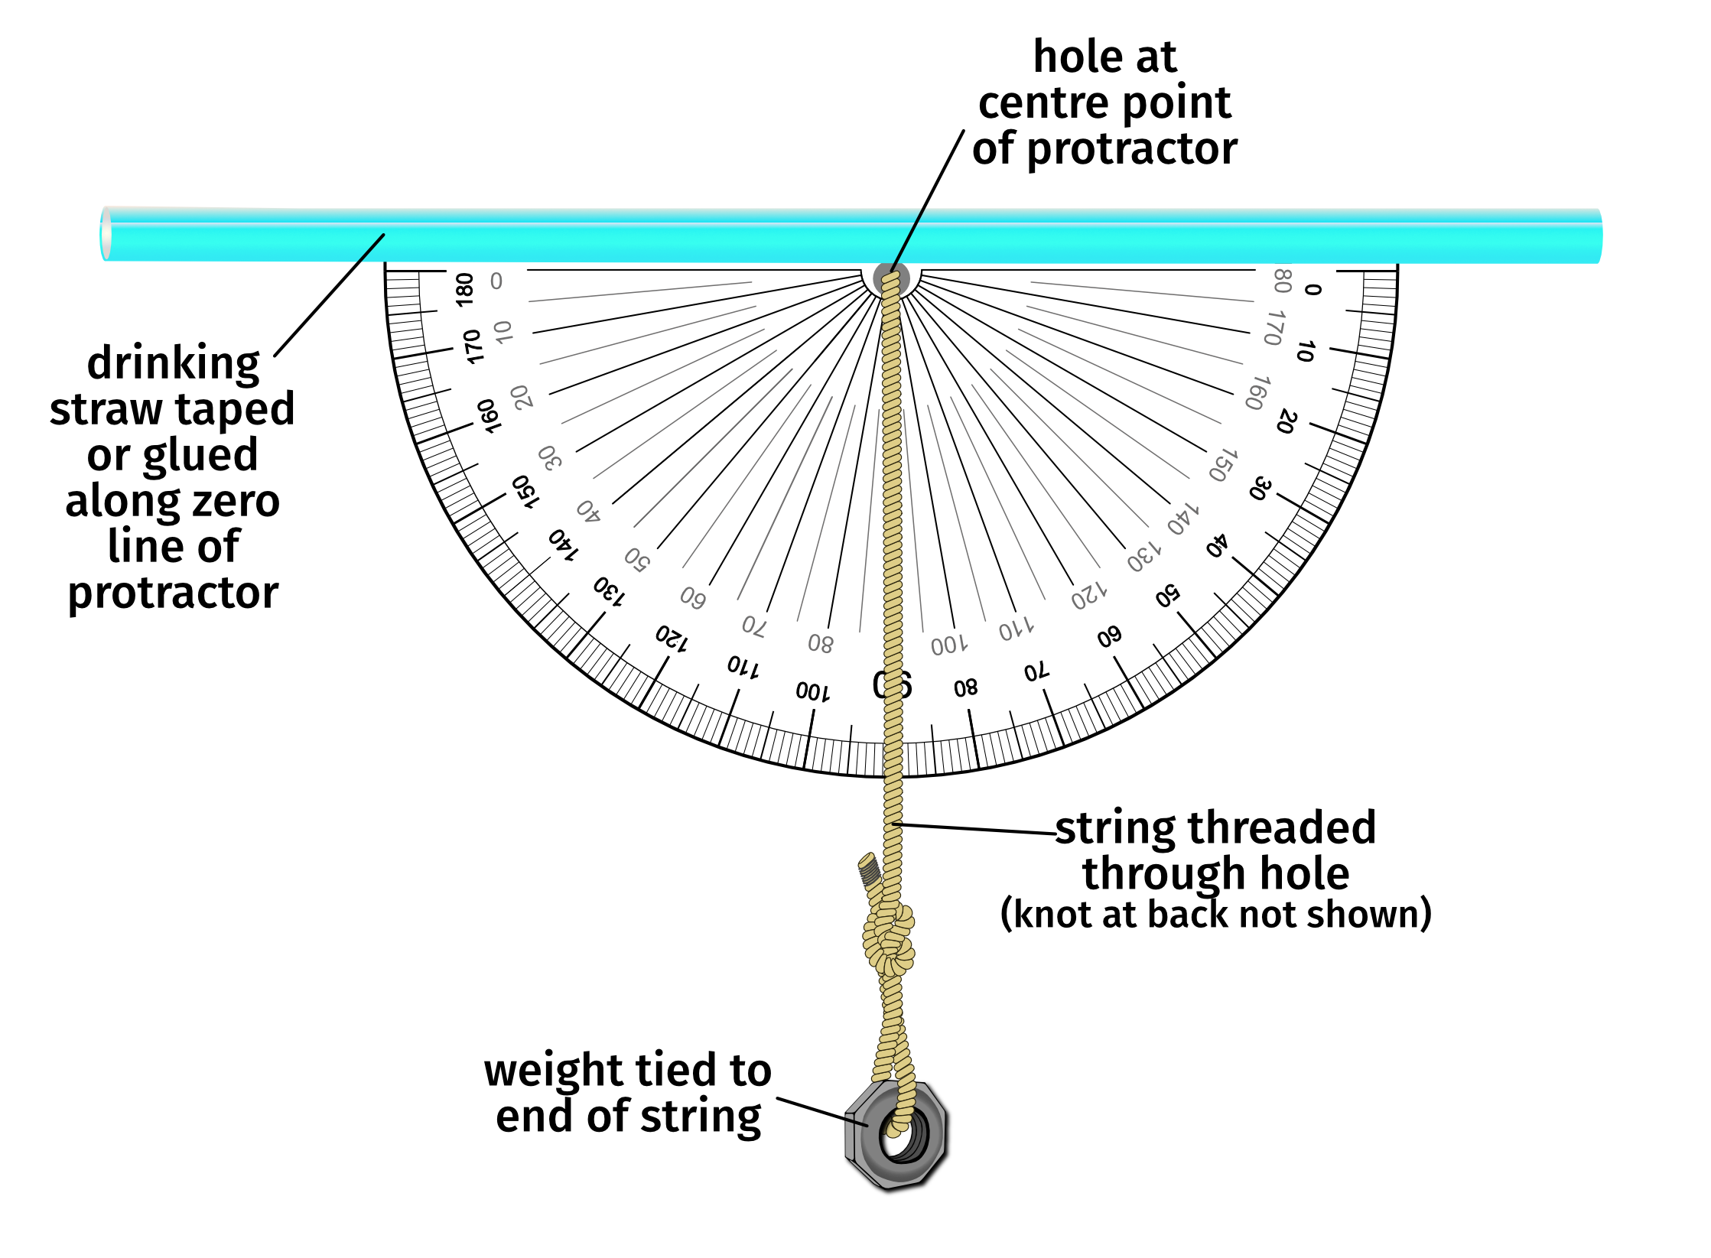
Making a clinometer
CAF (NCEO) using graphics by hannazasimova on Freepik and Nina Garman and OpenClipart-Vectors from Pixabay
Notes:
Method 3
Making a clinometer

Slide 18
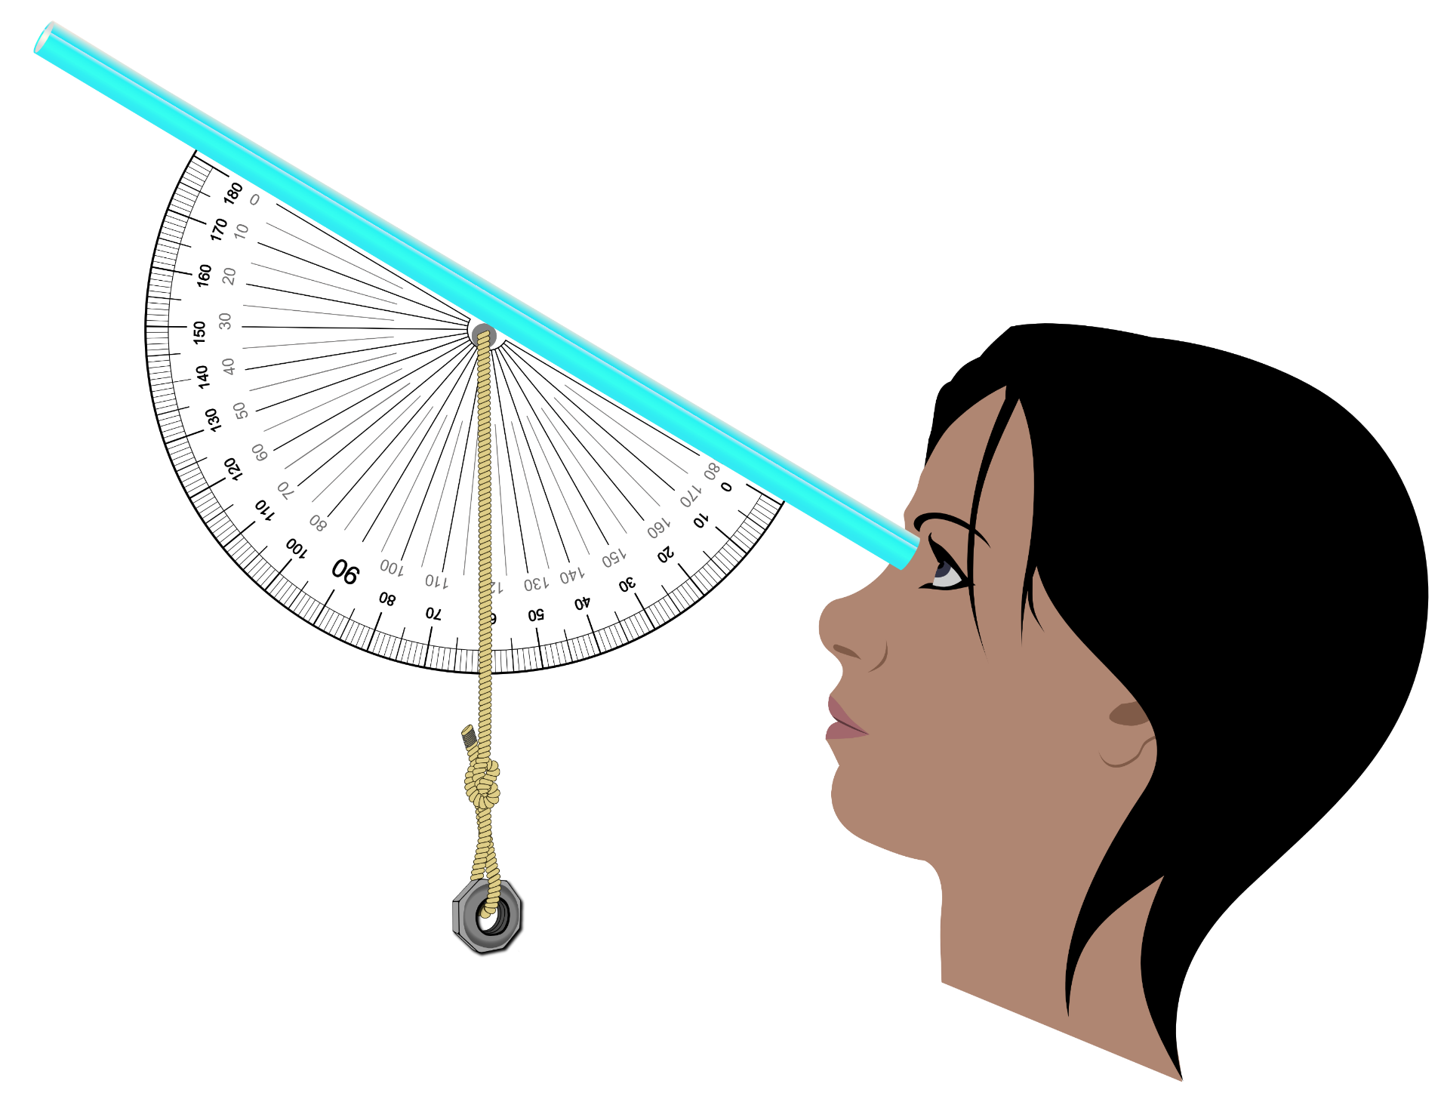
Using a clinometer
CAF (NCEO) using graphics by hannazasimova on Freepik and Nina Garman and OpenClipart-Vectors from Pixabay
Protractor shows angle with vertical.
Remember, we want angle with horizontal.
Notes:
Method 3
Using a clinometer

Slide 19
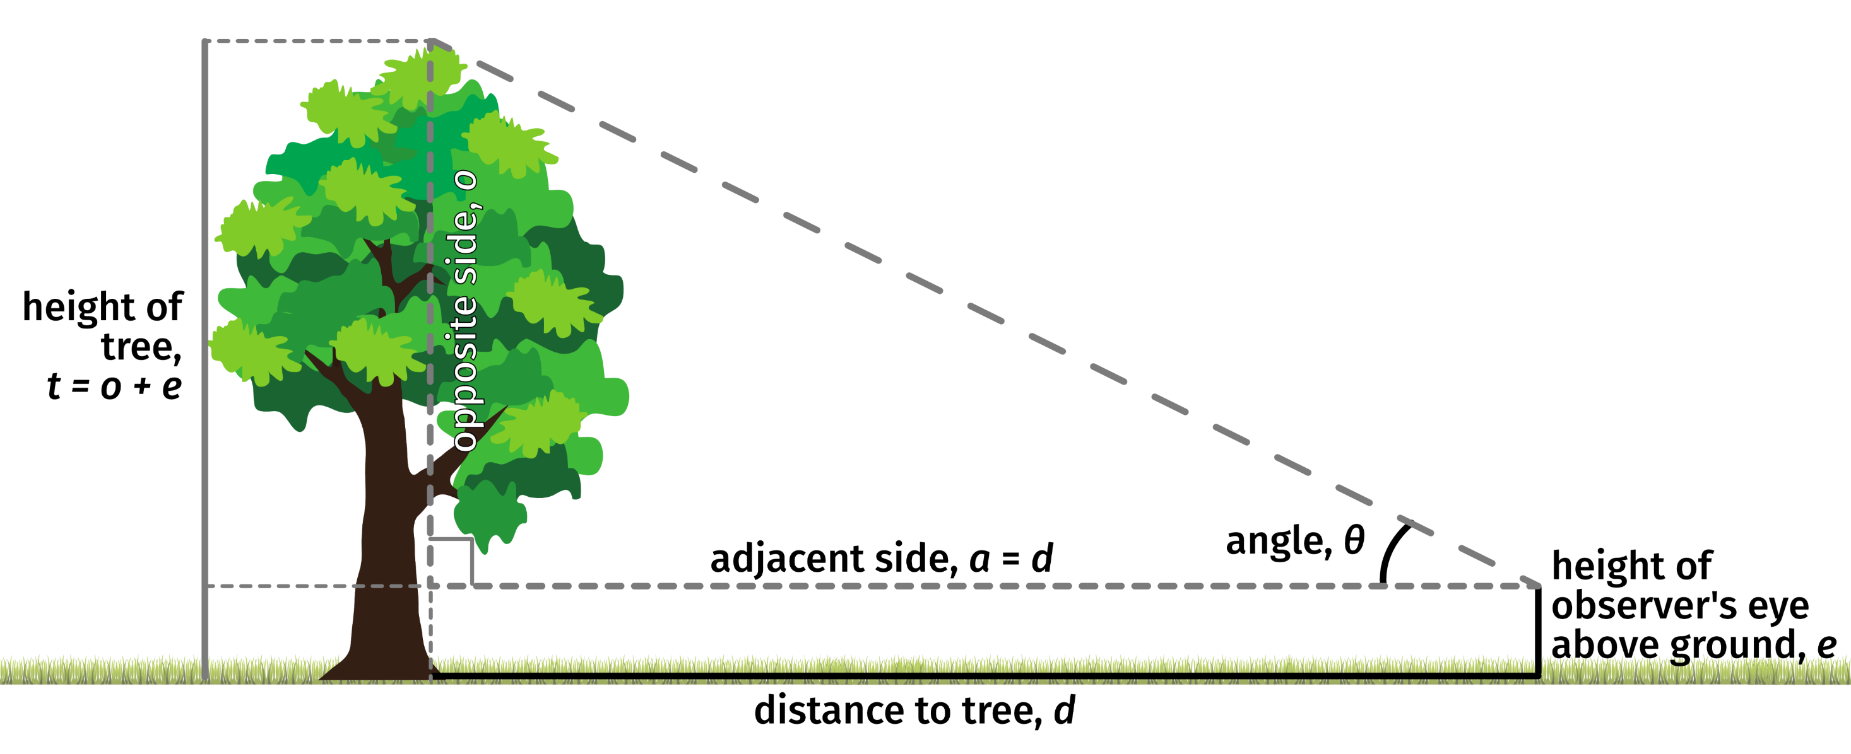
CAF (NCEO) using graphics by Divyansh Kumarand and Georges Tsukaïmah from Pixabay
Notes:
Method 3
Hold the clinometer so the string can move freely.
Look through the straw and tilt the clinometer until you can see the top of the tree.
Read the angle the string shows on the protractor. This is the angle between the straw and the vertical.

Slide 20

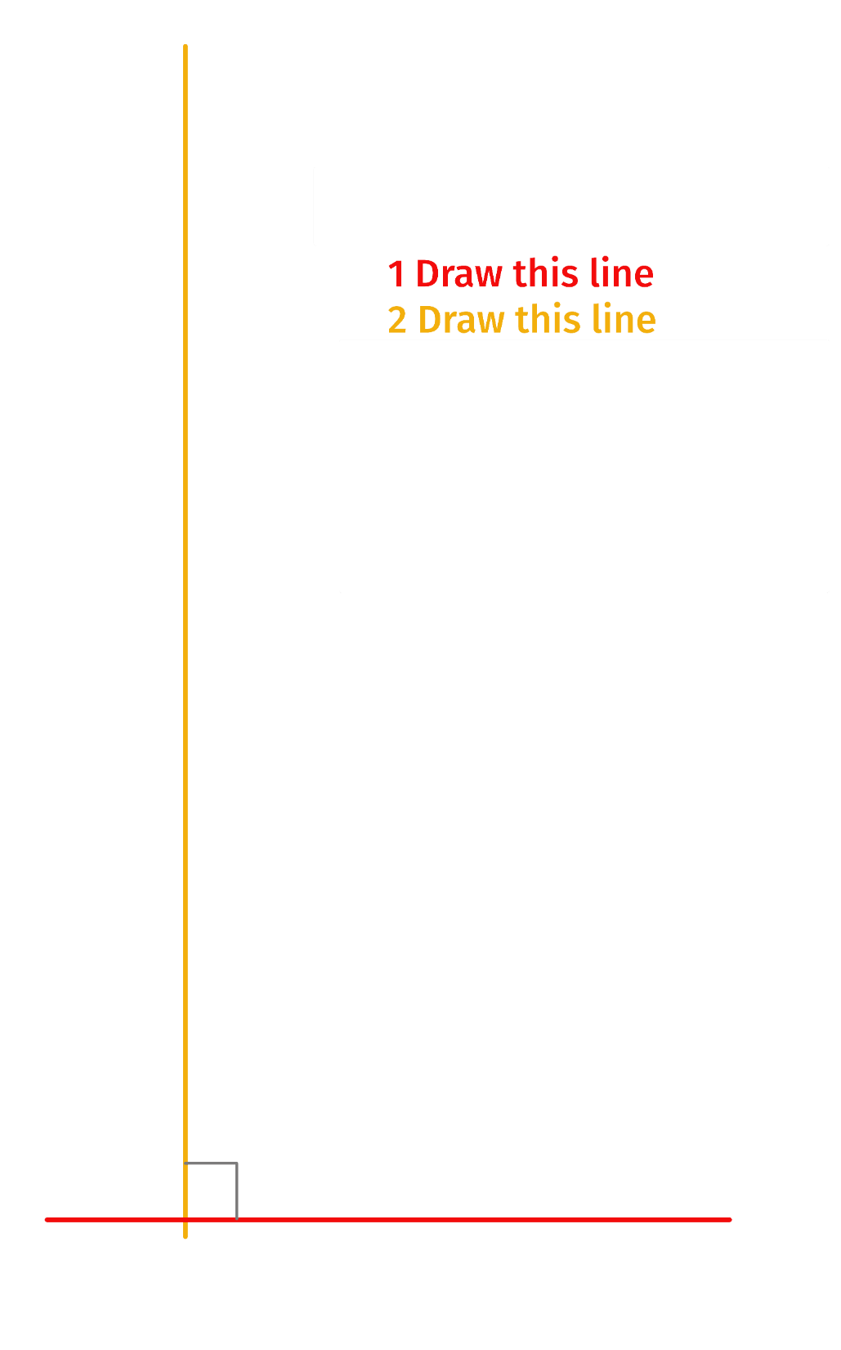
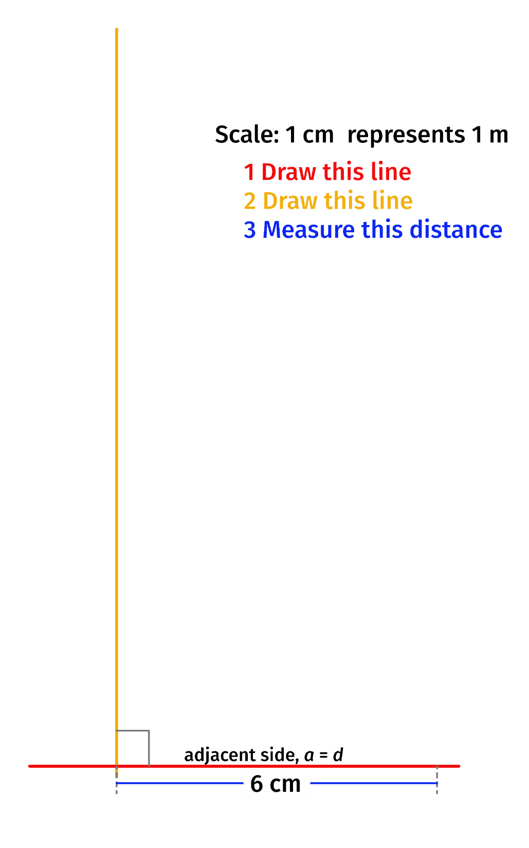
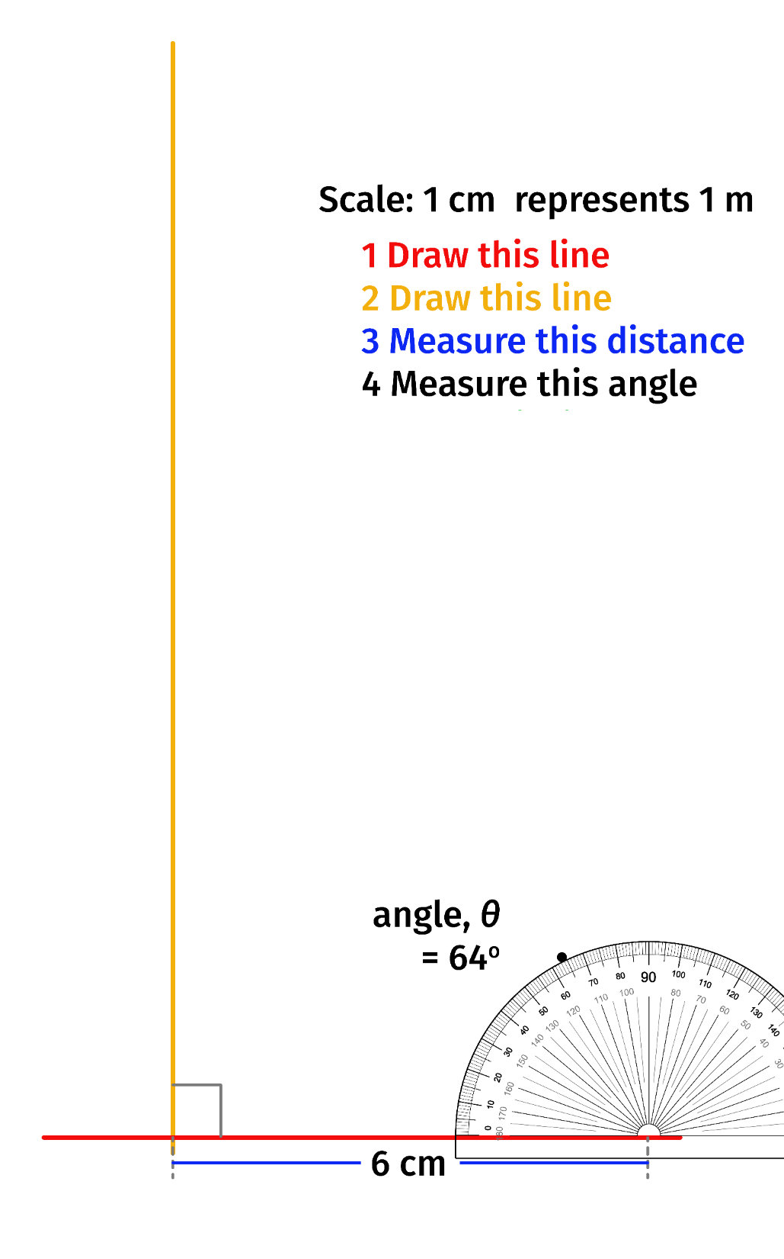
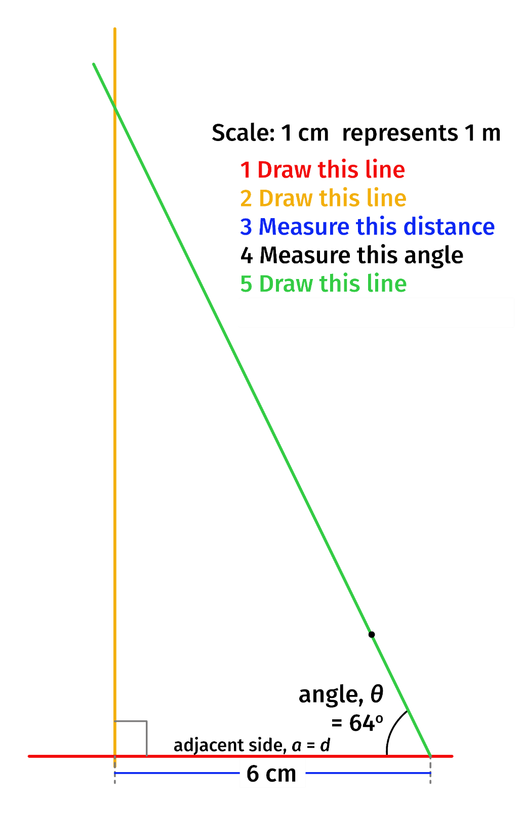
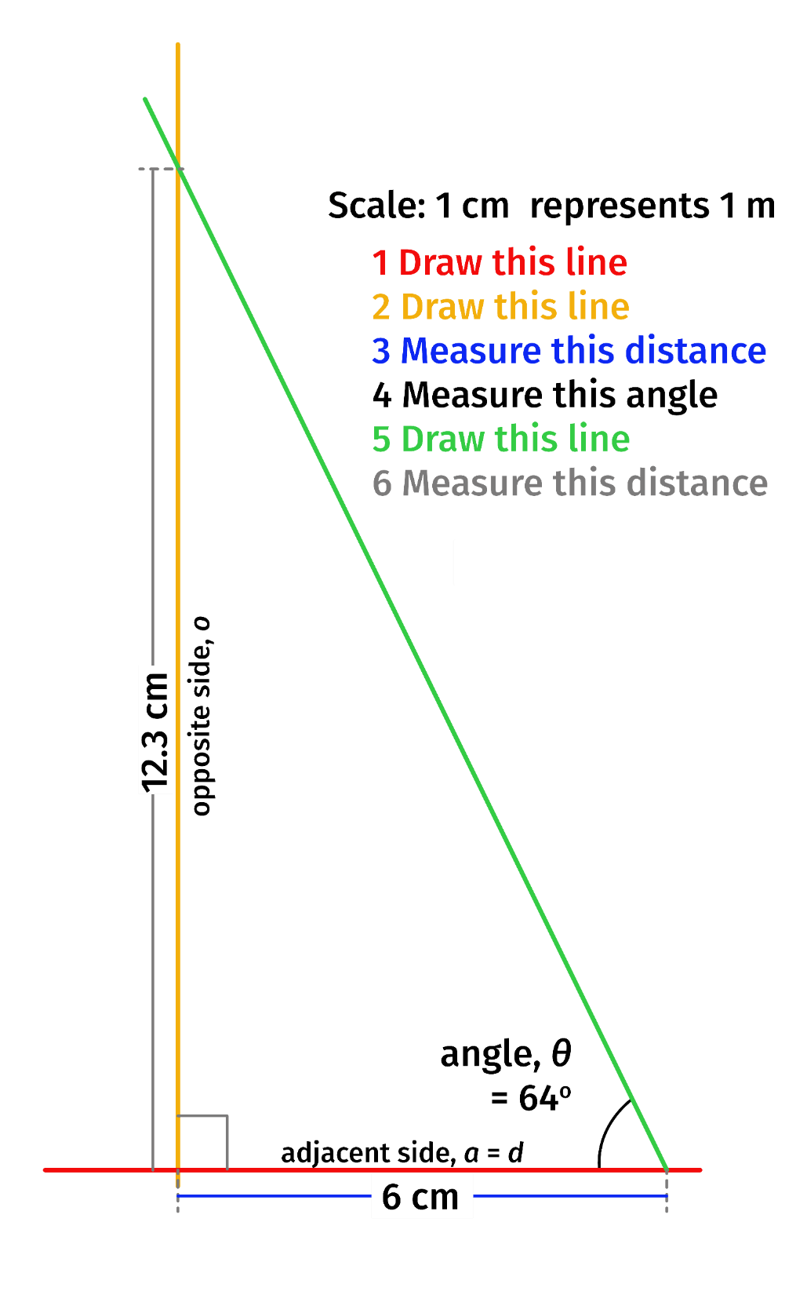
Calculating height using an angle and scale drawing
Using the sample results
e = 1.54 m, θ = 64°, d = 6.00 m
From diagram, o = 12.3 m
t = e + o = 1.54 +12.3 = 13.84
The height of the tree is 13.84 m
CAF (NCEO)
Notes:
Method 3 sample results – calculating with a scale drawing
Each line or step of drawing after the first appears on a click.

Slide 21
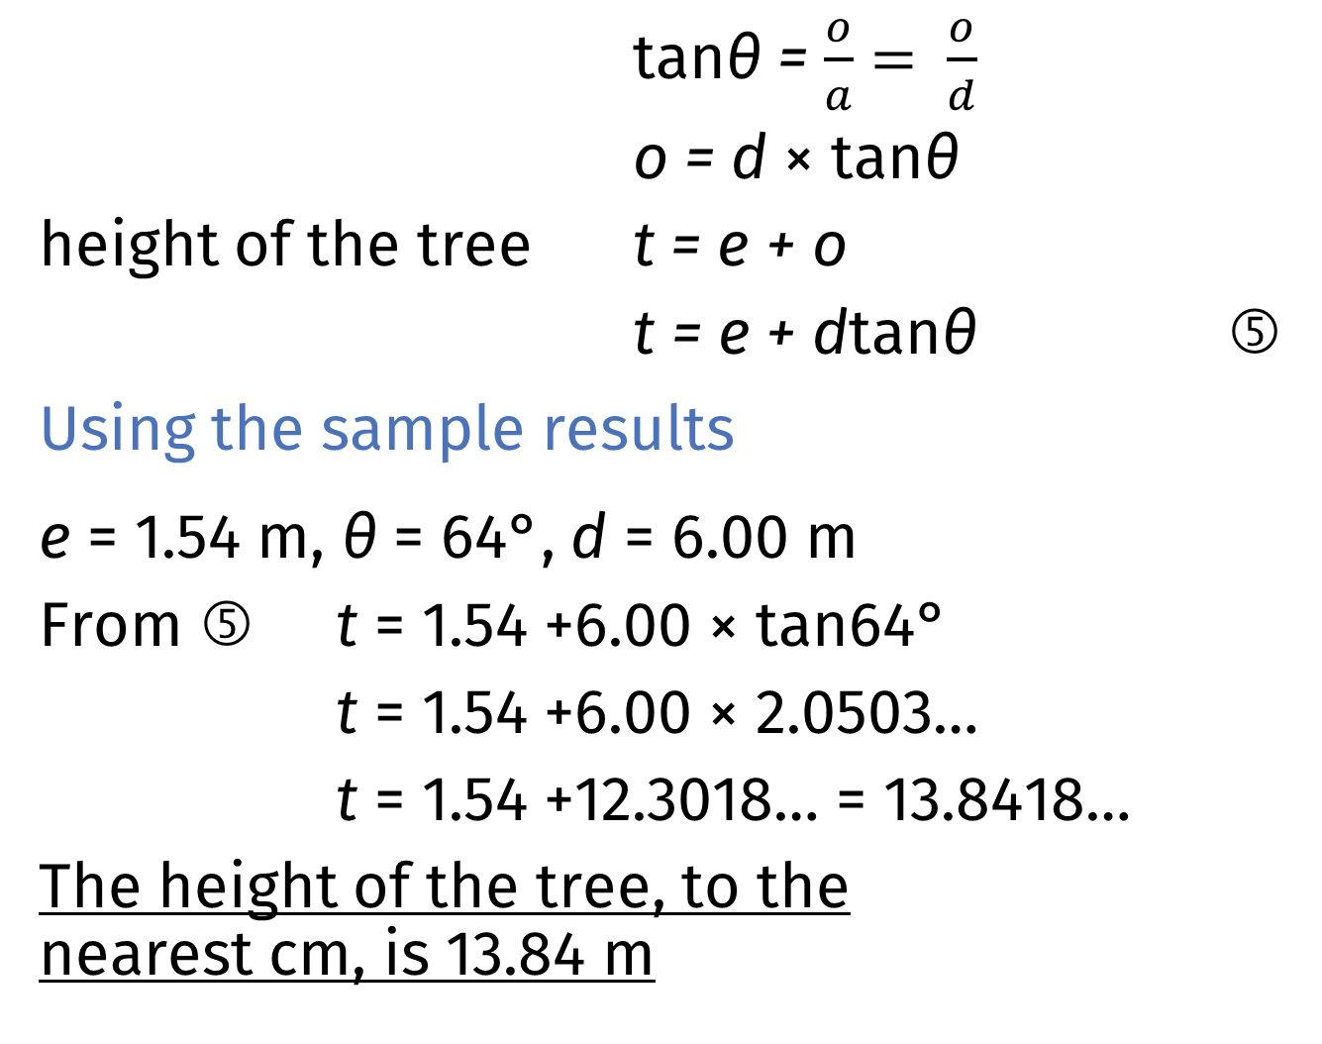
tanθ = $\frac{o}{a}= \frac{o}{d}$
o = d × tanθ
height of the tree t = e + o
t = e + dtanθ ⑤
Using the sample results
e = 1.54 m, θ = 64°, d = 6.00 m
From ⑤ t = 1.54 +6.00 × tan64°
t = 1.54 +6.00 × 2.0503…
t = 1.54 +12.3018… = 13.8418…
The height of the tree, to the nearest cm, is 13.84 m
Calculating height using tangents
Notes:
Method 3 sample results – calculating with tangents
Each line after the first appears on a click.

Slide 22
Use these questions to help you evaluate your final answer(s).
How easy was the/each method you used?
How reliable was it? (Would someone else get the same results?)
What errors might there be in your measurements? (Give values if possible.)
What effect might these errors have on your final answer?
What improvements could you make?
Measuring height:
Evaluation

Slide 23
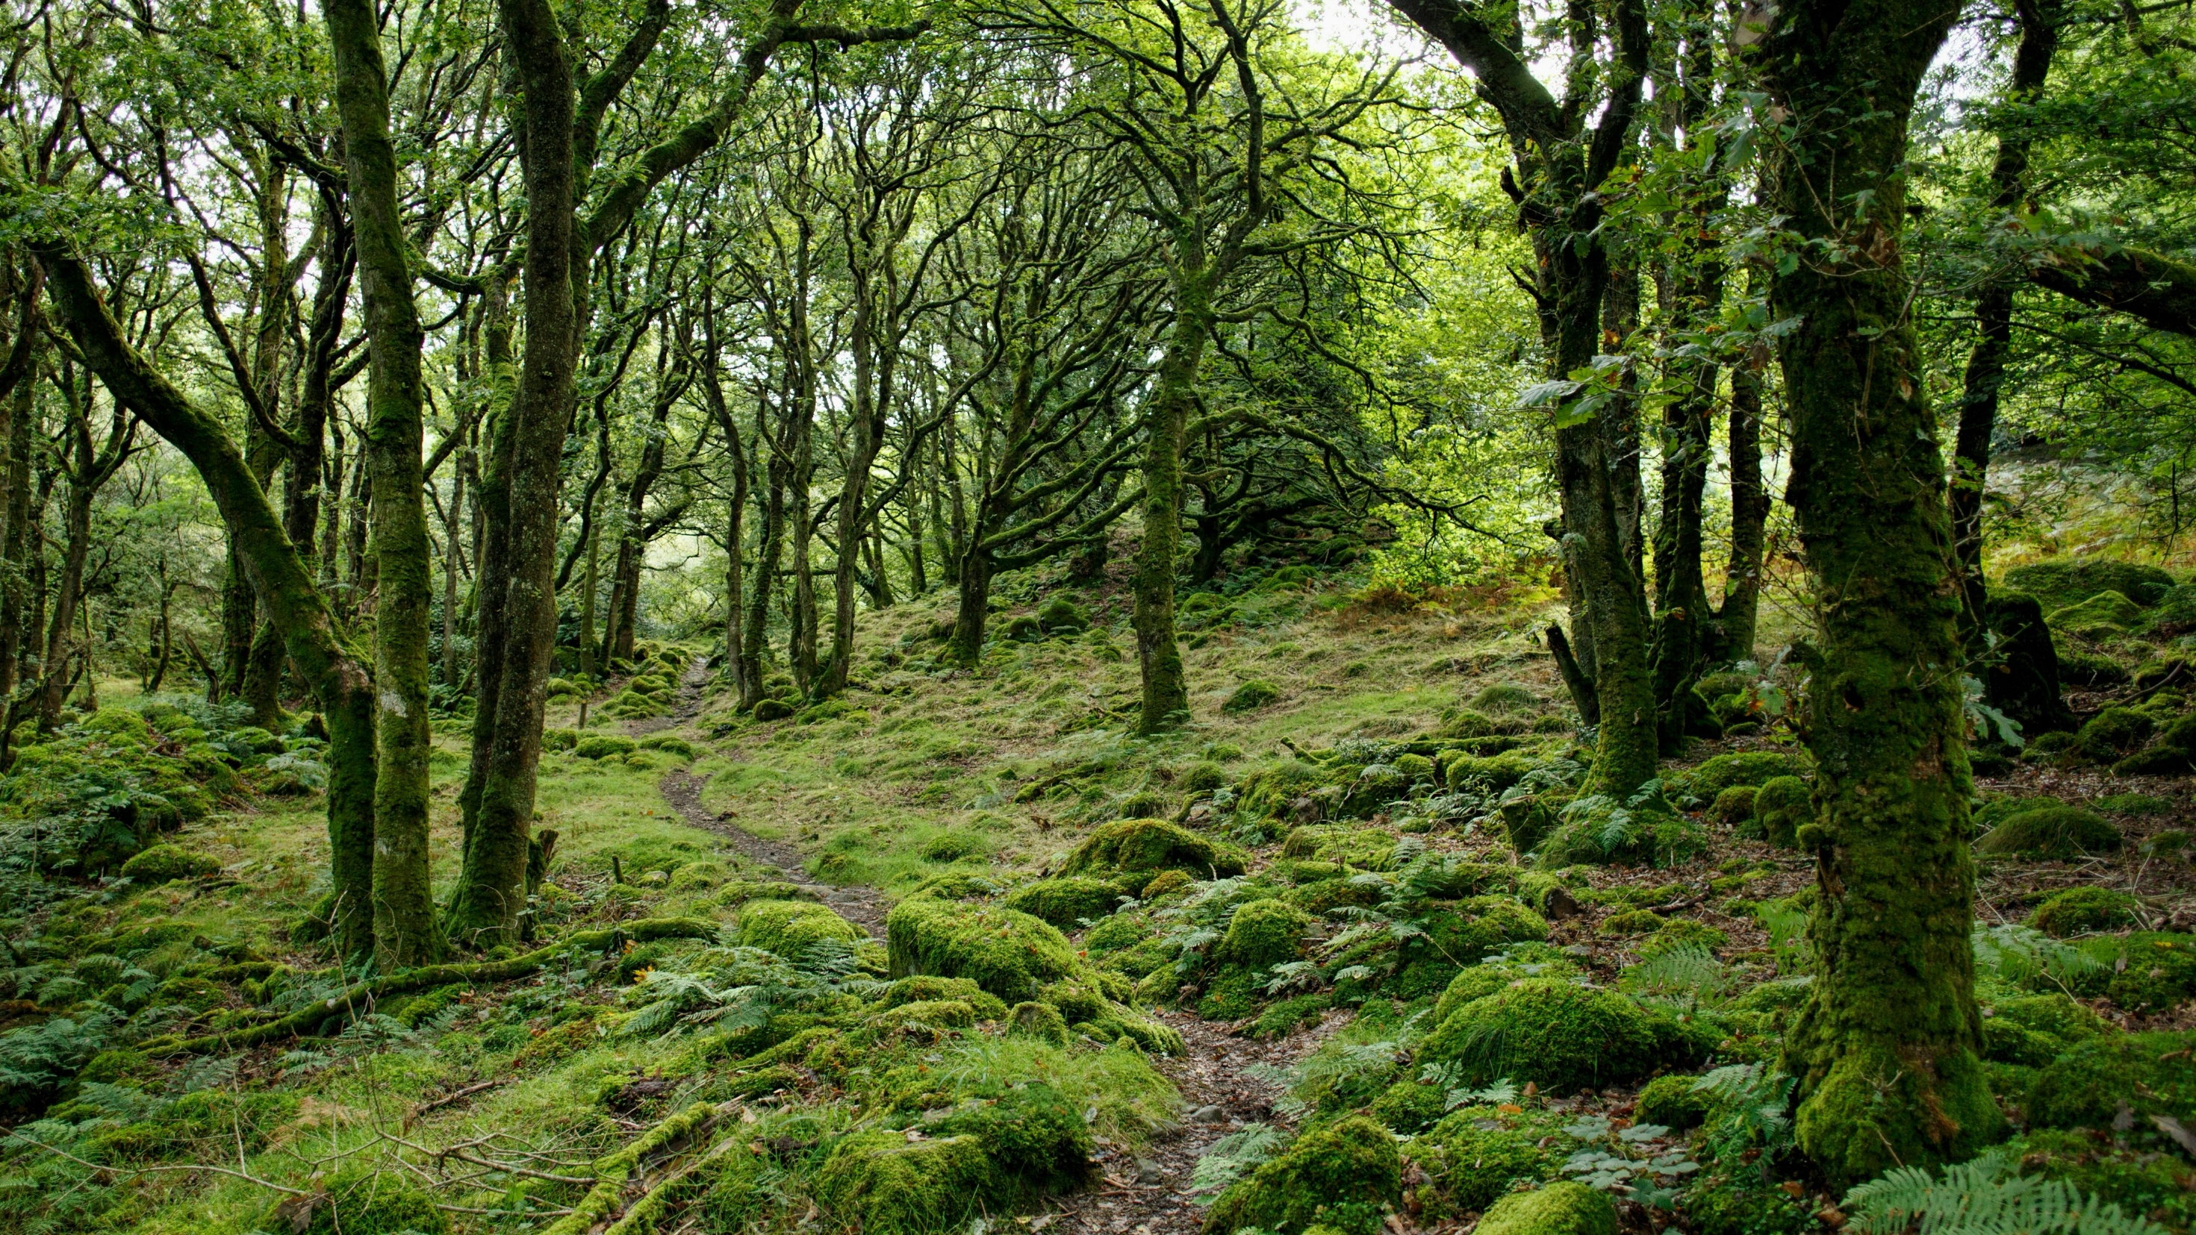
Marc Pell on Unsplash

Slide 24
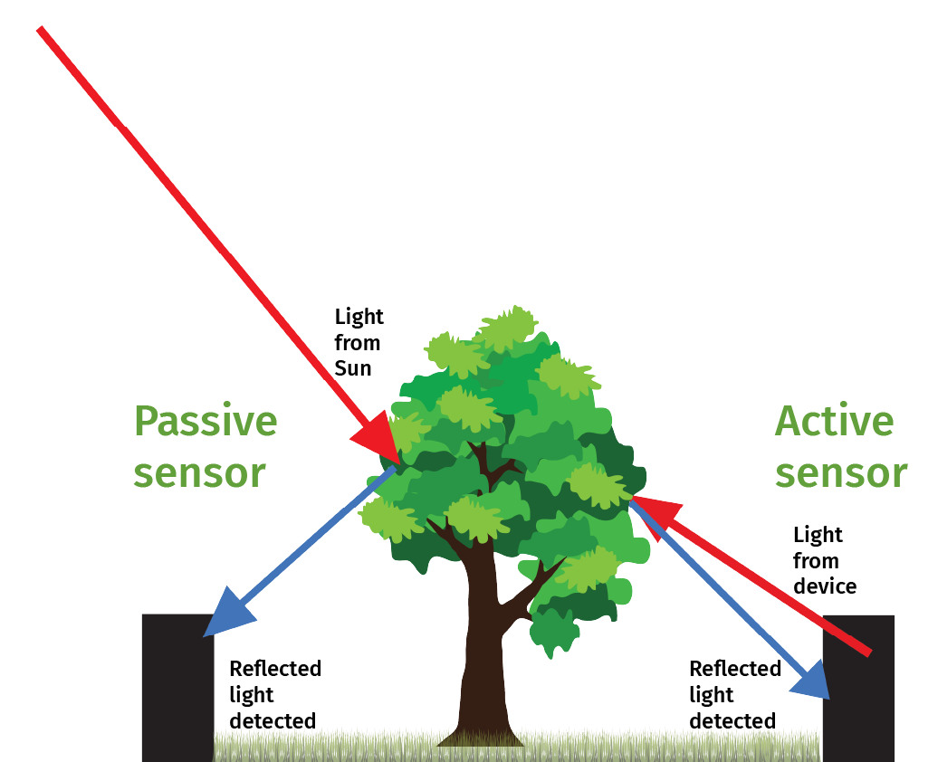
Active and passive sensors
CAF (NCEO) using graphics by Divyansh Kumarand and Georges Tsukaïmah from Pixabay

Slide 25
your eyes
the parking sensor on a car
an infrared thermometer
a camera
a laser measurer used for DIY
a microphone
an ultrasound machine in a hospital
the pressure sensor under an object in a museum
a speed camera
your eyes
the parking sensor on a car
an infrared thermometer
a camera
a laser measurer used for DIY
a microphone
an ultrasound machine in a hospital
the pressure sensor under an object in a museum
a speed camera
Active or passive?
Active or passive?
Notes:
On first click, title changes to colour. Items on list appear in colour one-by-one on consecutive clicks.

Slide 26
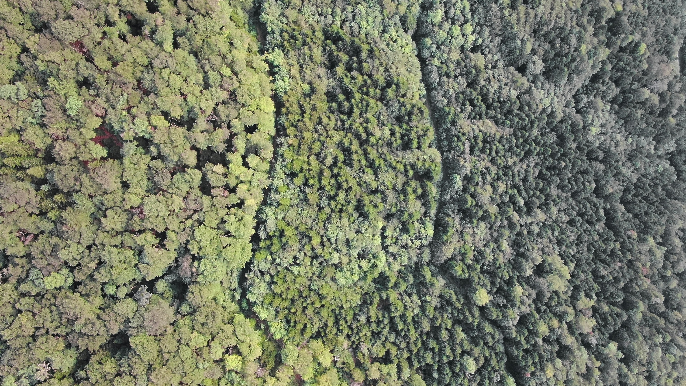
Nathan Queloz on Unsplash

Slide 27
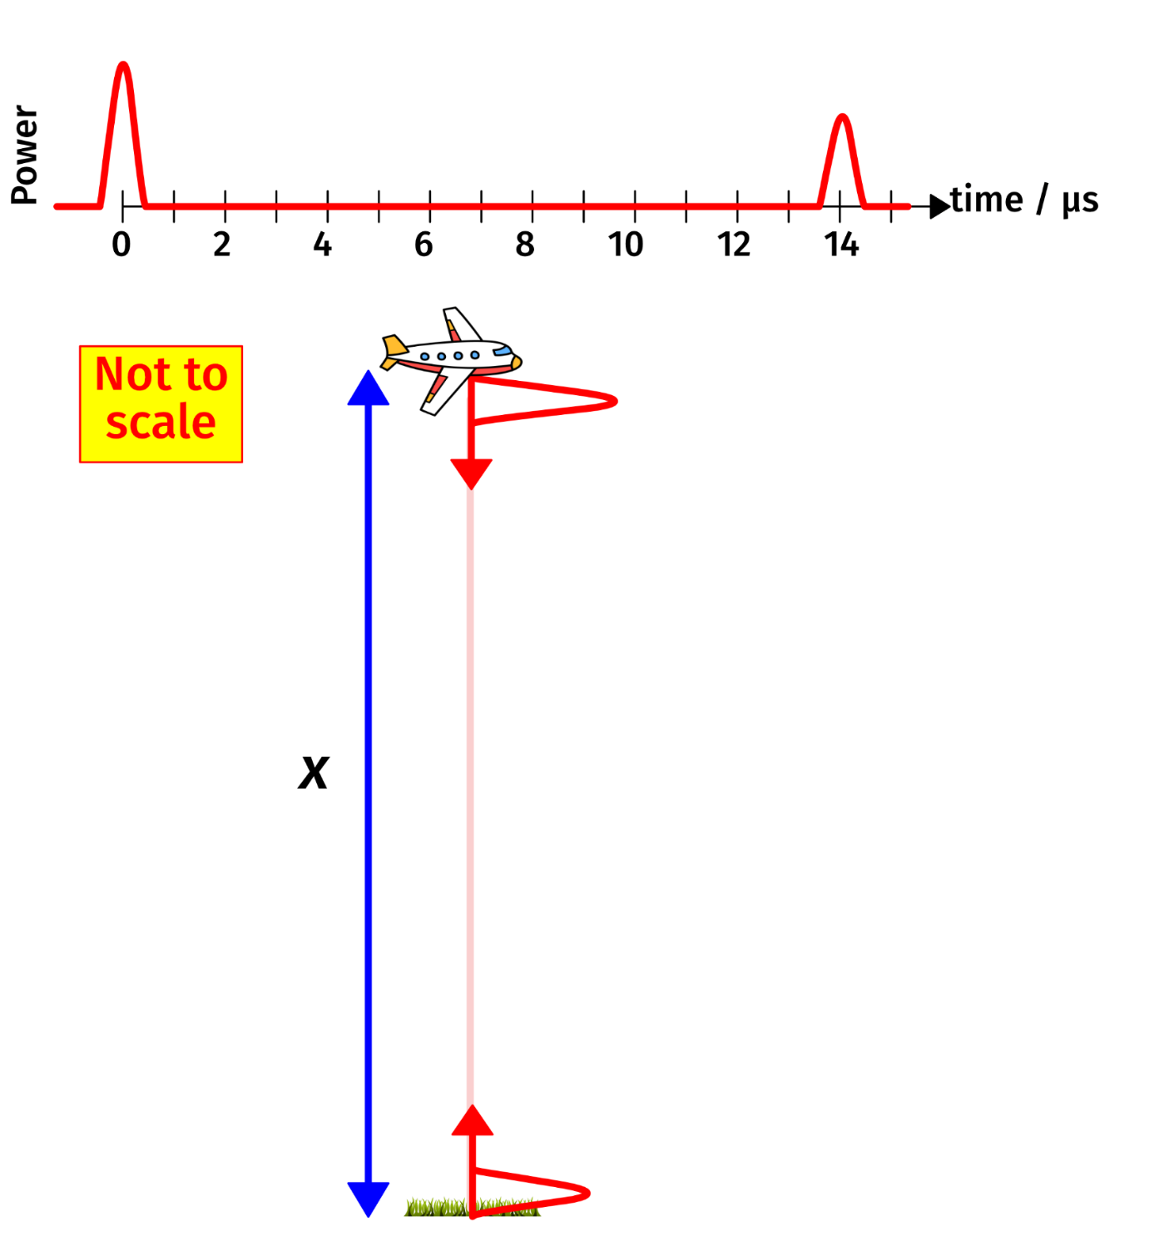
①
③
How ALS works
speed = distance ÷ time
speed of light = 3 × 10⁸ m/s
distance = 2x
time = 14 μs = 14 × 10⁻⁶ s
3 × 10⁸ = 2x ÷ 14 × 10⁻⁶
2x = 3 × 10⁸ × 14 × 10⁻⁶
x = 42 × 10² ÷ 2
x = 2100
The aircraft is flying 2100 m above the ground.
①
CAF (NCEO) using graphics by VectorStock / vectorstock and Georges Tsukaïmah from Pixabay
②
Notes:
The numbers ① – ③ and each line of the calculation appear on a click.

Slide 28
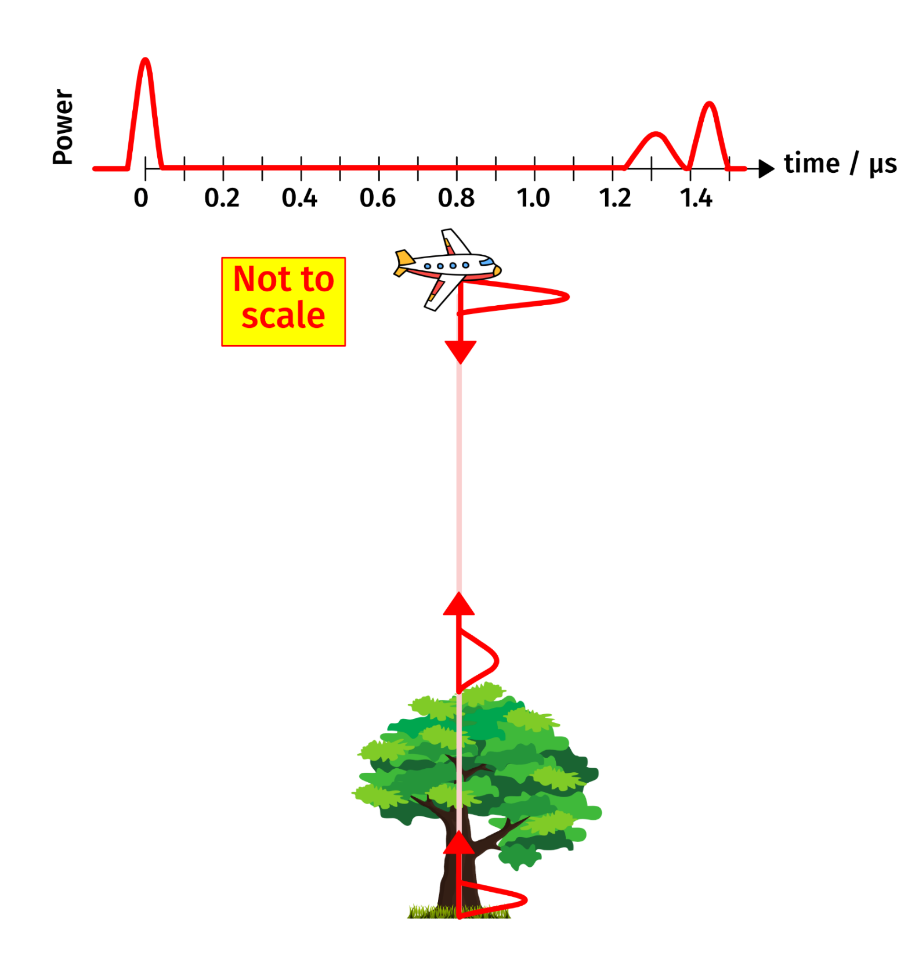
How tall is this tree?
x = 217.5 m
y = 195 m
h = 22.5 m
y
CAF (NCEO) using elements)
x
h
Notes:
Arrows and answers appear on individual clicks.

Slide 29
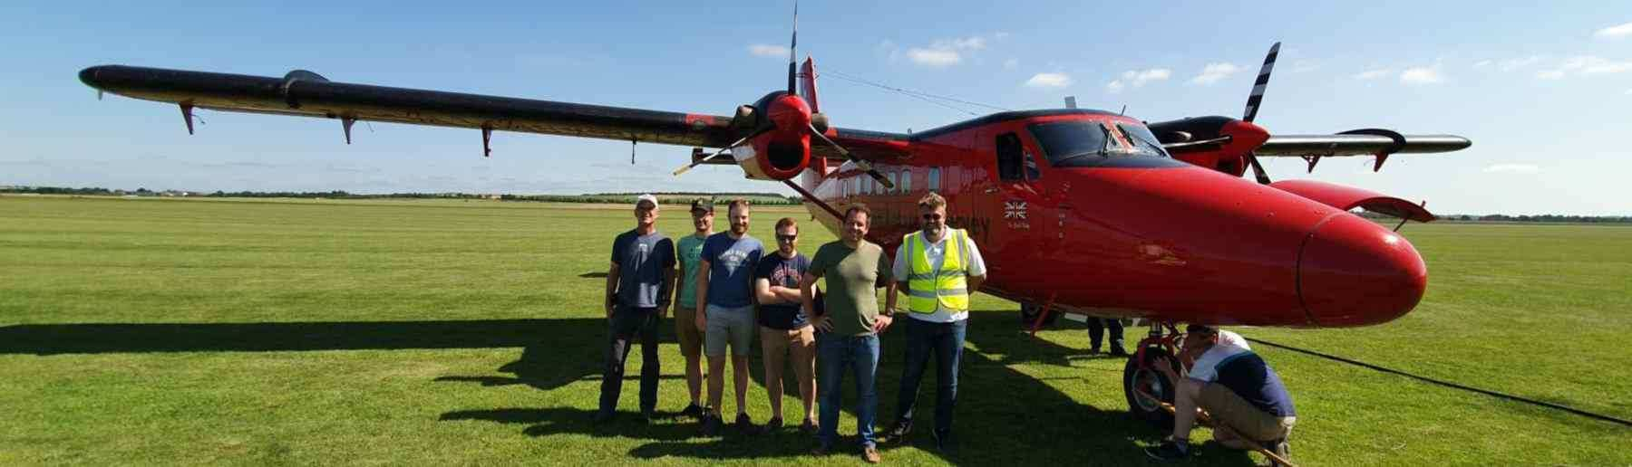
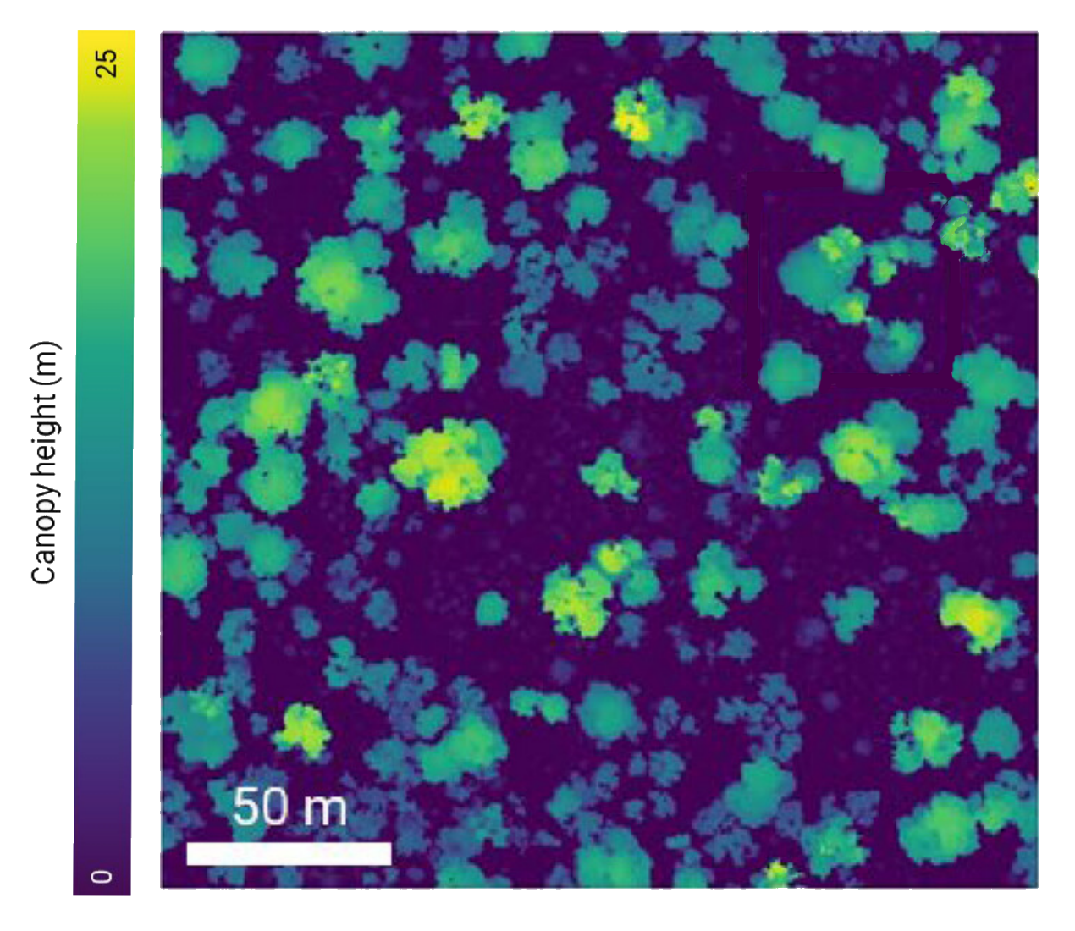
Airborne
lidar scanning (ALS)
NCEO Airborne Earth Observatory (KCL) | Zhang et al (2024) Fig 2 (extract)
Notes:
The photo shows an NCEO team who used an airborne lidar on the British Antarctic Survey’s plane to collect data like that in the second image.

Slide 30
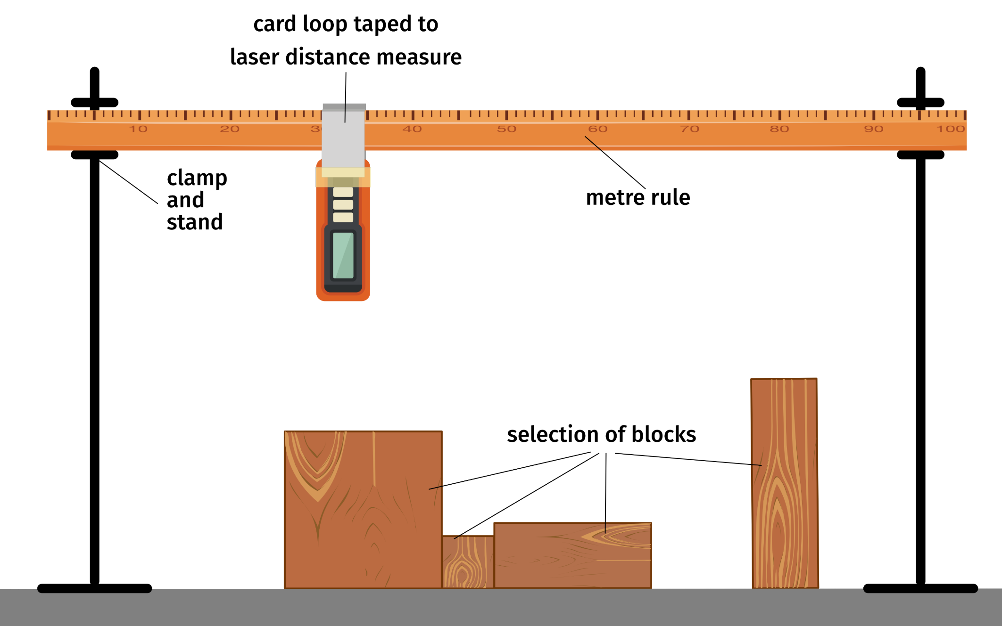
Modelling ALS:
Set up
card to hide blocks
CAF (NCEO) using graphics by Clker-Free-Vector-Images from Pixabay and blueringmedia and anatolir on Adobe Stock (education licence))
Notes:
Card hiding blocks disappears on click

Slide 31
Distance along rule / cm | Height of measure above surface / cm
Modelling ALS:
Results table

Slide 32
One person from Group B:
Make a drawing showing the height, width and position of each block.
Meanwhile:
Group A choose a position along the rule.
Rest of Group B move the laser measure to this position and take a reading.
Group A write the result in their tables.
Continue until Group A have about 15 readings.
Group A and B swap places:
Group A make a new arrangement for Group B to find.
Modelling ALS
What to do when
everyone has a results table
Group B have set some blocks
Notes:
Card hiding blocks disappears on click

Slide 33
Distance along rule / cm | Height of measure above surface / cm
10 | 10.2
15 | 11.0
20 | 11.0
25 | 11.0
30 | 4.8
35 | 4.8
40 | 4.8
45 | 8.8
50 | 8.2
Distance along rule / cm | Height of measure above surface / cm
55 | 8.2
60 | 8.2
65 | 8.2
70 | 11.0
75 | 11.0
80 | 2.6
85 | 11.0
90 | 10.3
Modelling ALS:
Sample results

Slide 34
Use the results table to answer these questions.
How far below the laser measure was the table?
How many different block heights were there in the other group’s arrangement?
What was the height of tallest block? The shortest?
Can you say anything about the width or position of any of the blocks?
Modelling ALS:
Analysing results 1
Notes:
Opens to blank grid, with xs plotted appears on click, actual set-up with xs on second click.

Slide 35
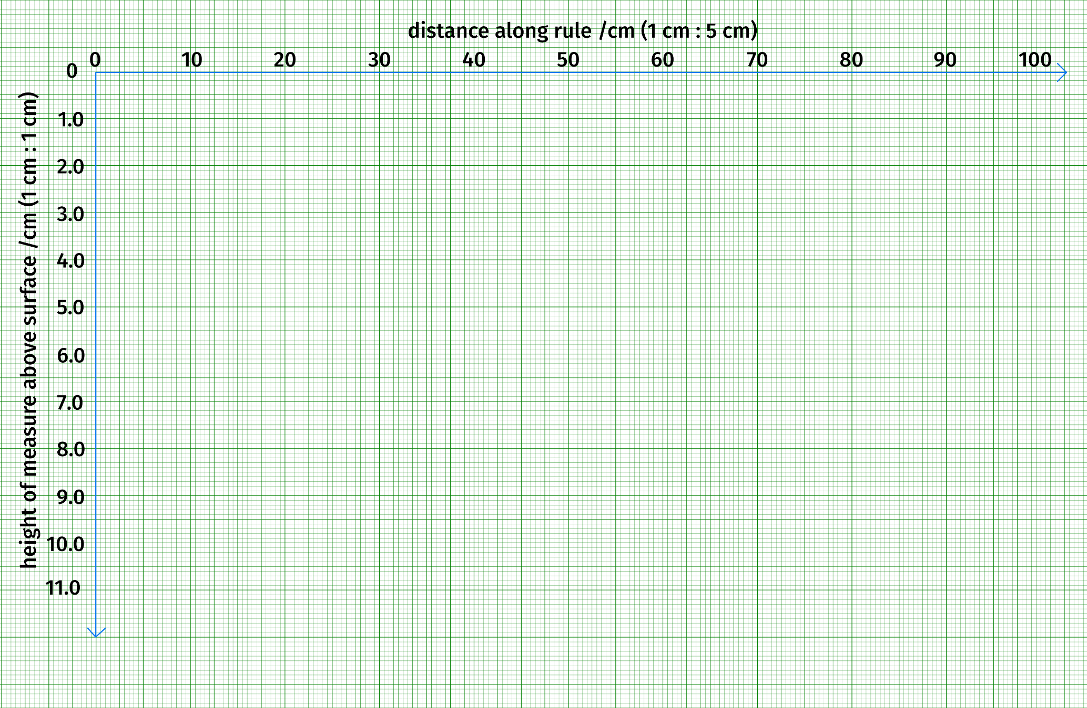
Modelling ALS:
Analysing results 2
Use axes like these to plot your results. You may need a different vertical scale.
Draw a horizontal line to show the position of the table.
Add rectangles to your graph to show where you think the blocks were.
Compare your graph with the drawing made by the other group.
CAF (NCEO) using graphics from Open Clip Art

Slide 36
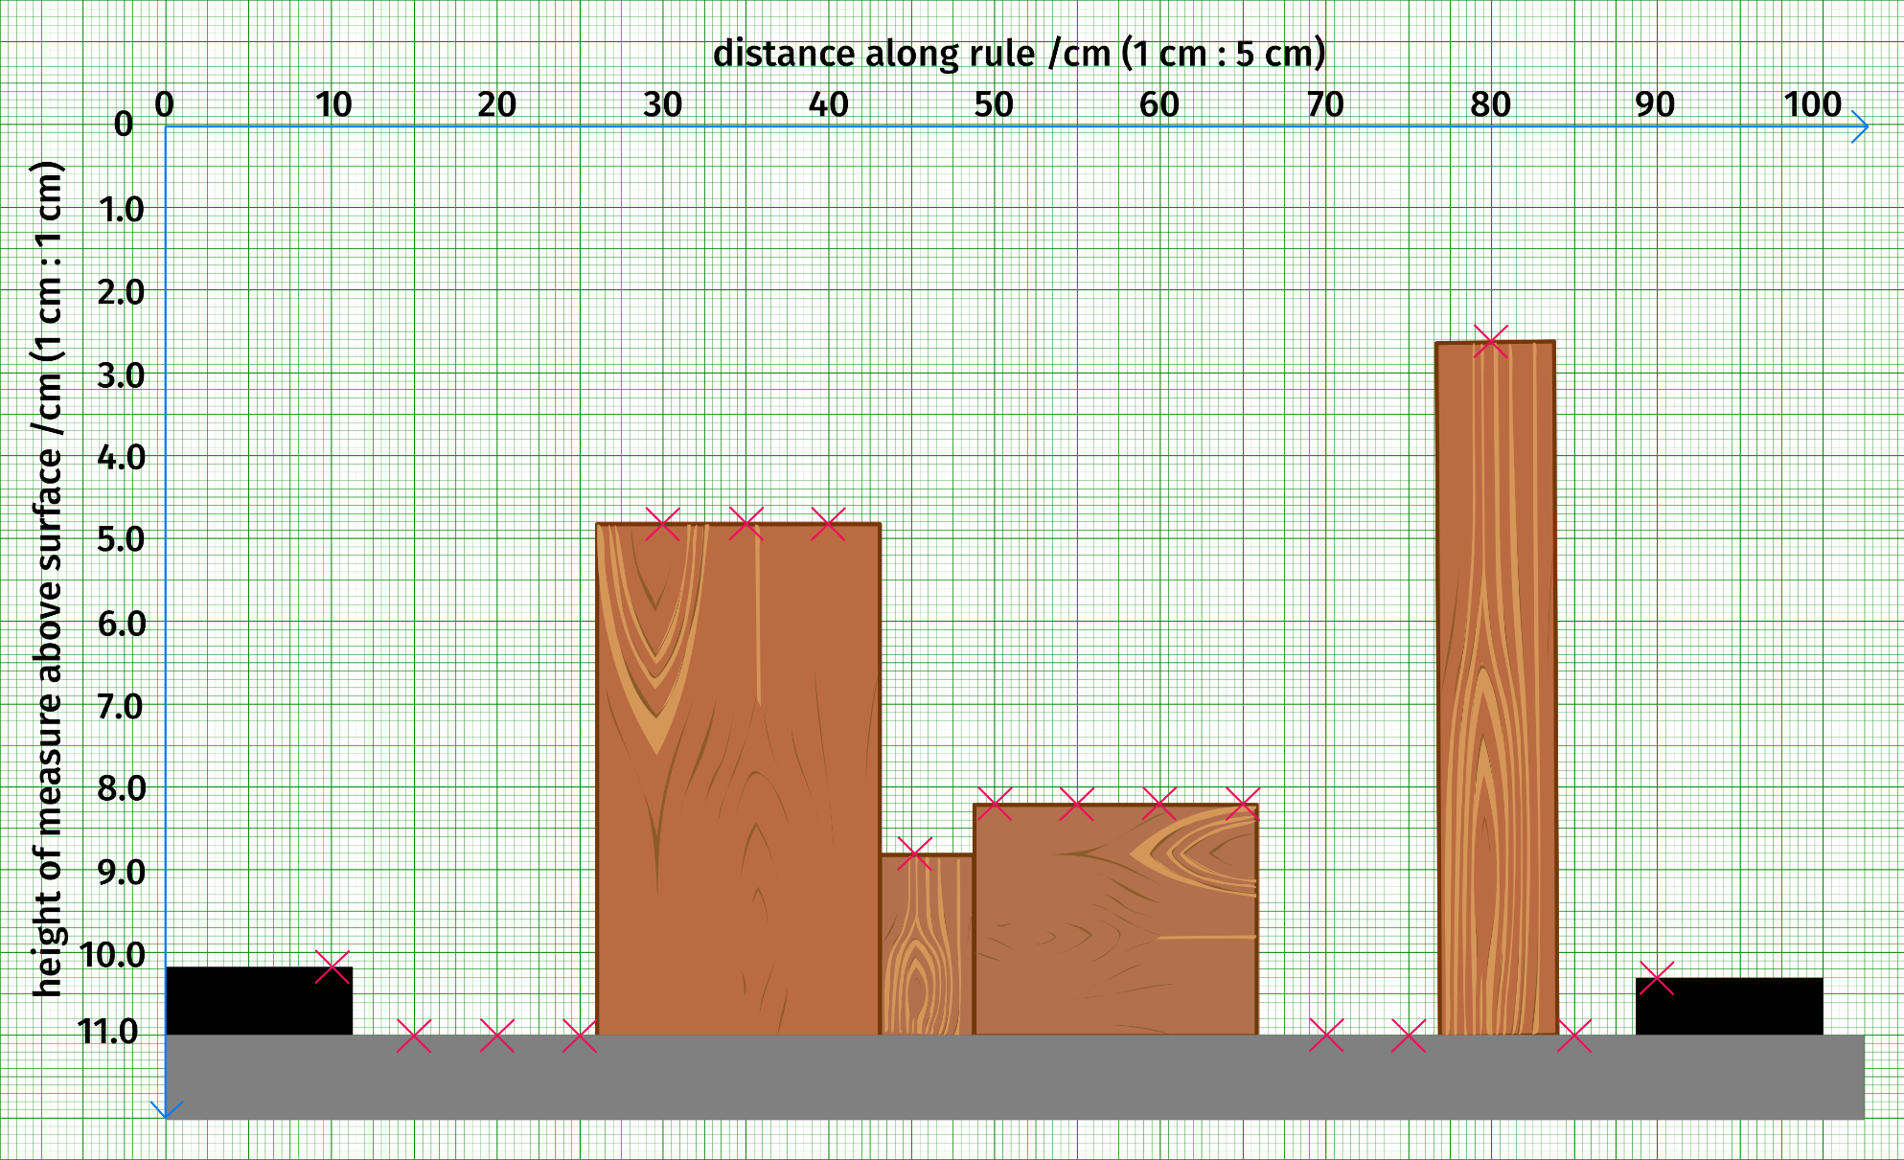
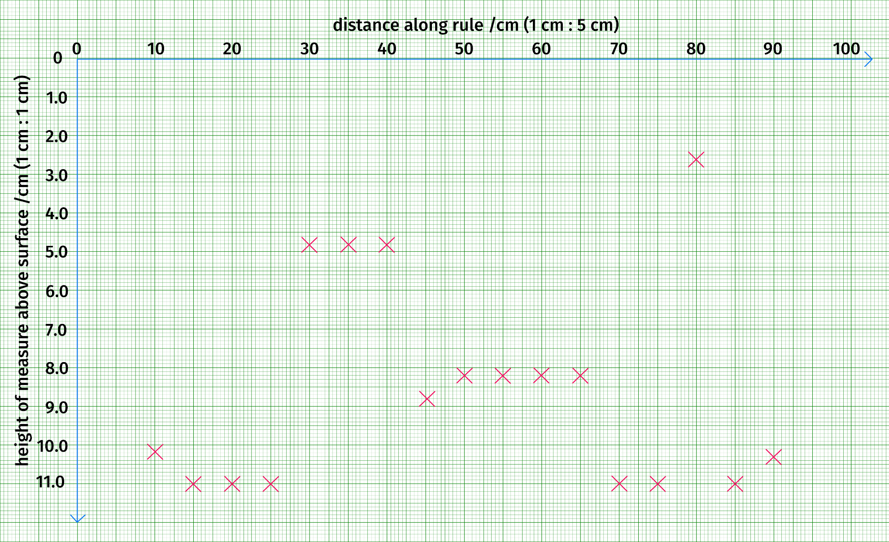
Modelling ALS:
Analysis of sample results
CAF (NCEO) using graphics by Clker-Free-Vector-Images from Pixabay and Open Clip Art
Notes:
Opens grid with xs plotted; blocks and table added on click.

Slide 37
Compare your graph with the drawing of the other group.
What parts of your drawing were correct?
What information did you use to create them?
What parts of your drawing were wrong?
Why?
a) Did you just need more information? If so, what?
b) Were your mistakes because of the equipment? If so, what could have been done better?
What do your answers tell you about getting good results from a lidar sensor on an airplane or UAV (drone)?
Modelling lidar:
Evaluation

Slide 38
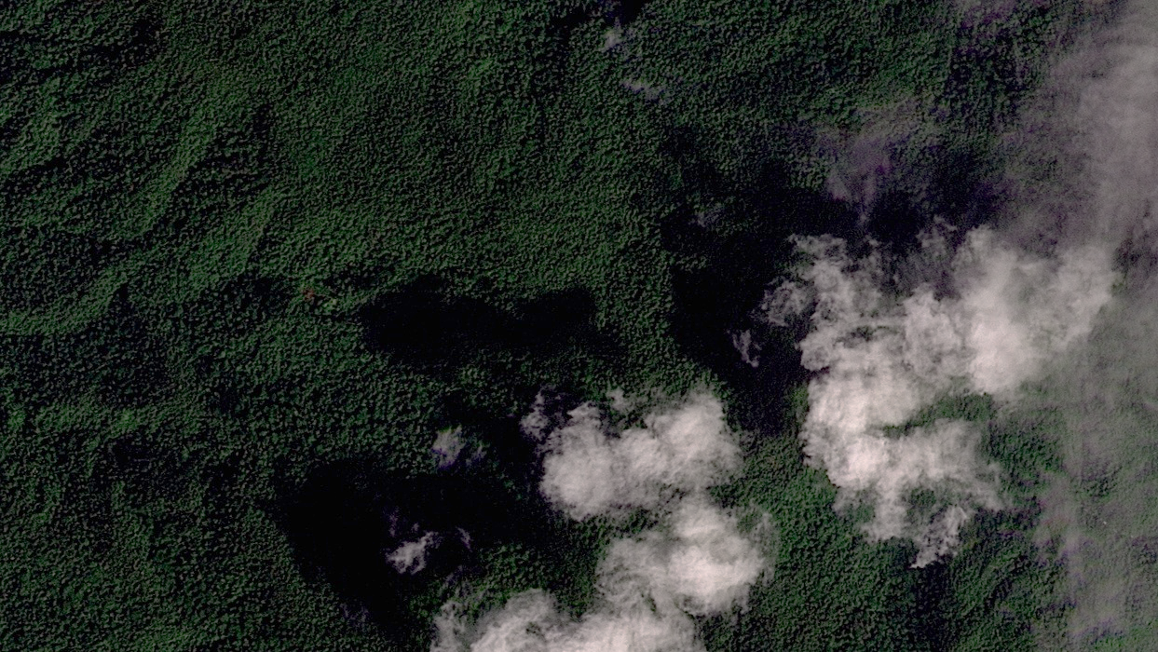
© 2025 Planet Labs

Slide 39
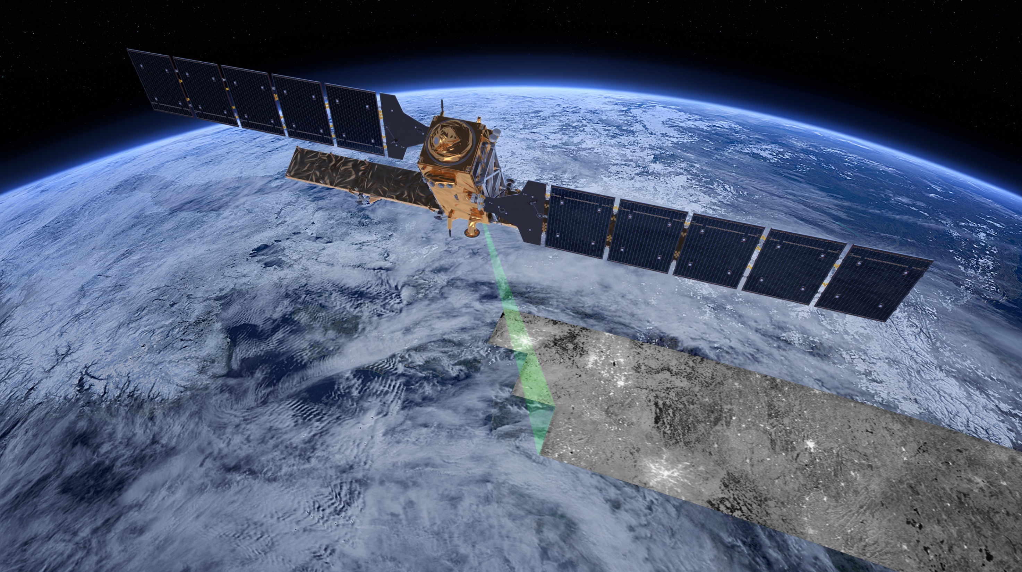
ESA/ATG medialab

Slide 40
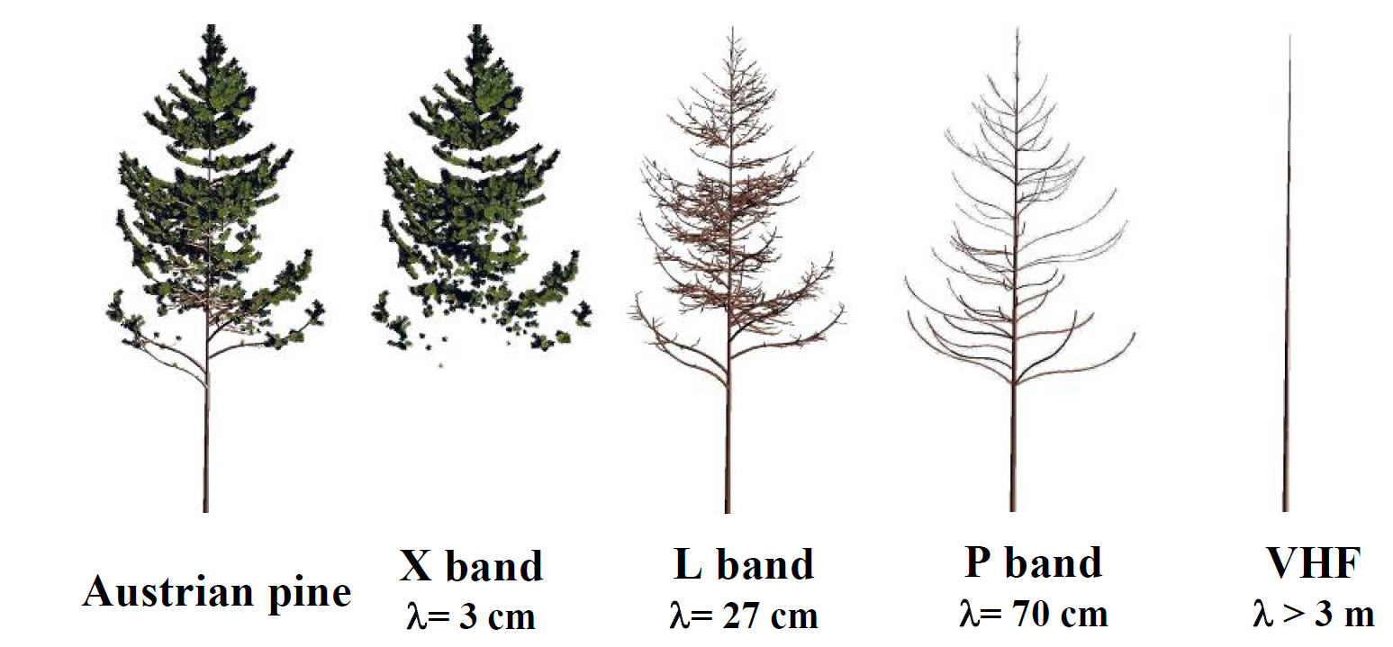
Viewing a tree at different radar wavelengths
Visible X band L band P band VHF
light radar radar radar radar
Le Toan (2007)

Slide 41
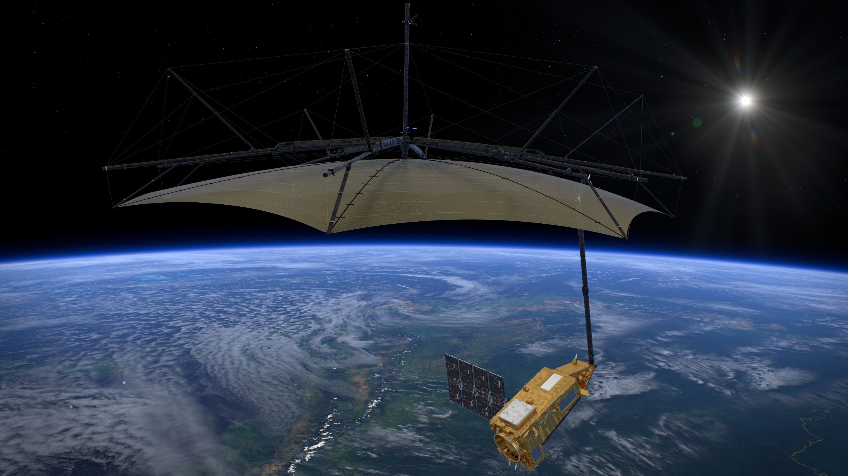
ESA/ATG medialab

Slide 42
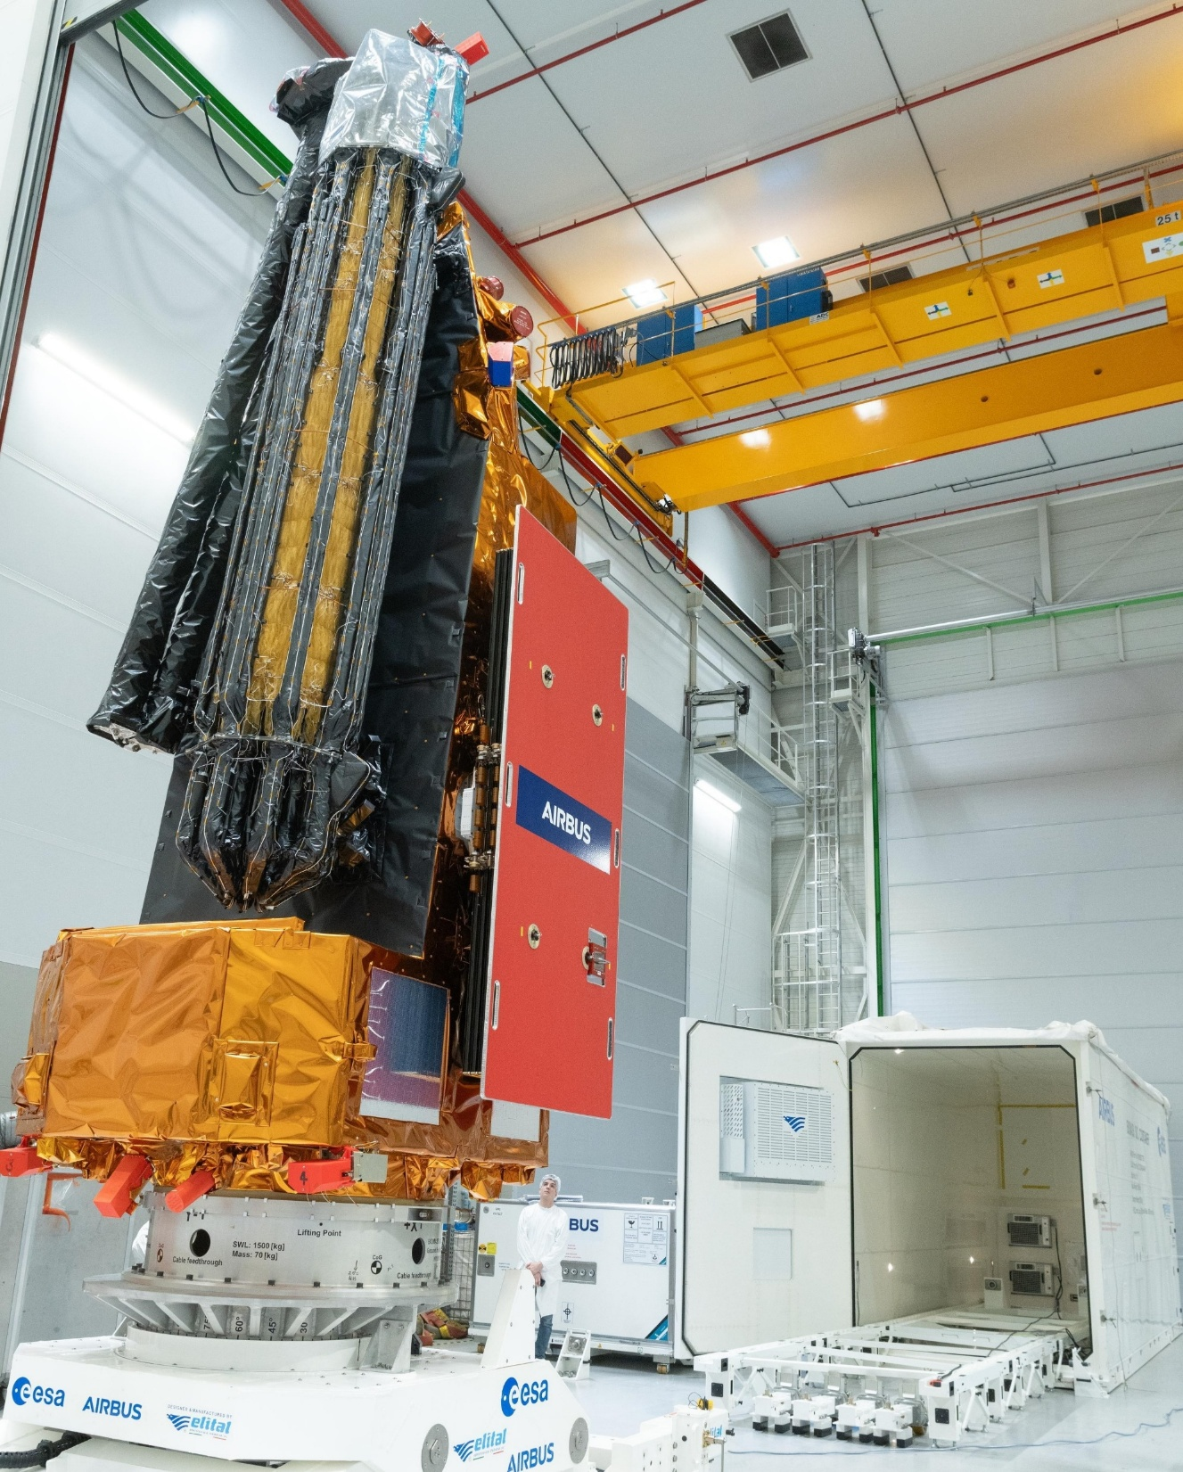

Patch: ESA Photo: ESA–P. Sebirot
Notes:
The photograph shows Biomass folded down for shipping and launch: the solar panels and reflector will unfold once it is in space.
The person in the picture gives some idea of the size of the satellite.
The ESA patch features flags of all ESA member countries. Which one is not in Europe?

Slide 43
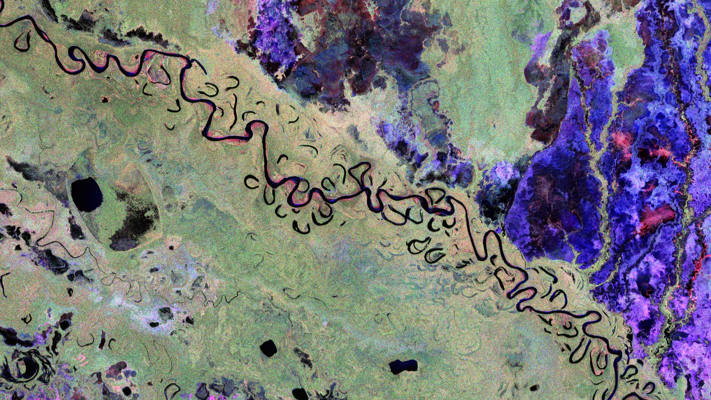
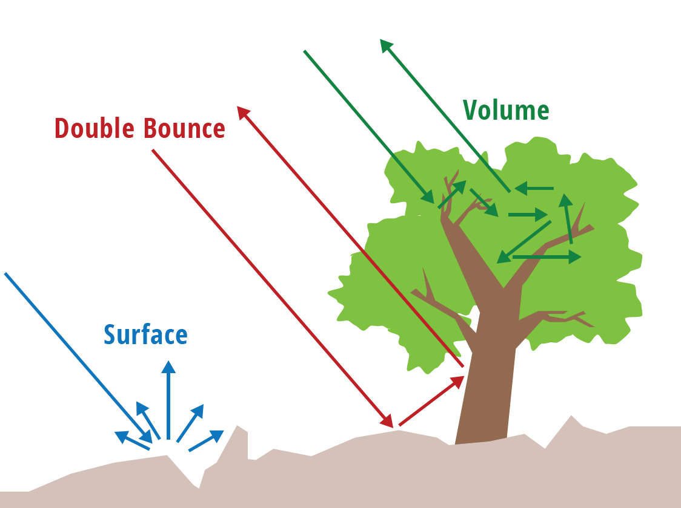

ESA (main image) | Servir Global SAR handbook Fig 2.8 (inset)
Notes:
Diagram showing mechanisms appears on click.
In this image of data from the Biomass satellite uses different colours to show different scattering mechanisms: blue = single-bounce reflection from flat surfaces, red = double-bounce reflection from vertical surfaces and green = a signal that returns after multiple bounces e.g. between leaves. No reflection from black areas.
So: green areas are forest; red areas have more spaced out trees (or buildings); blue areas are flatter – probably grassland and black areas are water.

Slide 44
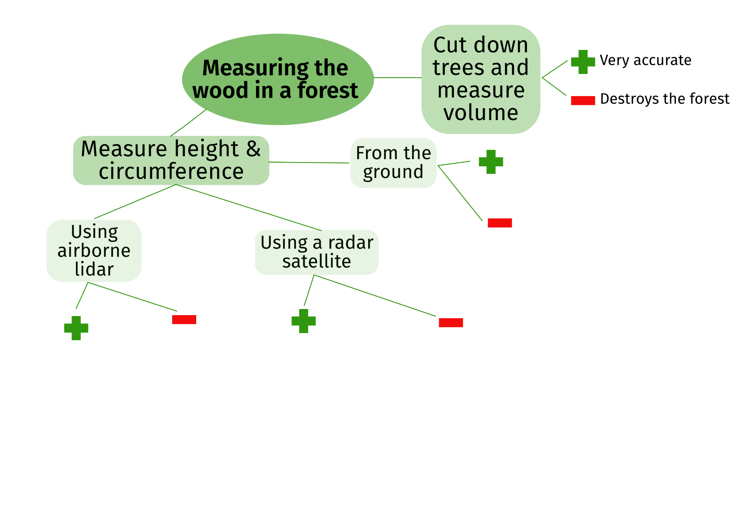
What’s the best way to measure how much wood there is in a forest?
CAF (NCEO)
CAF (NCEO)
Notes:
Point cloud appears on click

Slide 45
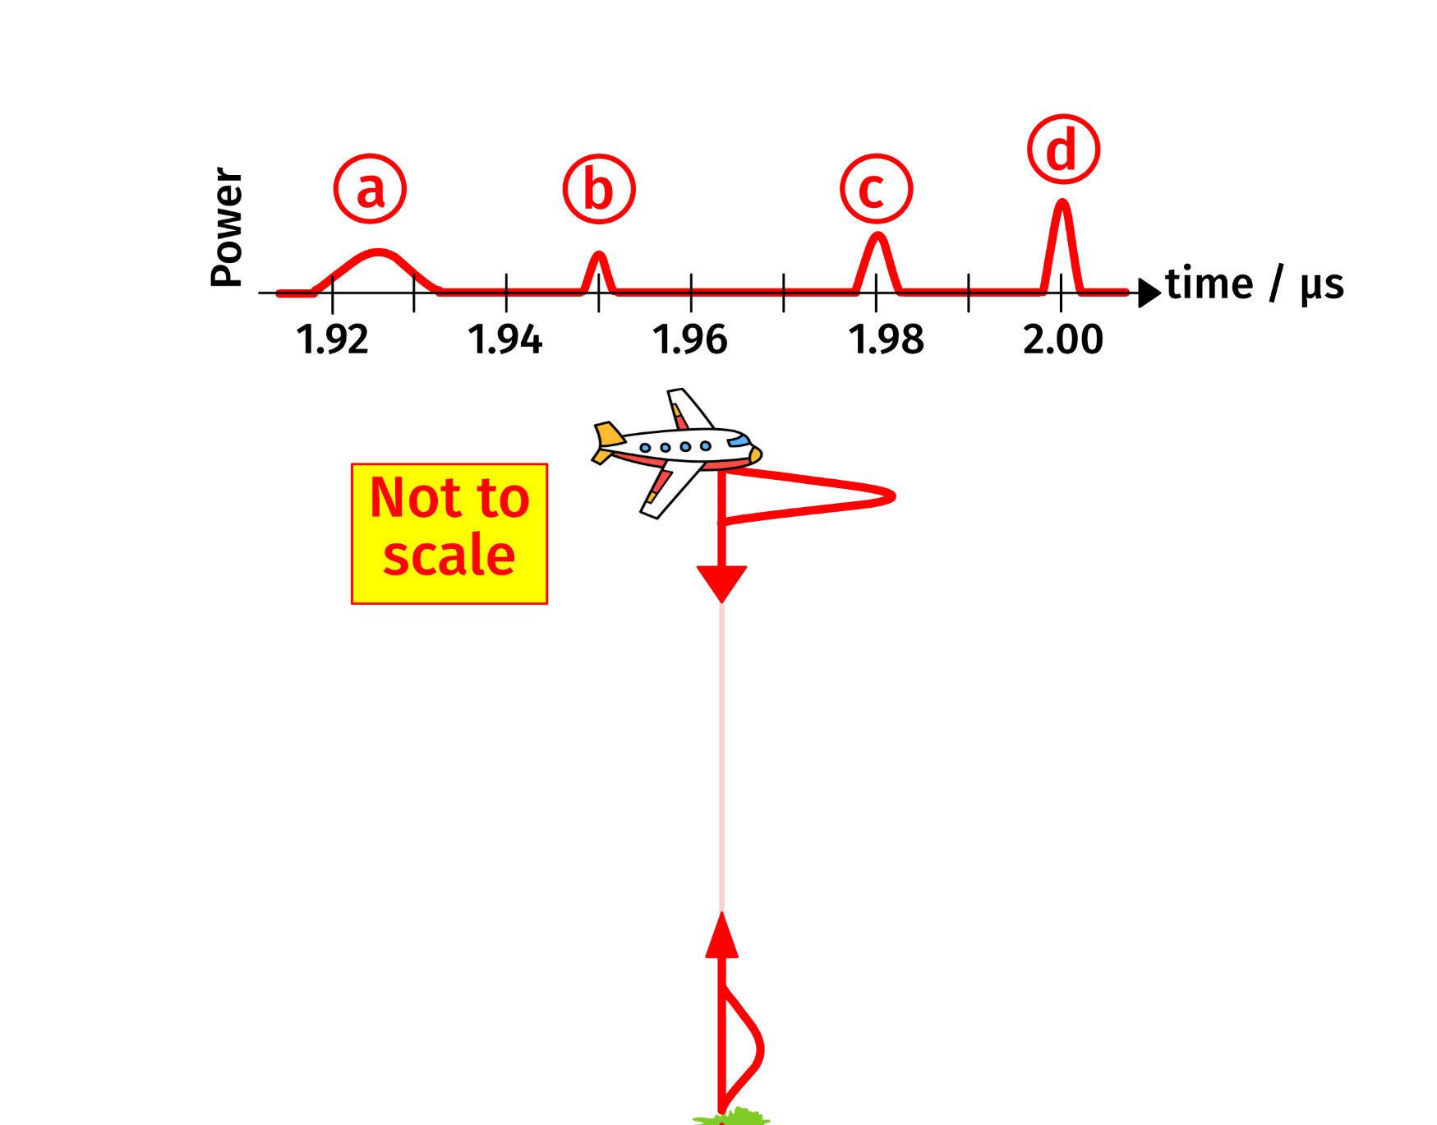
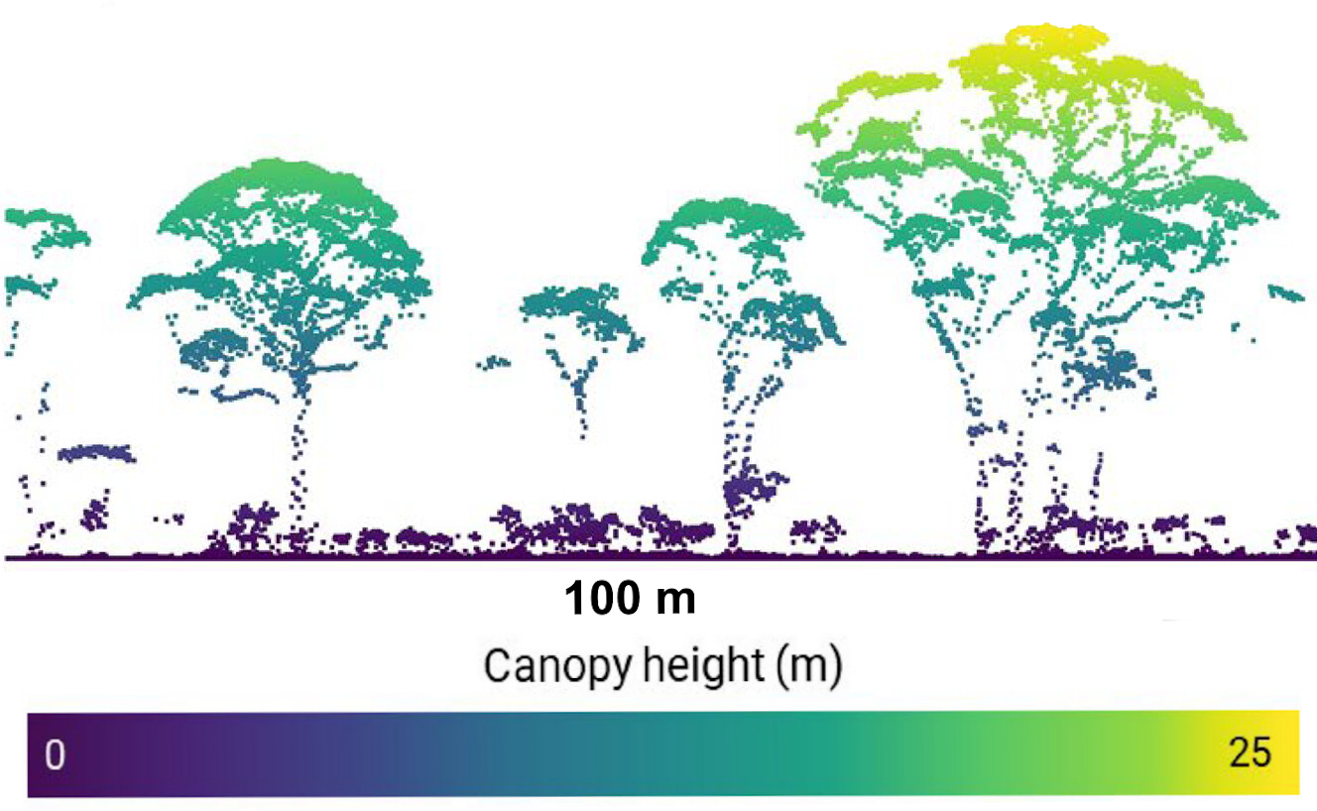
Getting more detail from airborne sensors
CAF (NCEO) using graphics by VectorStock / vectorstock and Divyansh Kumar and Georges Tsukaïmah from Pixabay|Zhang et al (2024) Fig 2 (extract)
Notes:
Point cloud appears on click

Slide 46
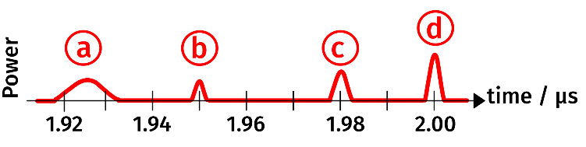
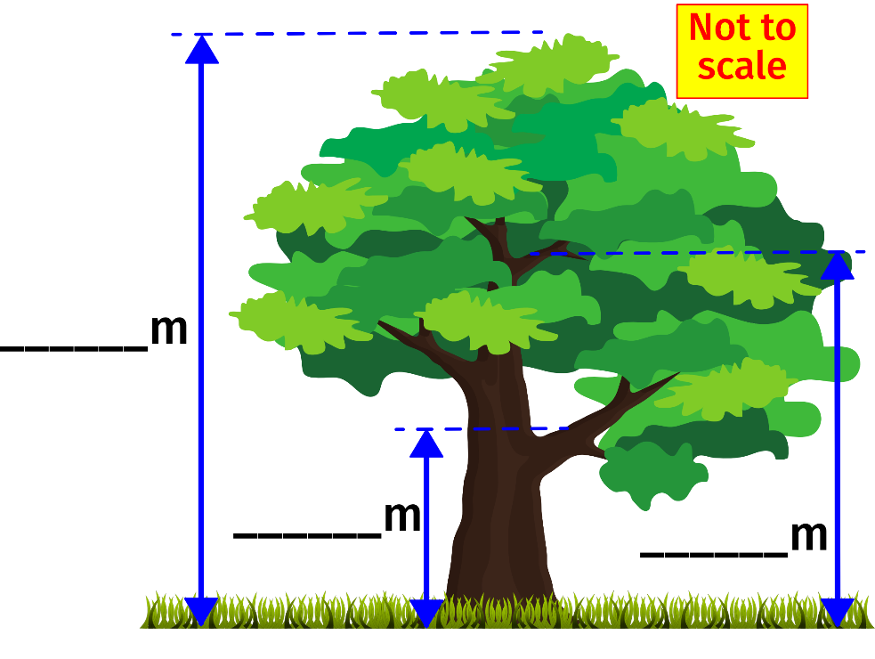
Using airborne sensors to see tree structure
What reflects the light to make the pulse labelled (a)?
Which pulse, (b) or (c), is made by a reflection from a branch higher up in the tree?
How high above the ground is the aircraft carrying the lidar?
Use information from the graph to calculate the heights labelled in the diagram.
CAF (NCEO) using graphics by Divyansh Kumar and Georges Tsukaïmah from Pixabay

Slide 47

ESA

