Slide 1
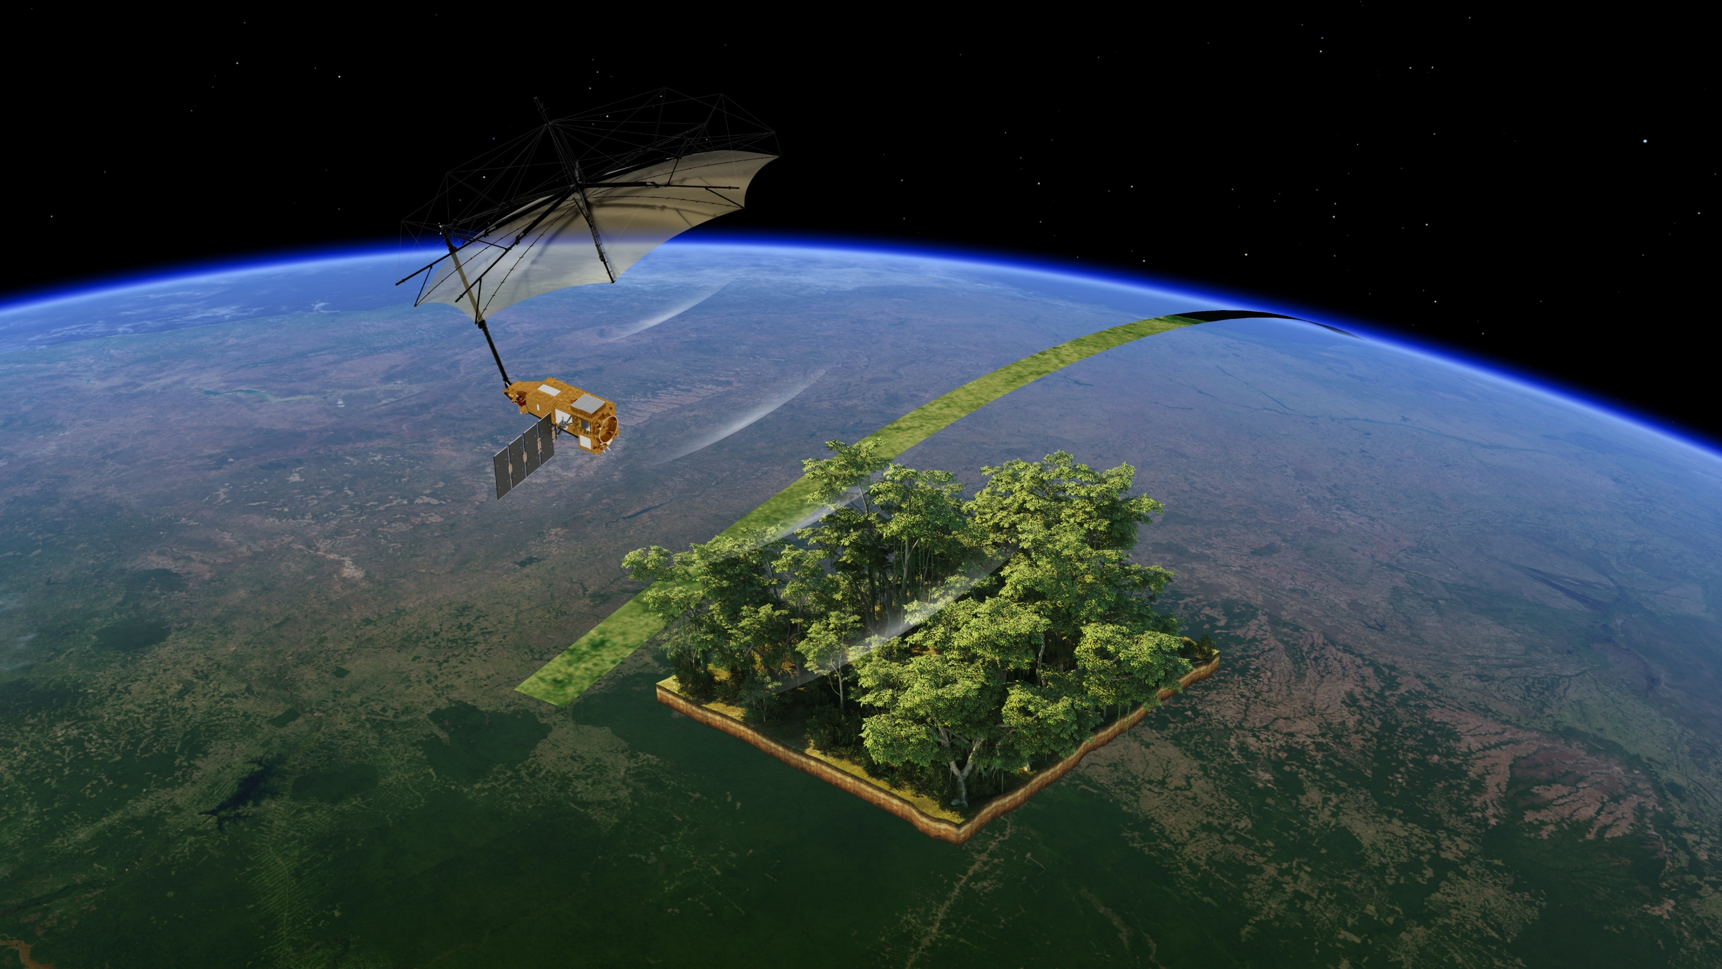


Counting trees
How many trees in a forest?
ESA/ATG medialab

Slide 2


Show the biggest forests of the Earth on a map of the world.
Give ideas about why the number of trees in forests can change.
Explain how to count trees.
Know how the Biomass satellite will help.
Notes:
Lesson outcomes slide.
Title is blank so you can add the wording used in your school if you wish to share these at the start or/and end of the lesson.

Slide 3
wood
forest
tropical rainforest
climate
deforestation
agriculture
ecosystem
biome
climate zone
vegetation
Notes:
Key words slide.
Title is blank so you can add the wording used in your school if you wish to share these at the start or/and end of the lesson.

Slide 4
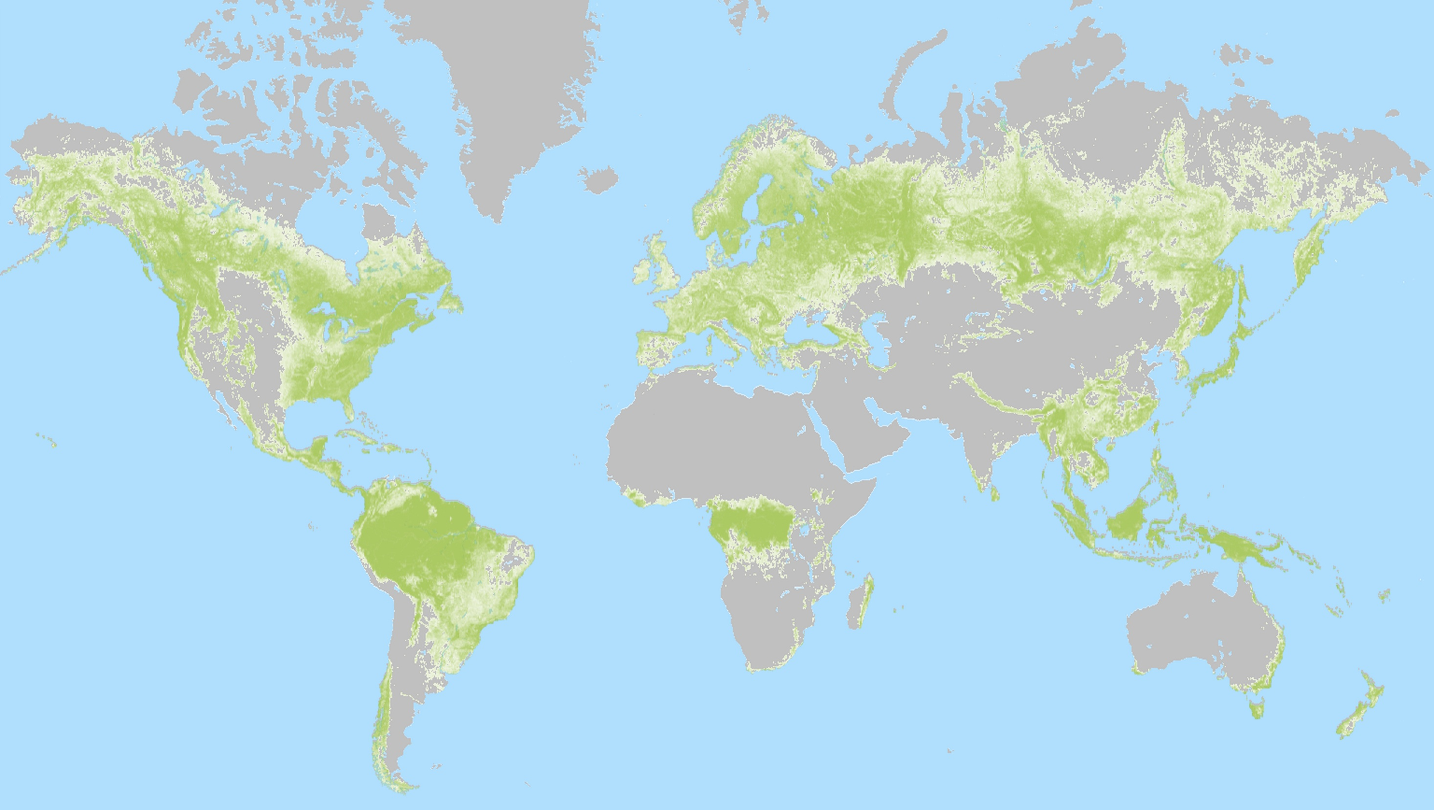
Congo
Russia
Amazon
Indonesia
North America
South-East Asia
Sweden and Finland
Hansen/UMD/Google/USGS/NASA, accessed through Global Forest Watch
Notes:
Dark green areas show places where tree coverage was >75% in 2000 so are forests.
Pale green areas had quite a lot of trees but they are more spread out – in smaller forests, woods, along the edges of fields, in parks or cities.
Grey areas had few, if any trees.
(Note that some smaller areas have been removed to make this easier to understand. Full map at Global Forest Watch – see ‘Links’ in Teacher guide.)
Block of names appears on mouse-click.

Slide 5
Changing forests 1
On your map of the world:
Use a coloured pencil to colour in the biggest forests.
You can use the grey lines to help.
Use the same colour to colour in the ‘Forests’ box in the key.

Slide 6
Changing forests 2
Use these words to label some forests:
Congo
Russia
Amazon
Indonesia
North America
South-east Asia
Sweden and Finland
Hint
You could use an atlas to help.
Notes:
Hint appears on click

Slide 7

Changing forests 3
Draw a tree next to the names of tropical rainforests.
Sabrina Schmidt from Pixabay

Slide 8


Sweden and Finland
Russia
North America
South-east Asia
Congo
Indonesia
Amazon
Hansen/UMD/Google/USGS/NASA, accessed through Global Forest Watch
Notes:
Names of countries/regions appear one-by one on mouse click in order listed on previous slide.
Trees appear on a further click to indicate which regions are important tropical rainforests.

Slide 9
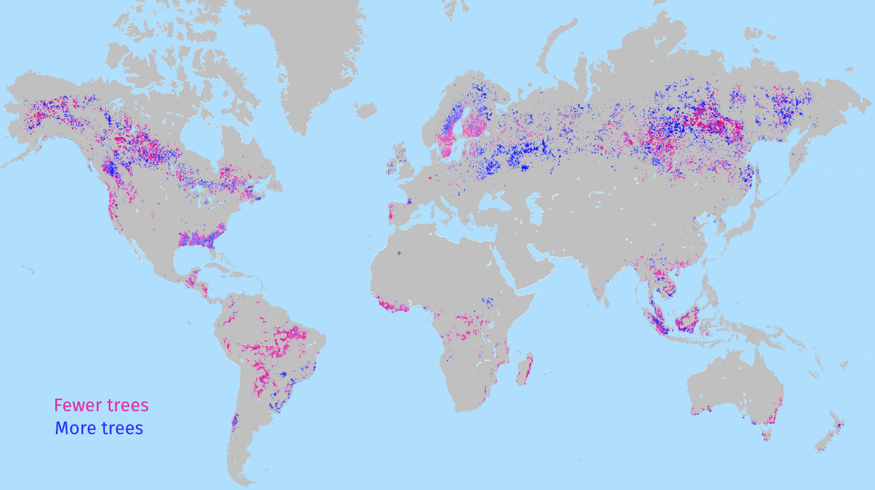
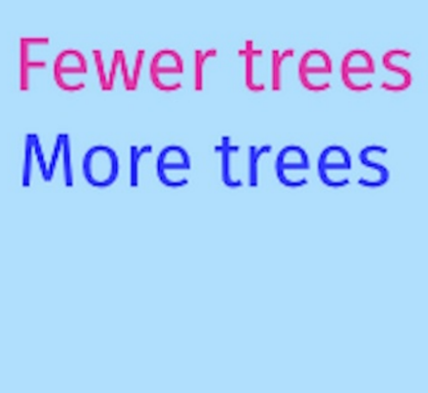
Hansen et al./Popatov et al., accessed through Global Forest Watch 25/3/25
Notes:
This map shows tree-cover gain 2000-2020 and loss 2000-2023
Next slide is an alternative version that shows the forest extent and labels as well as the changes

Slide 10
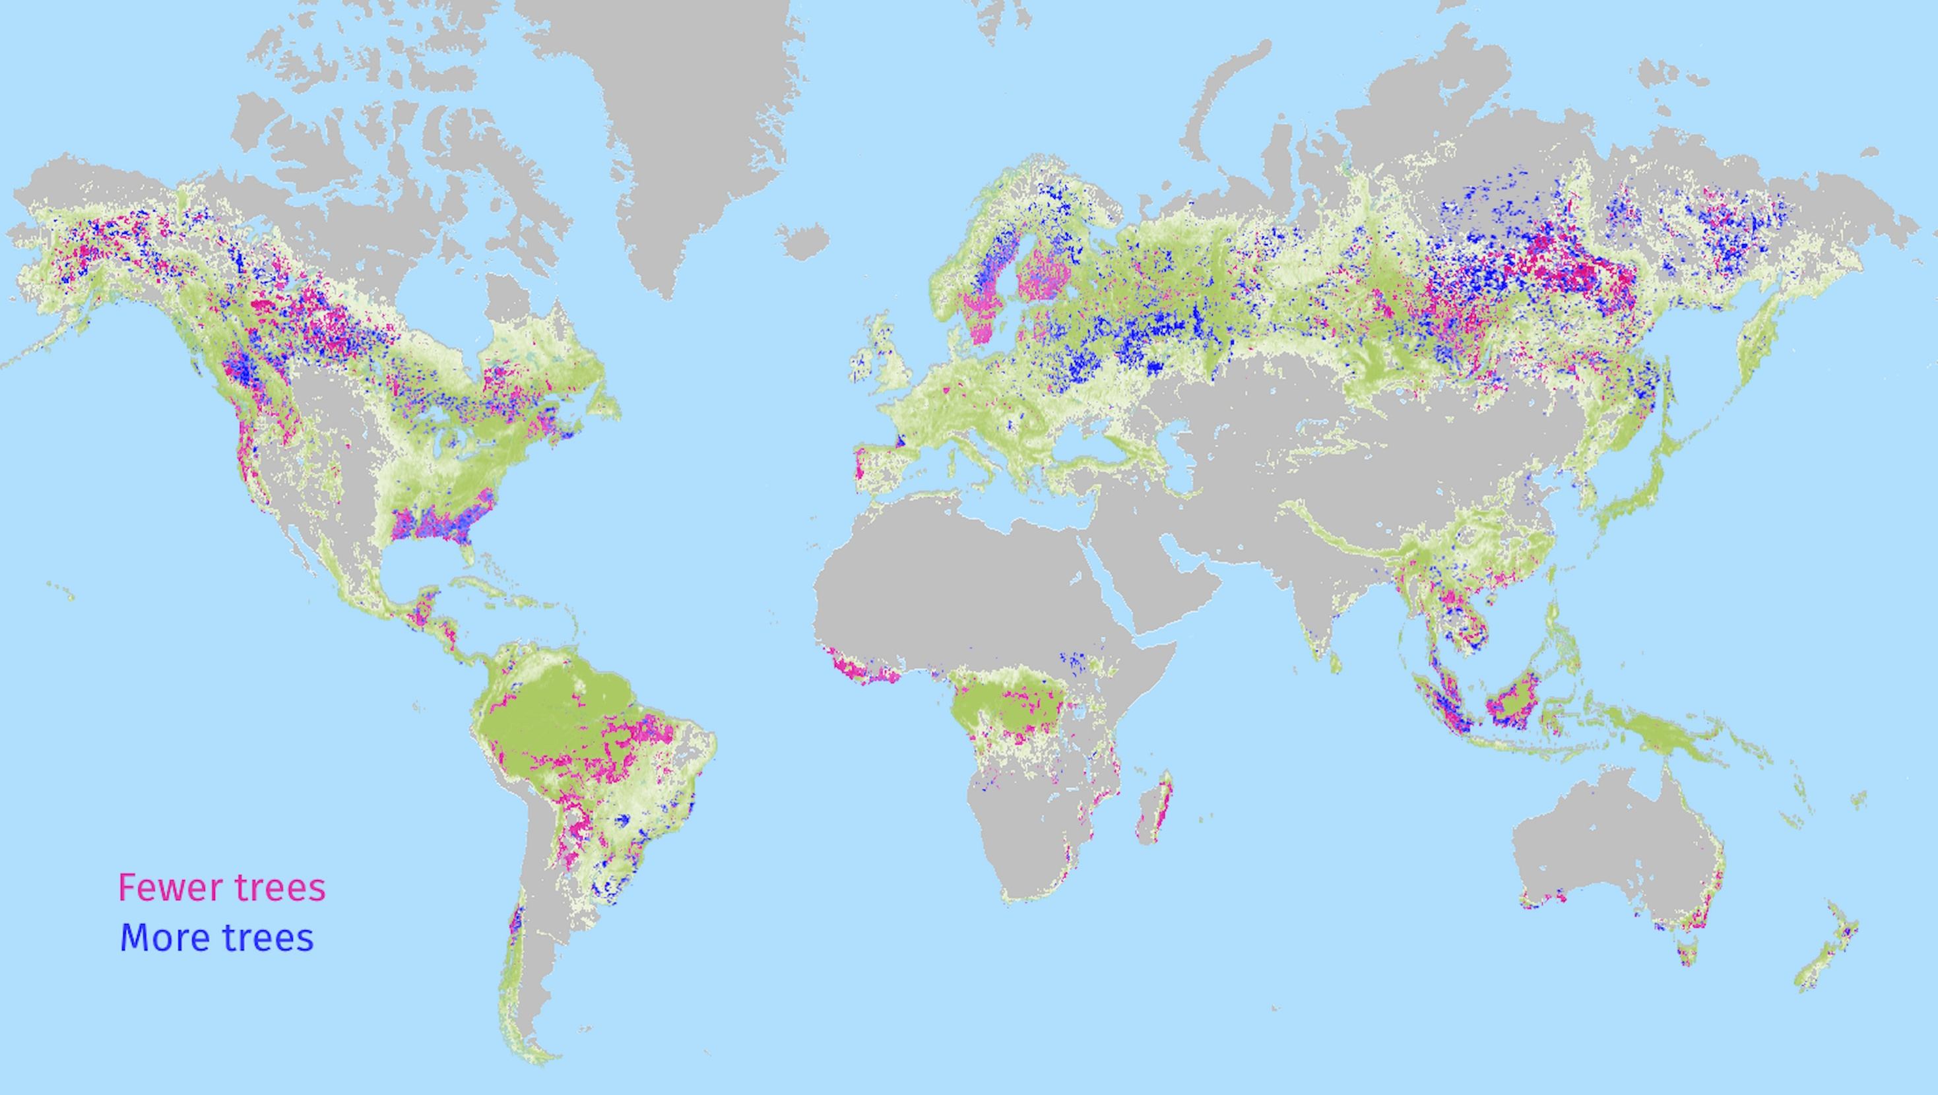
Sweden and Finland
Russia
North America
South-east Asia
Congo
Amazon
Indonesia
Hansen et al./Popatov et al., accessed through Global Forest Watch 25/3/25
Notes:
This map shows tree-cover gain 2000-2020 and loss 2000-2023

Slide 11
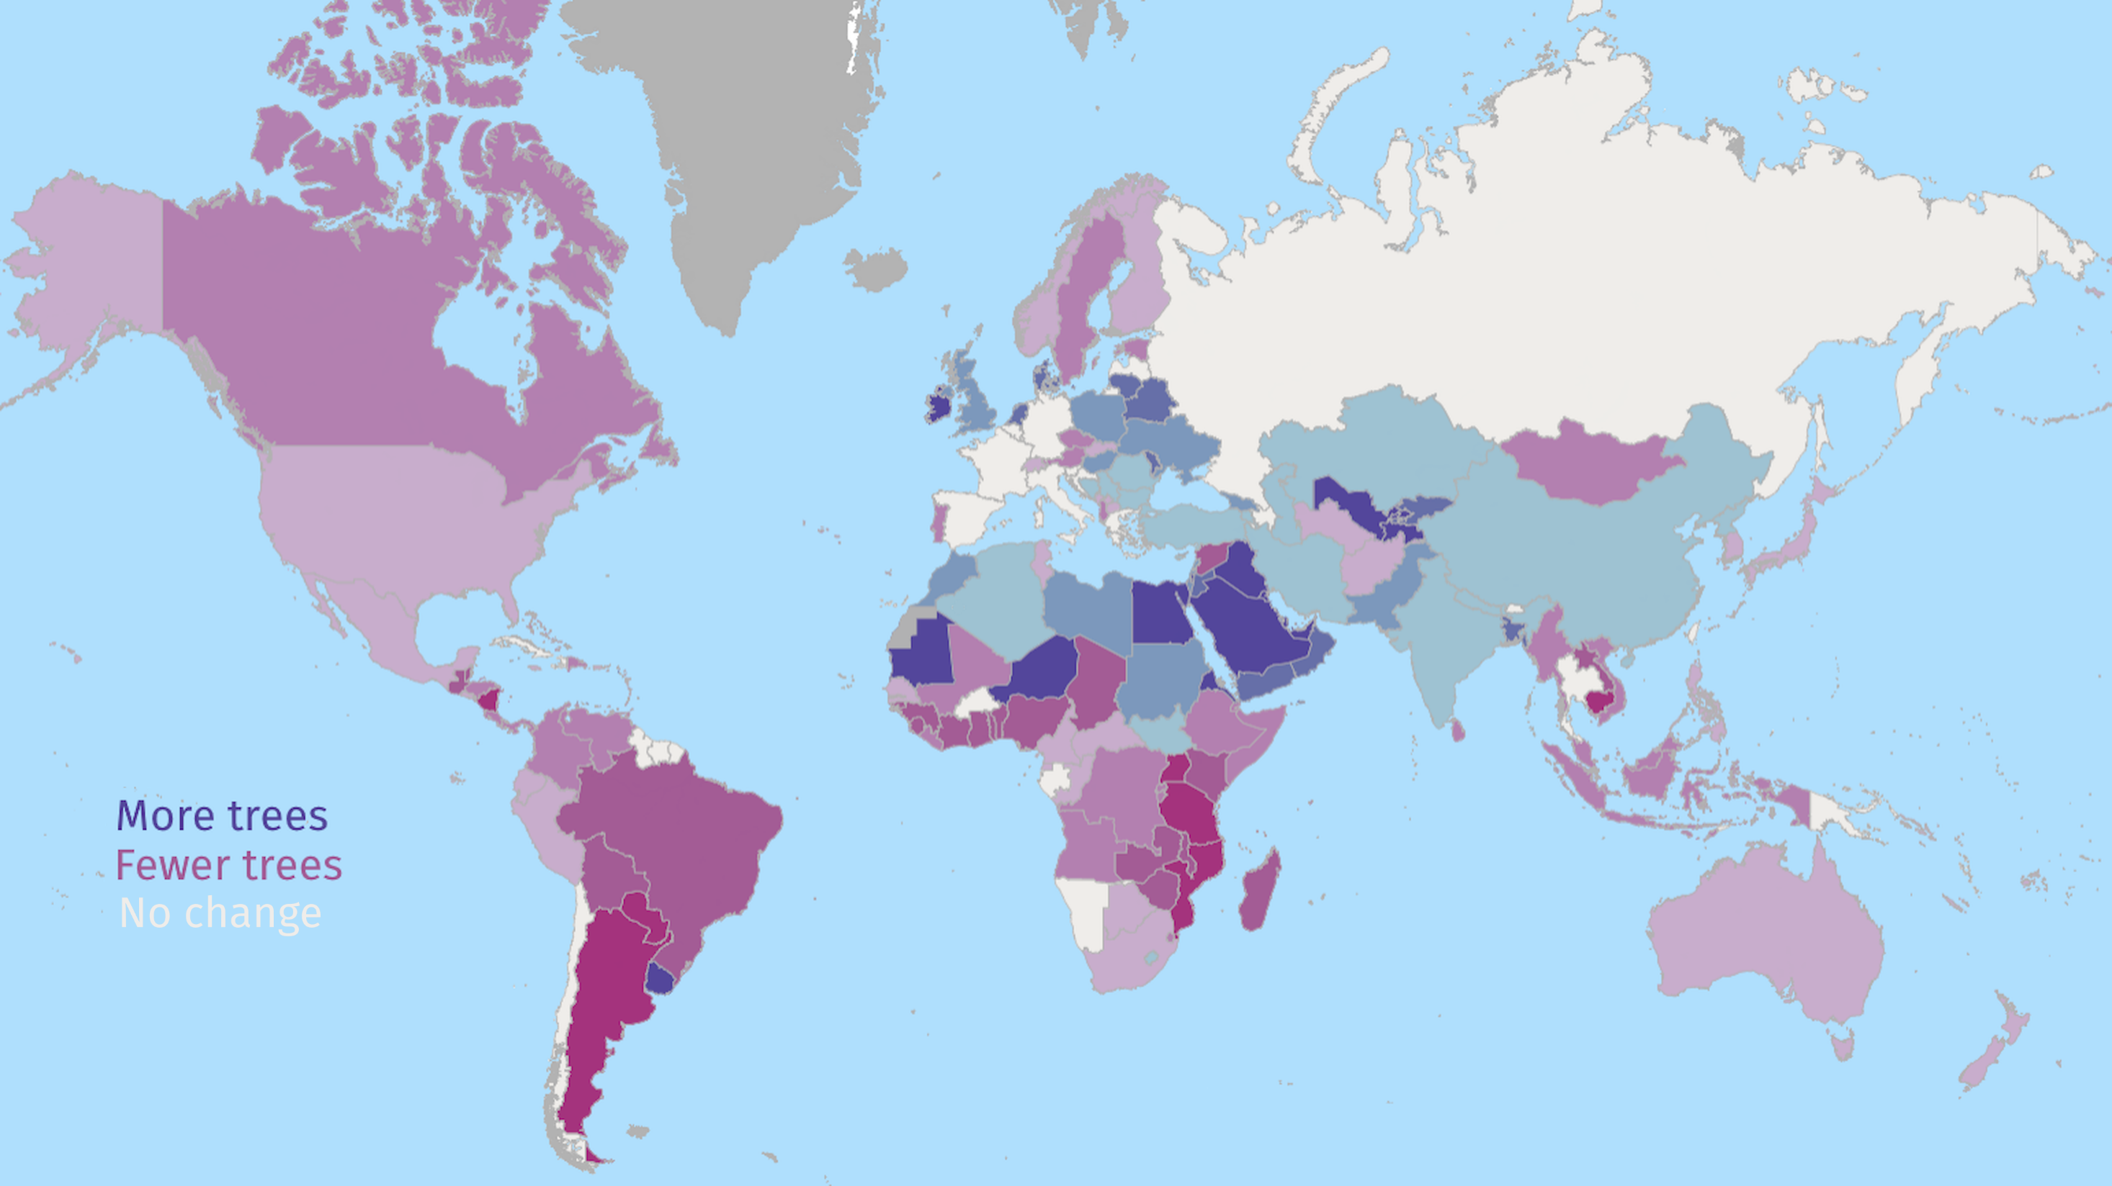
Popatov et al., accessed through Global Forest Watch 25/3/25
Notes:
Average change per country 2000-2020: the darker the colour the greater the change (compare with slides 9 & 10 to see how this hides variation within a country).
Greenland – no data

Slide 12
Changing forests 4
On your map of the world:
Use one colour to show the main areas where there are fewer trees now than in 2000.
Use another colour to show the main areas where there are more trees now than in 2000.
Remember to add these new colours
to the right boxes in the key.

Slide 13
Changing forests
Why do some places have more trees now than in 2000?
Why do some places have fewer trees now than in 2000?
Sabrina Schmidt from Pixabay

Slide 14
More trees | Fewer trees
People have planted trees: to replace trees cut down to make bigger forests to make homes for animals … Trees have grown: in burned areas in unfarmed fields on waste ground … | People have chopped down trees: for timber for fuel to build on (roads, houses …) to plant crops instead … Trees have died when they have: blown over in storms been burned in wildfires become diseased been eaten by animals … Trees covered in water: due to sea-level rise when a river is dammed …

Slide 15
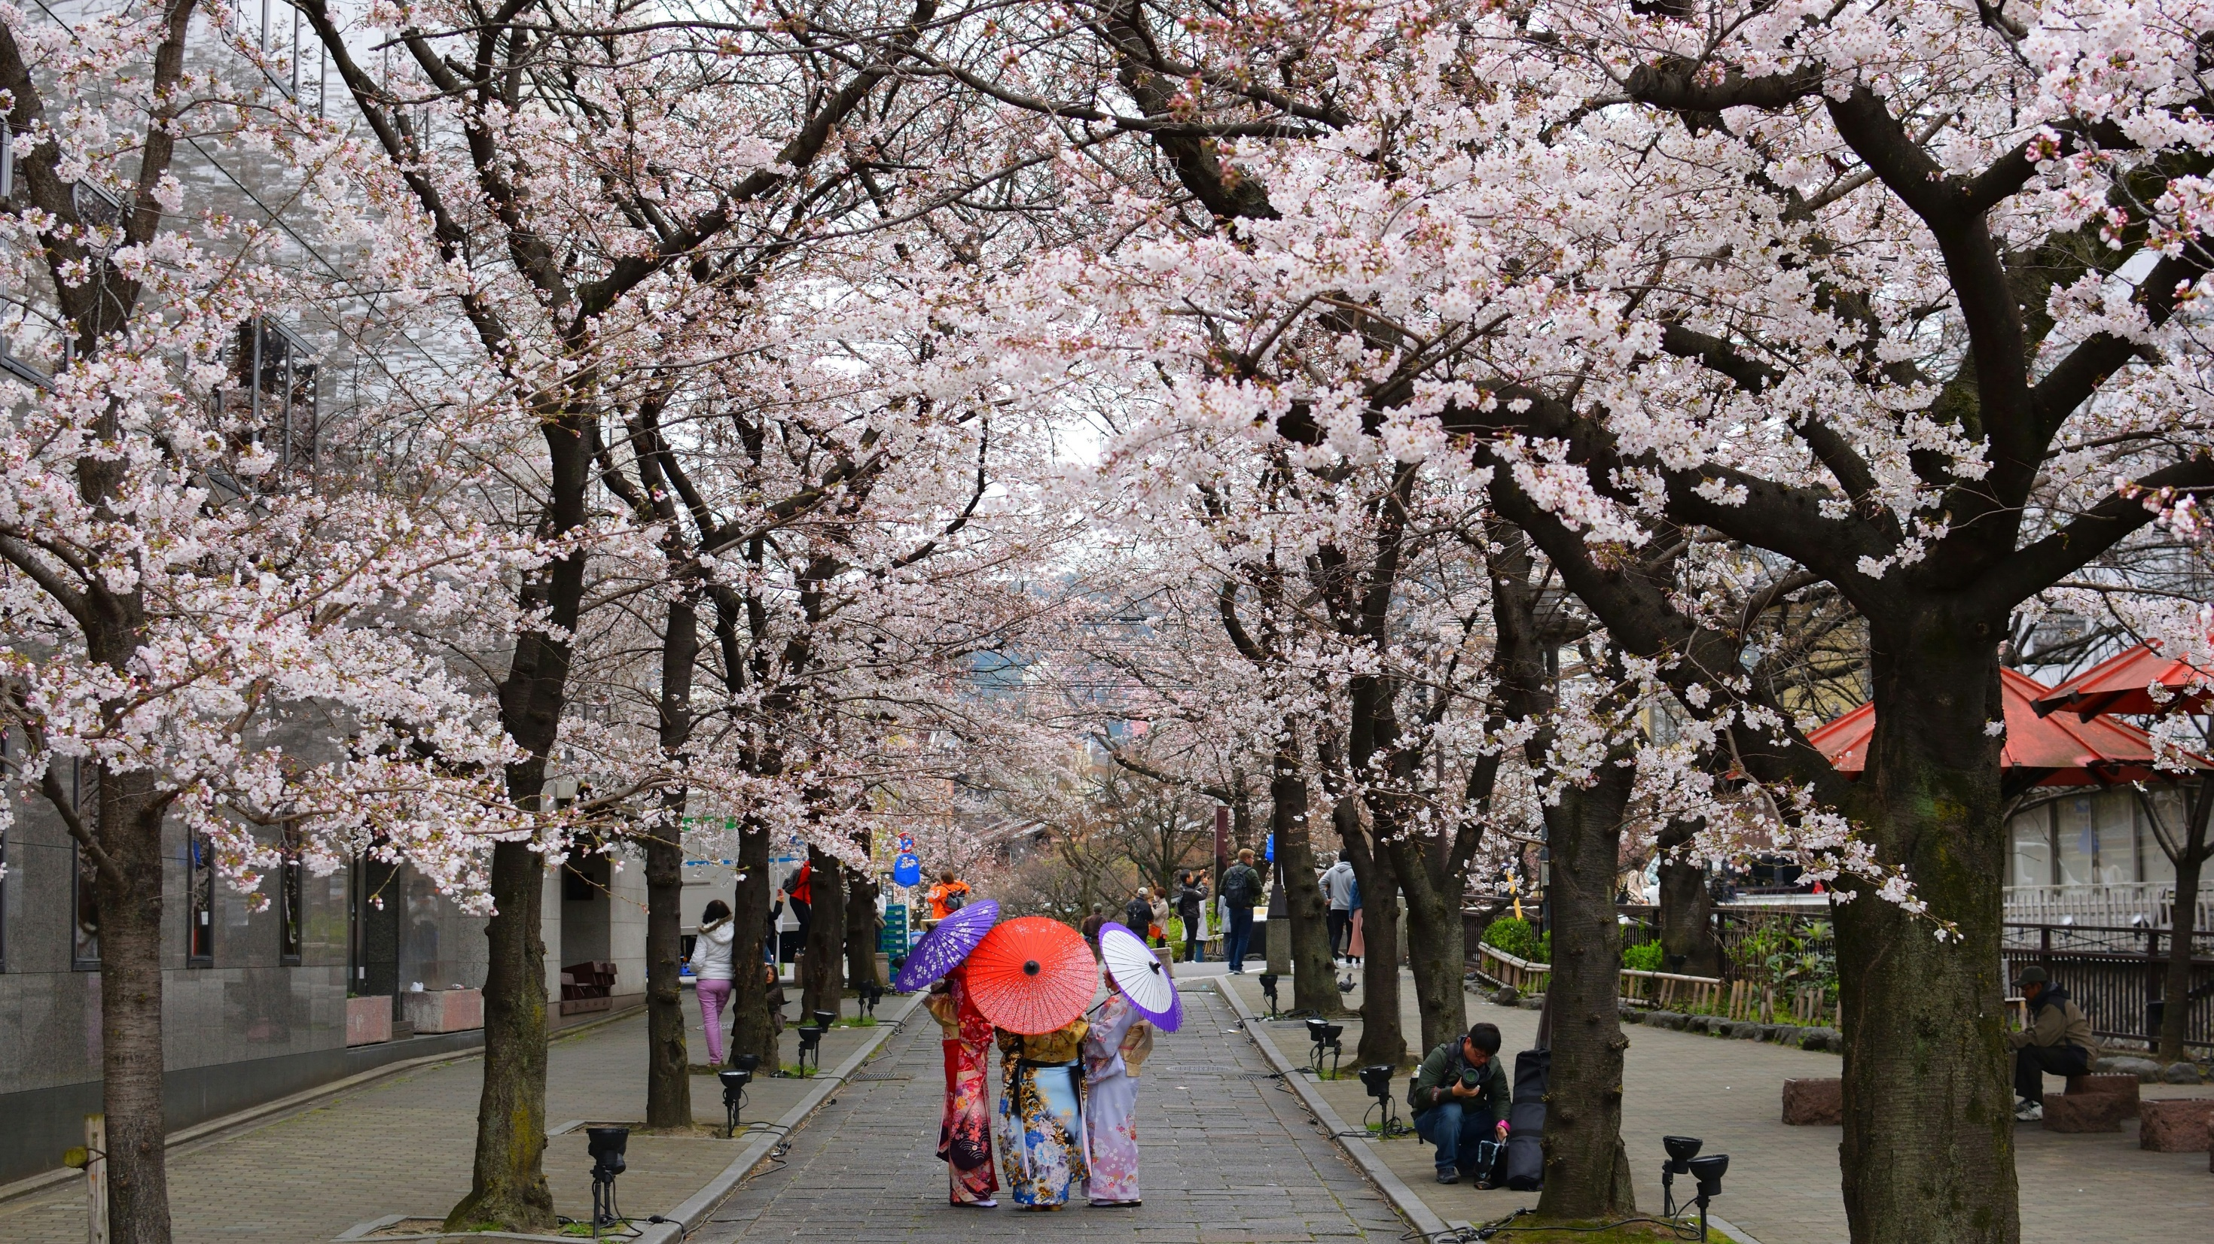
Pavlo Klein on Unsplash

Slide 16
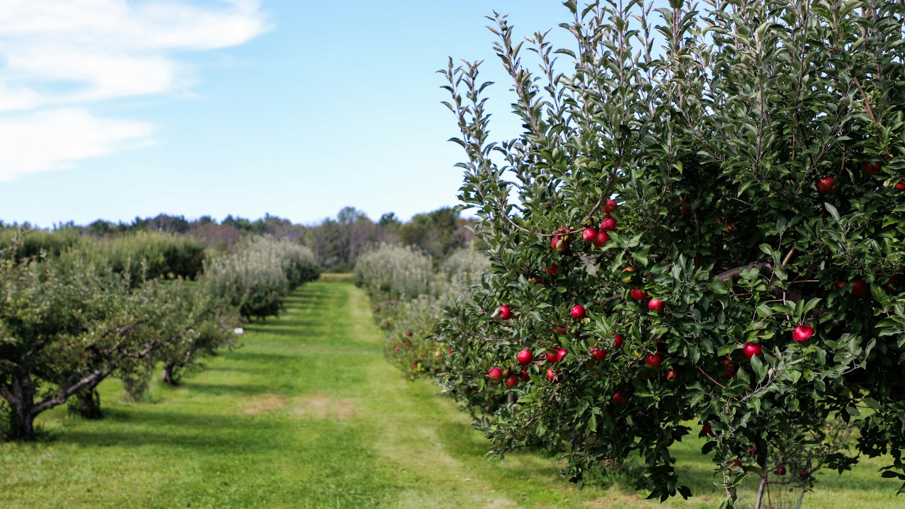
Michael & Diane Weidner on Unsplash

Slide 17
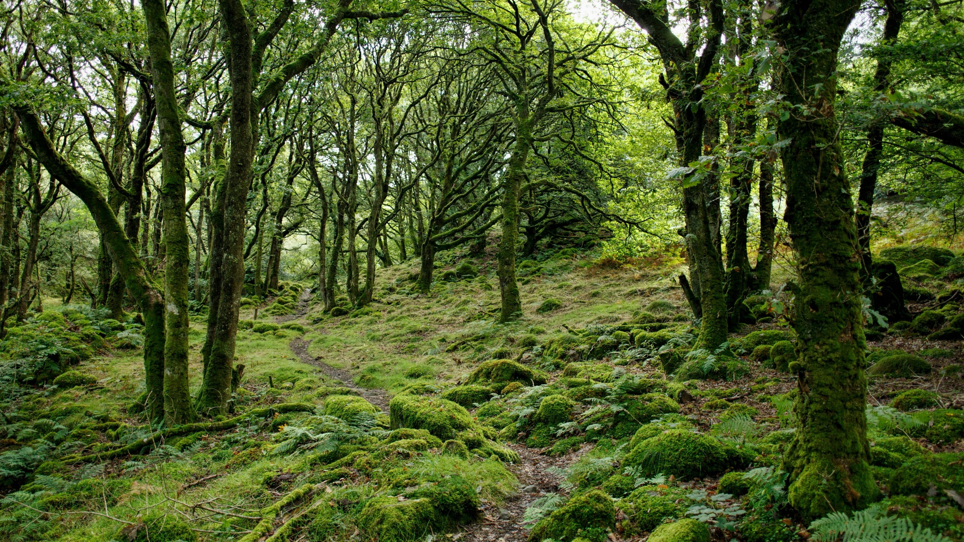
Marc Pell on Unsplash

Slide 18
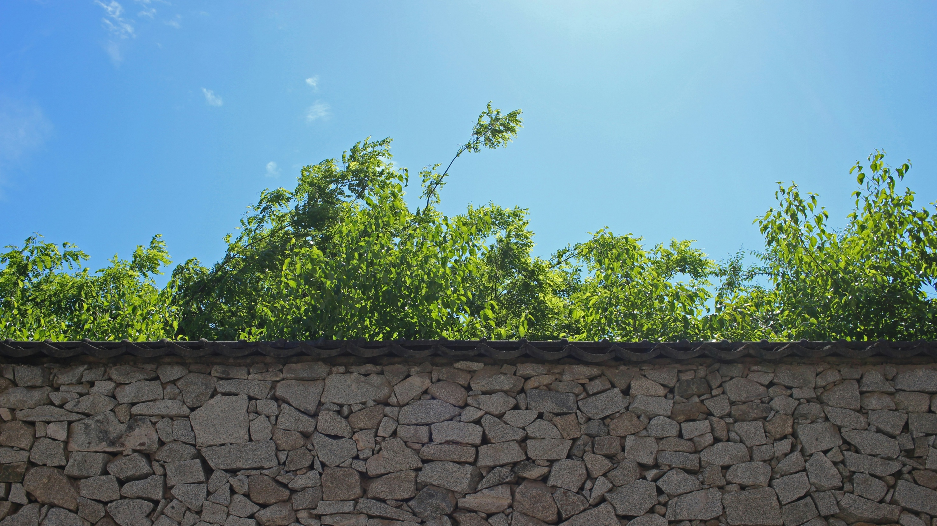
J Shim on Unsplash

Slide 19
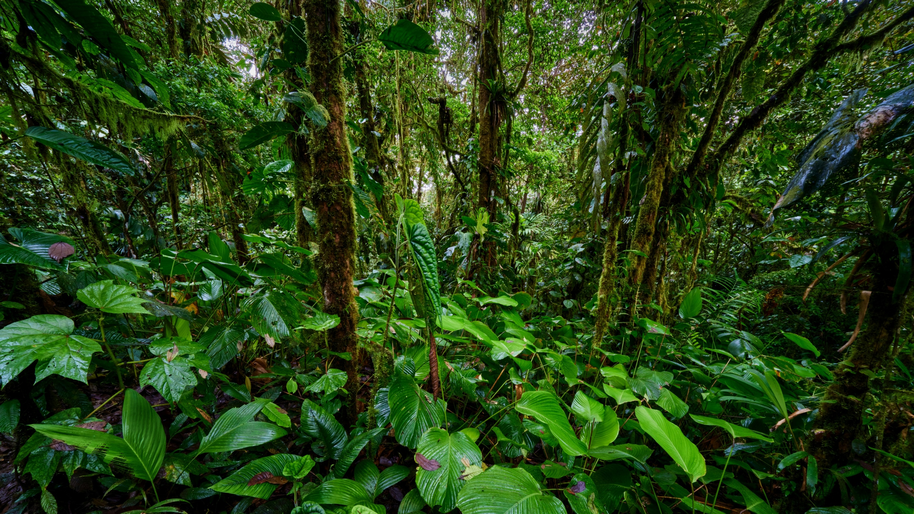
Zdeněk Macháček on Unsplash

Slide 20
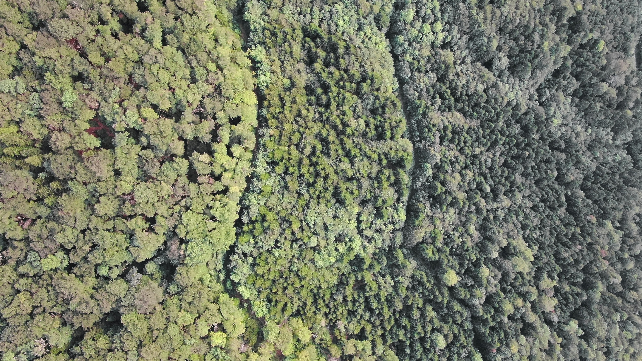
Nathan Queloz on Unsplash

Slide 21
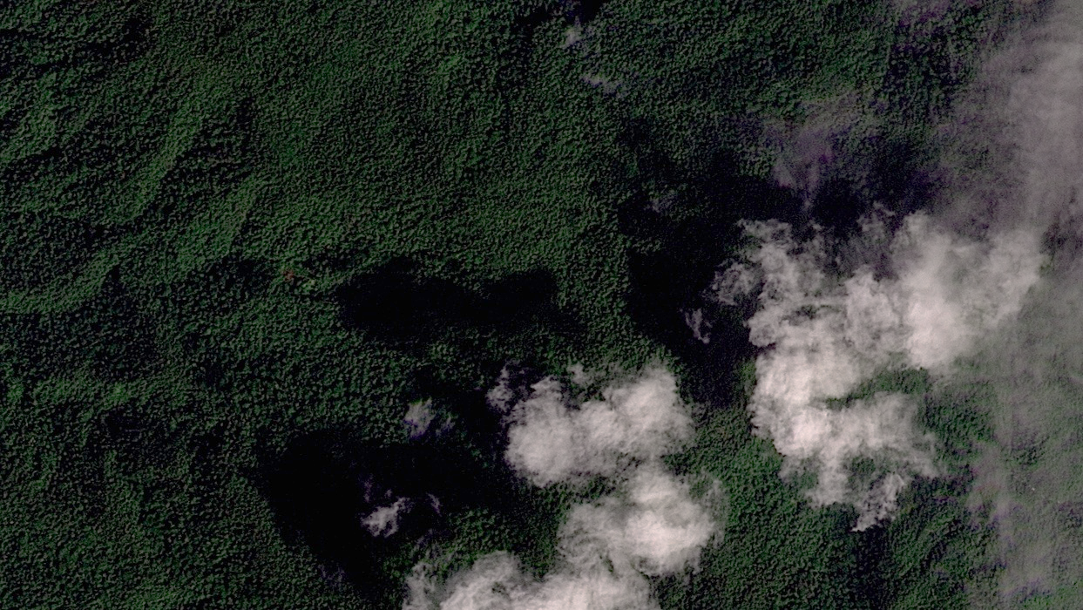
© 2025 Planet Labs

Slide 22
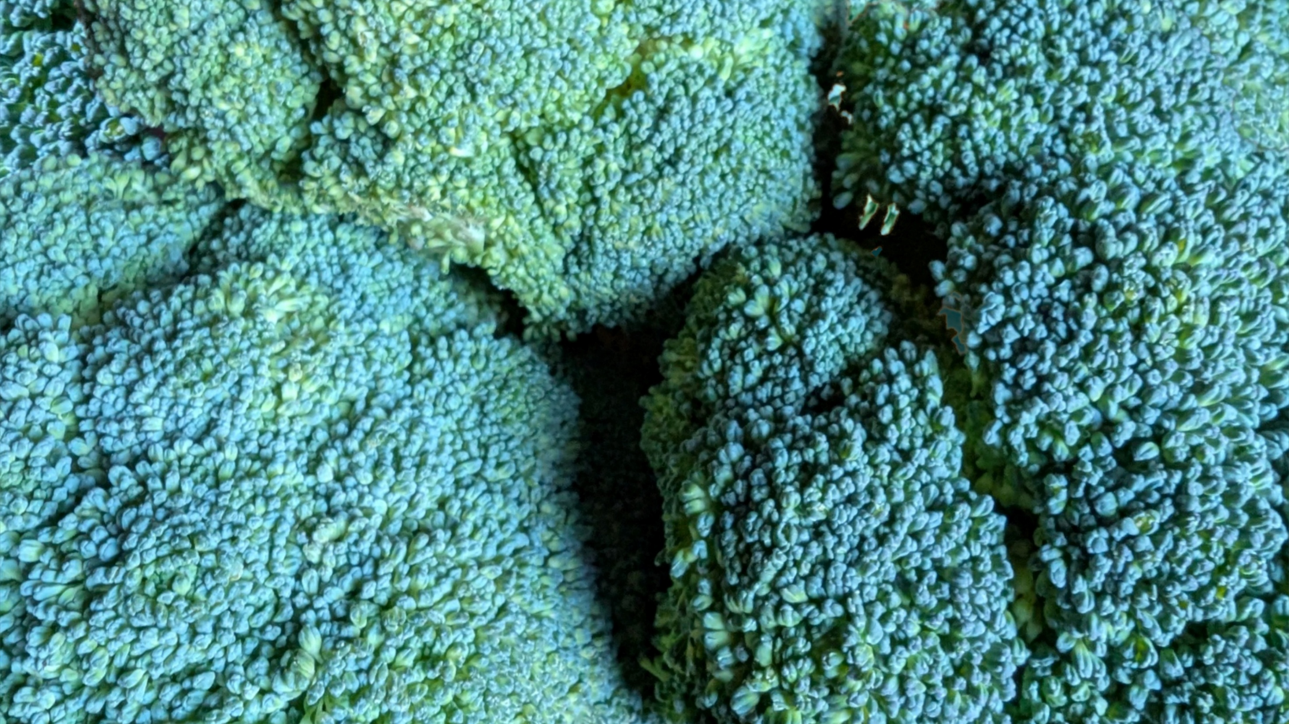

CAF

Slide 23

Łukasz Winiarski from Pixabay | CAF

Slide 24

Łukasz Winiarski from Pixabay | CAF

Slide 25
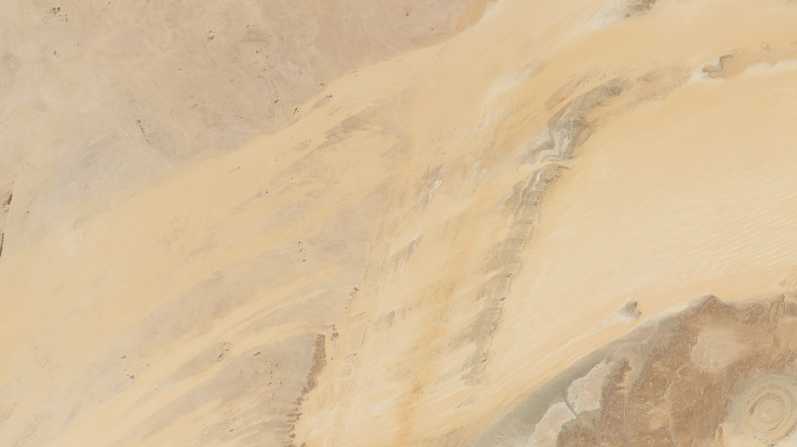
Contains Copernicus Sentinel 2 data (2025) and image from hrm on Adobe Stock (education licence)

Slide 26
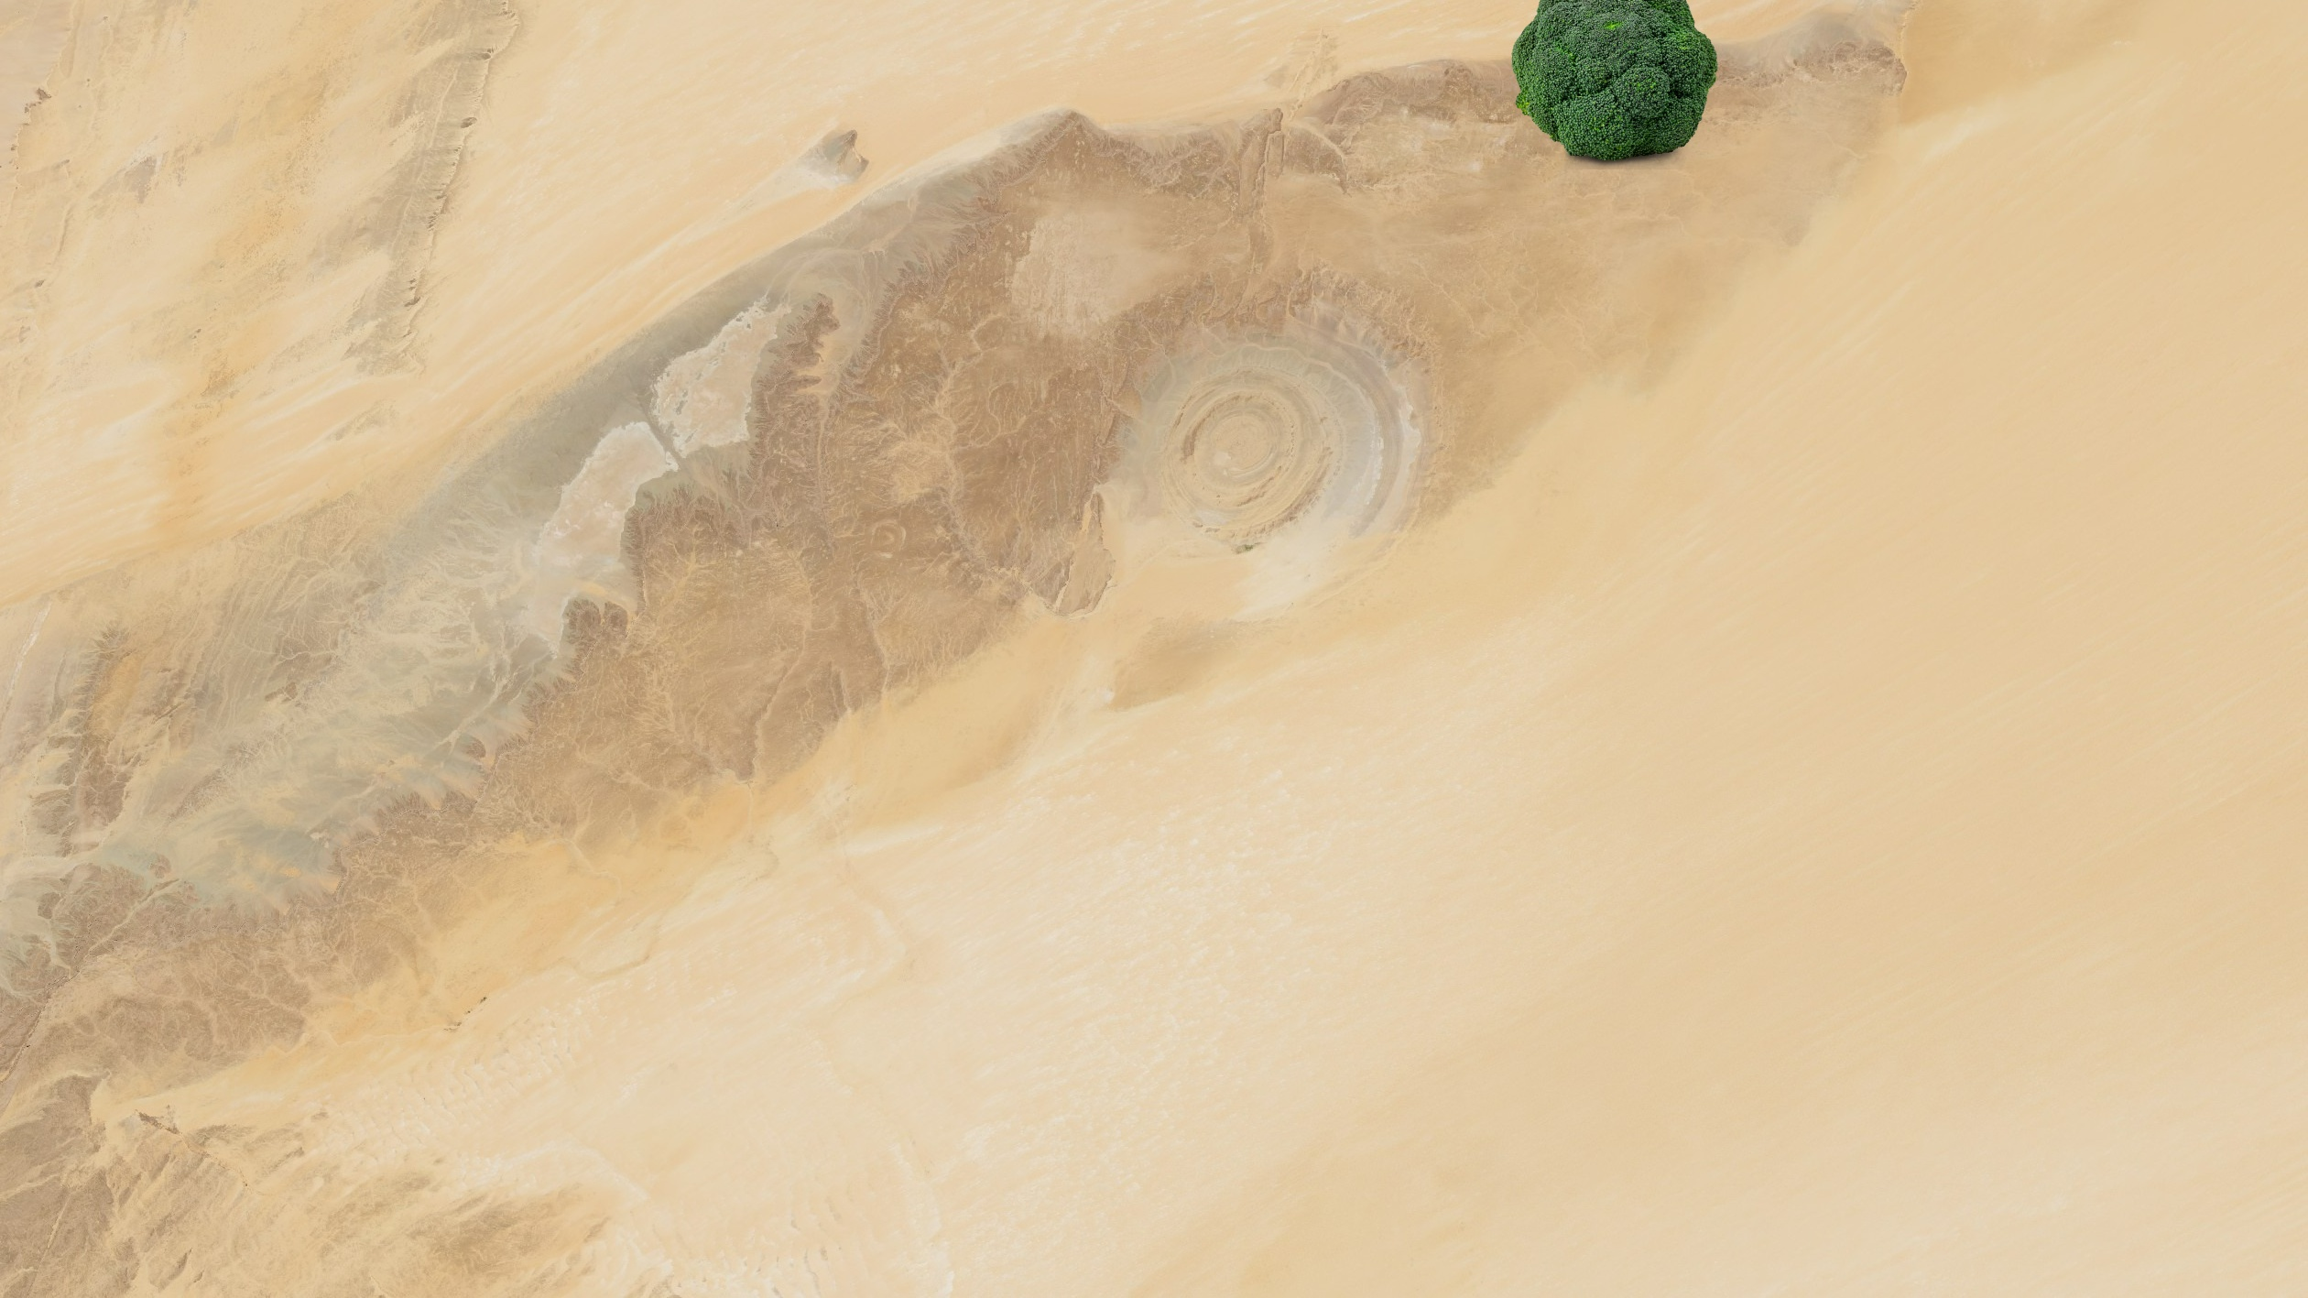
Contains Copernicus Sentinel 2 data (2025) and image from hrm on Adobe Stock (education licence)

Slide 27
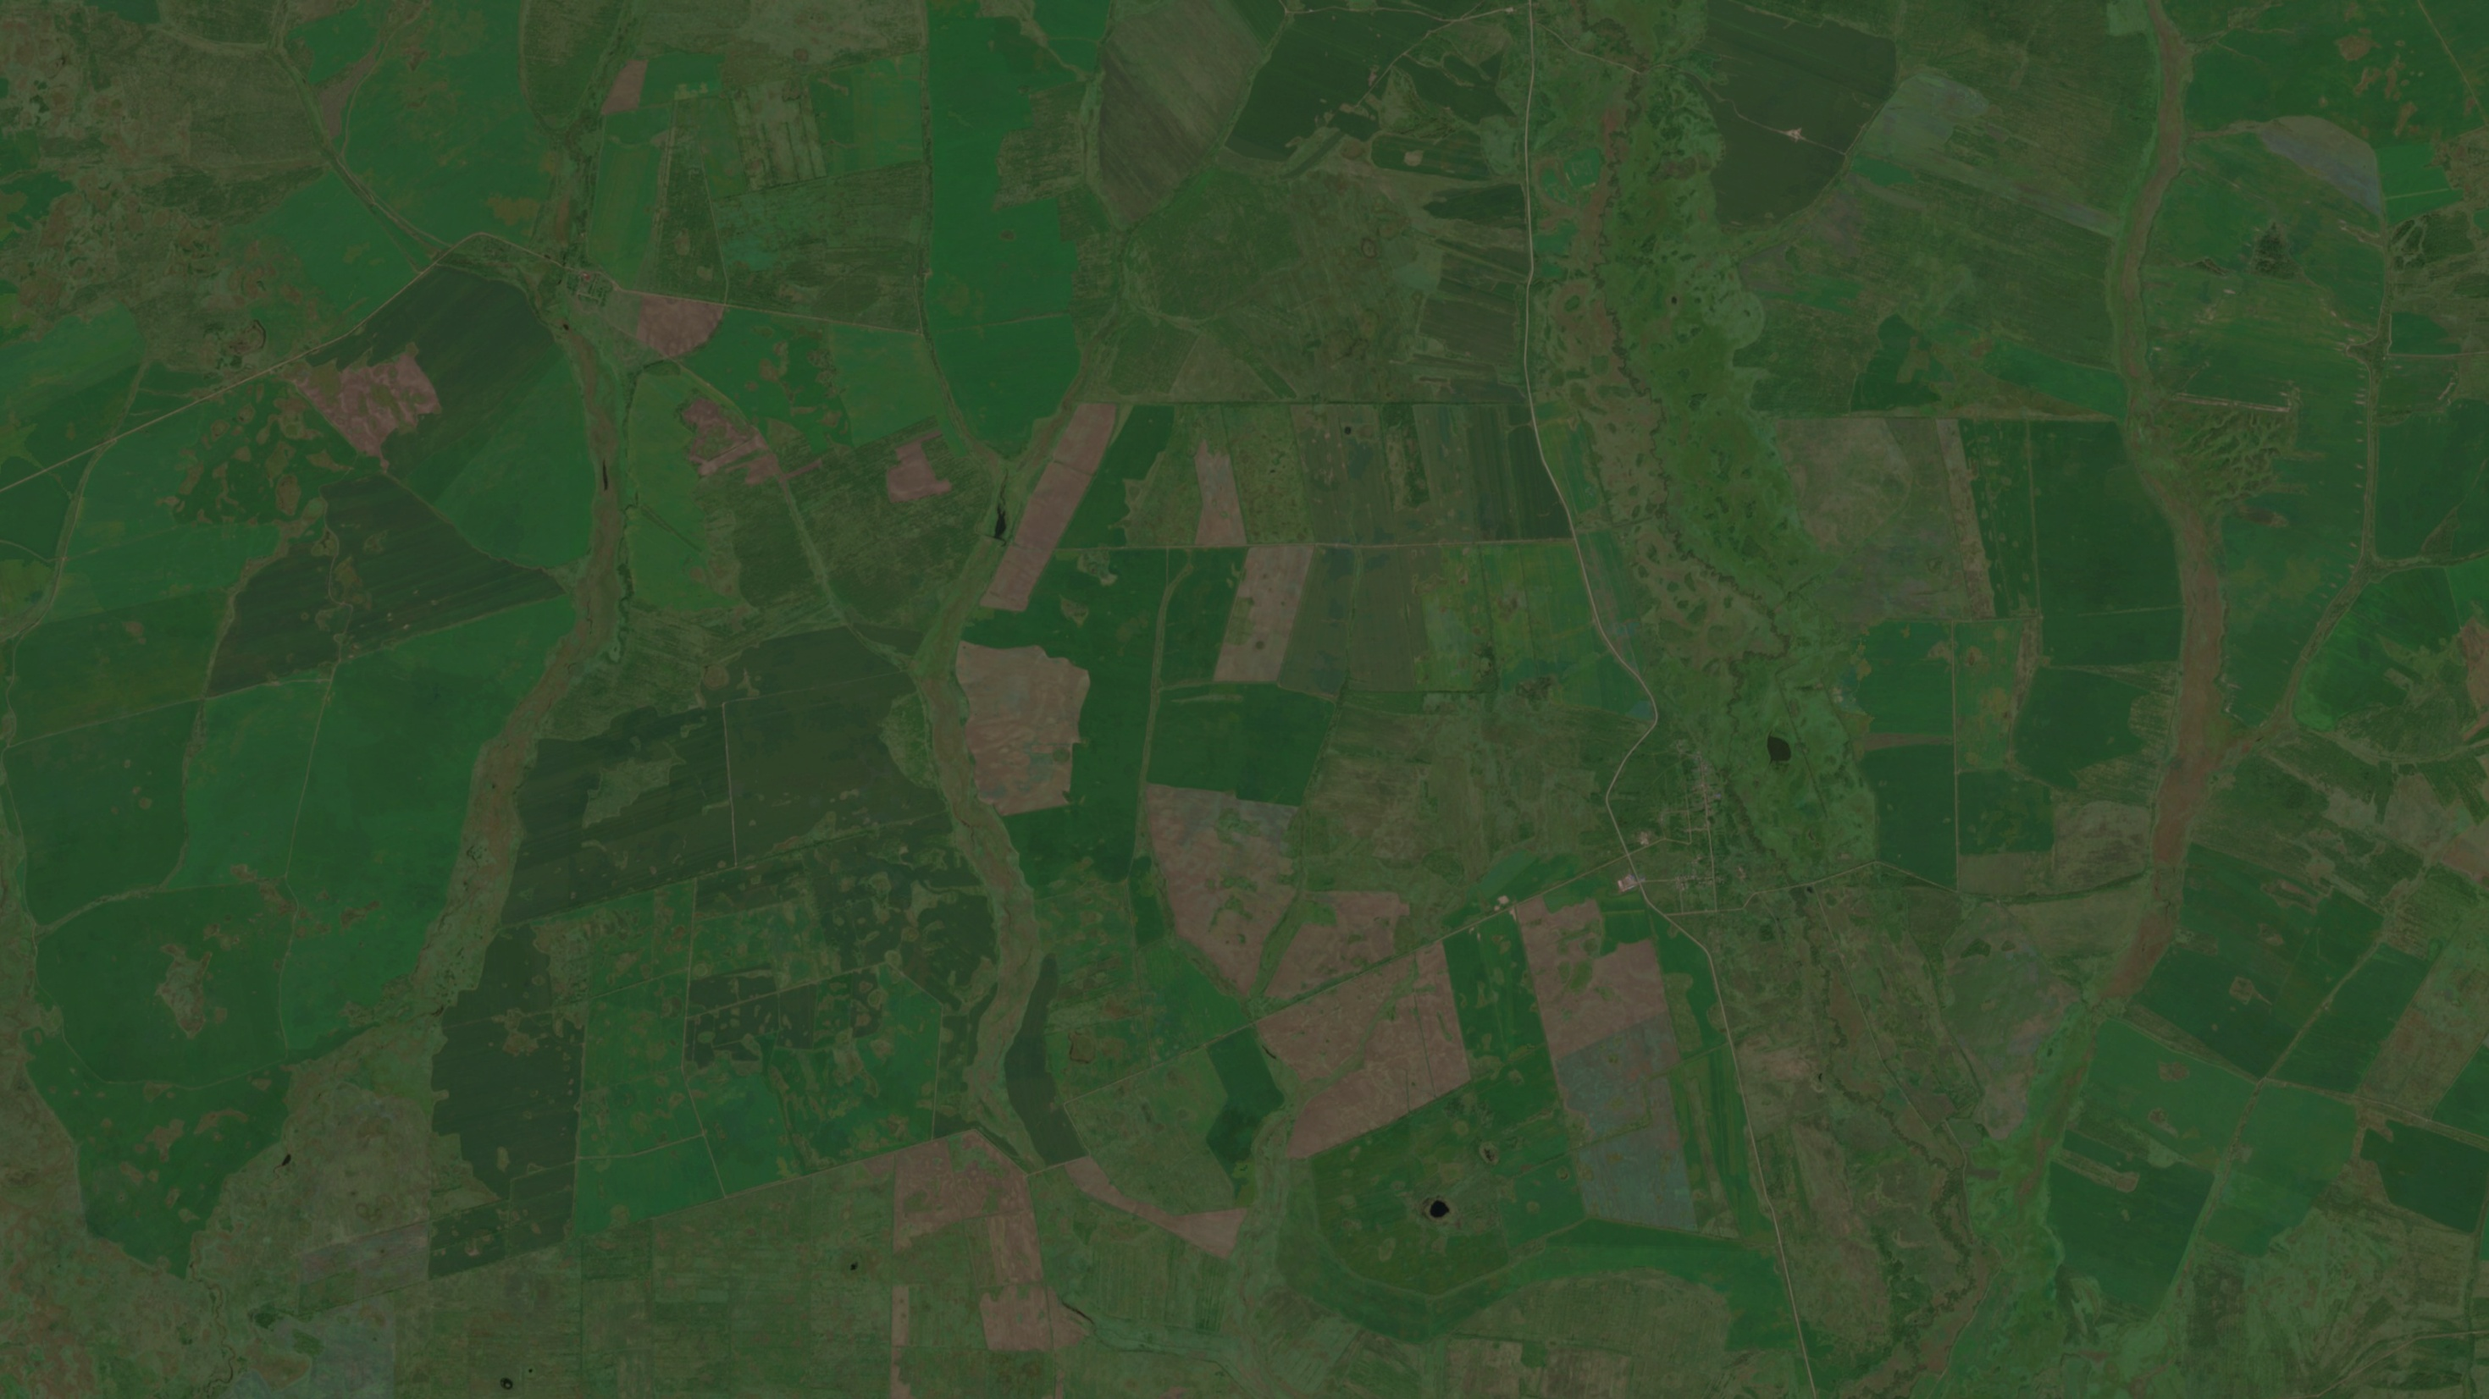
Contains Copernicus Sentinel 2 data (2024) and image from hrm on Adobe Stock (education licence)

Slide 28
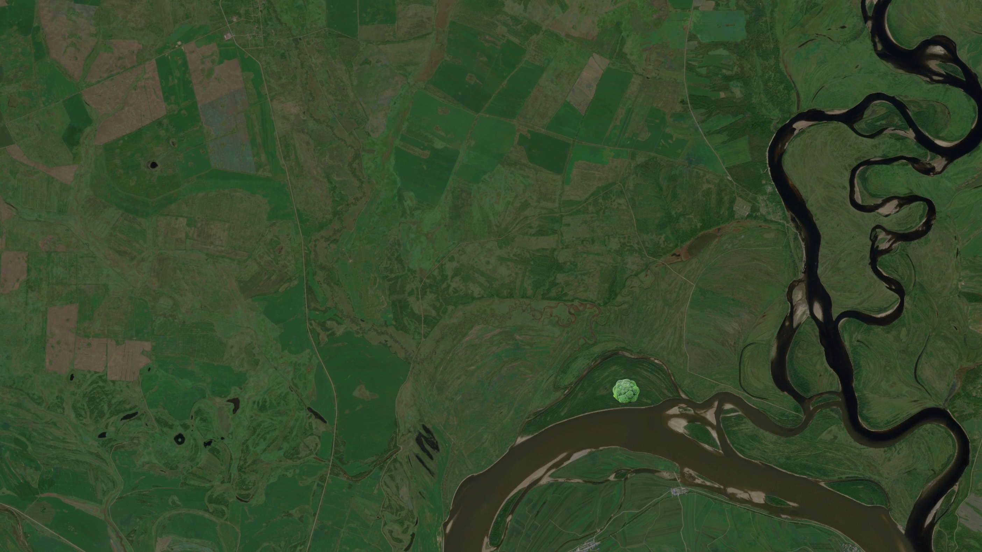
Contains Copernicus Sentinel 2 data (2024) and image from hrm on Adobe Stock (education licence)

Slide 29
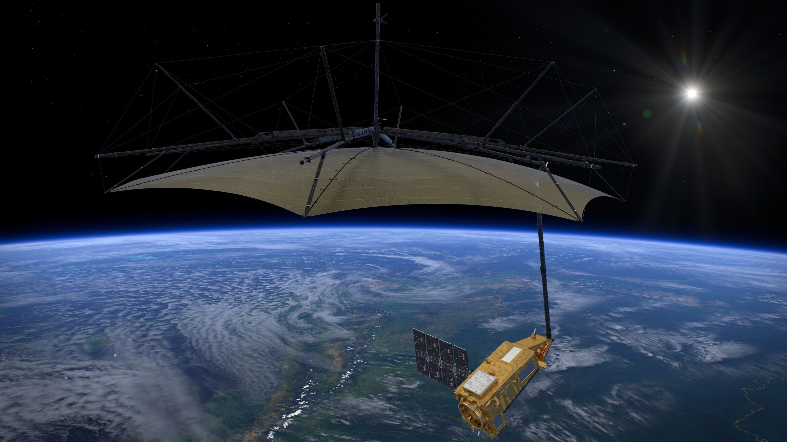
ESA/ATG medialab

Slide 30
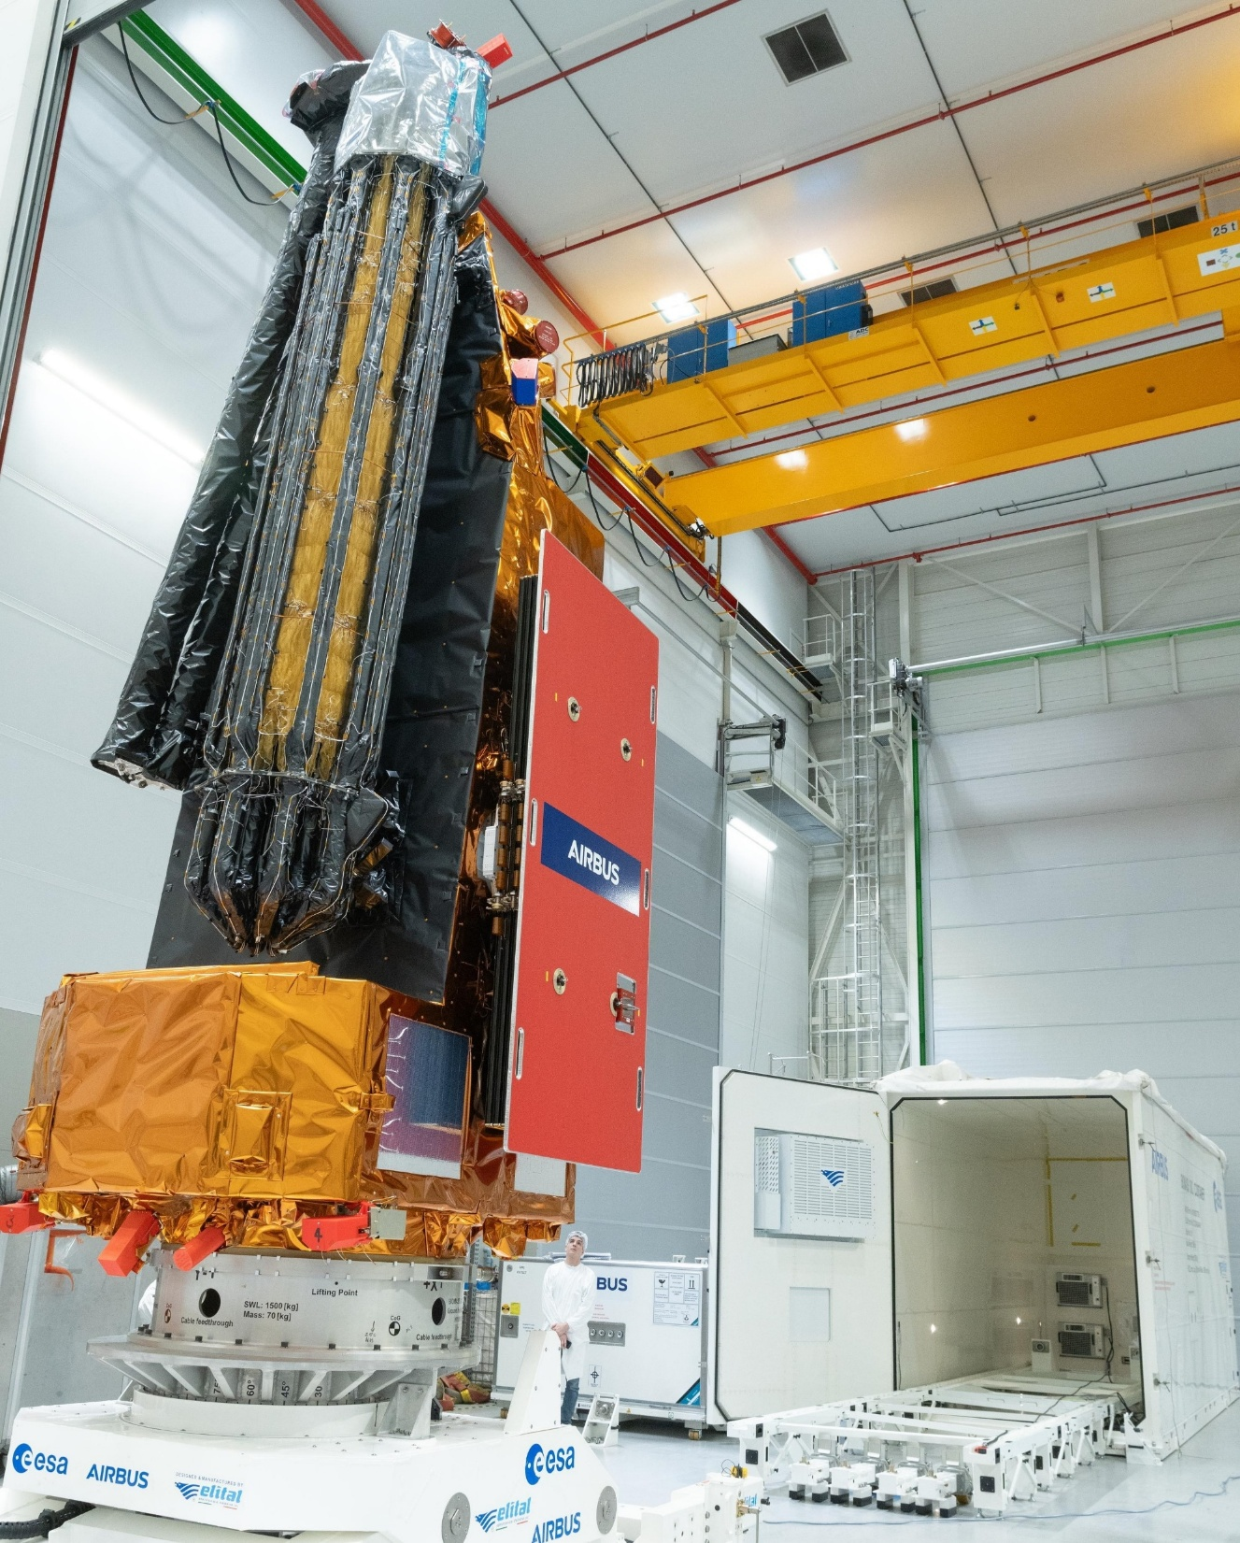

Patch: ESA Photo: ESA–P. Sebirot
Notes:
The photograph shows Biomass folded down for shipping and launch: the solar panels and reflector will unfold once it is in space.
The person in the picture gives some idea of the size of the satellite.
The ESA patch features flags of all ESA member countries. Which one is not in Europe?

Slide 31

ESA

