Slide 1
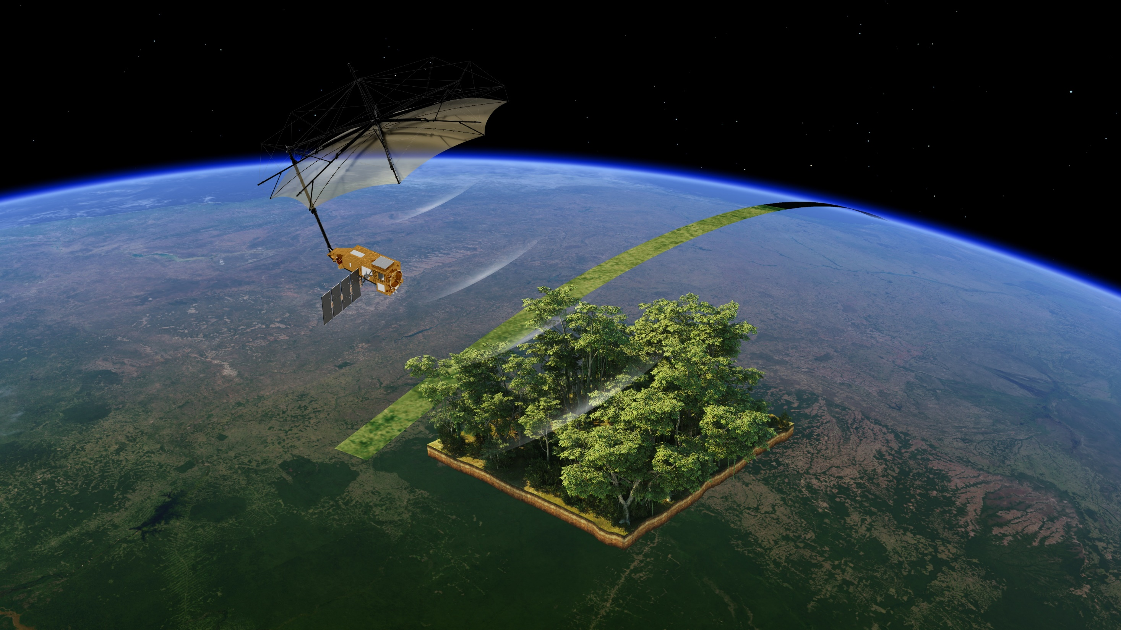


What do trees do?
How can we count trees?
ESA/ATG medialab

Slide 2


Describe some ways trees help other living things, including us.
Match some of these jobs to the right part of the tree.
Explain how to count trees.
Know how the Biomass satellite will help.
Notes:
Lesson outcomes slide.
Title is blank so you can add the wording used in your school if you wish to share these at the start or/and end of the lesson.

Slide 3
tree
root
trunk
branches
leaves
fruit
flower
wood
needles
cones
canopy
ecosystem services
Notes:
Key words slide.
Title is blank so you can add the wording used in your school if you wish to share these at the start or/and end of the lesson.

Slide 4
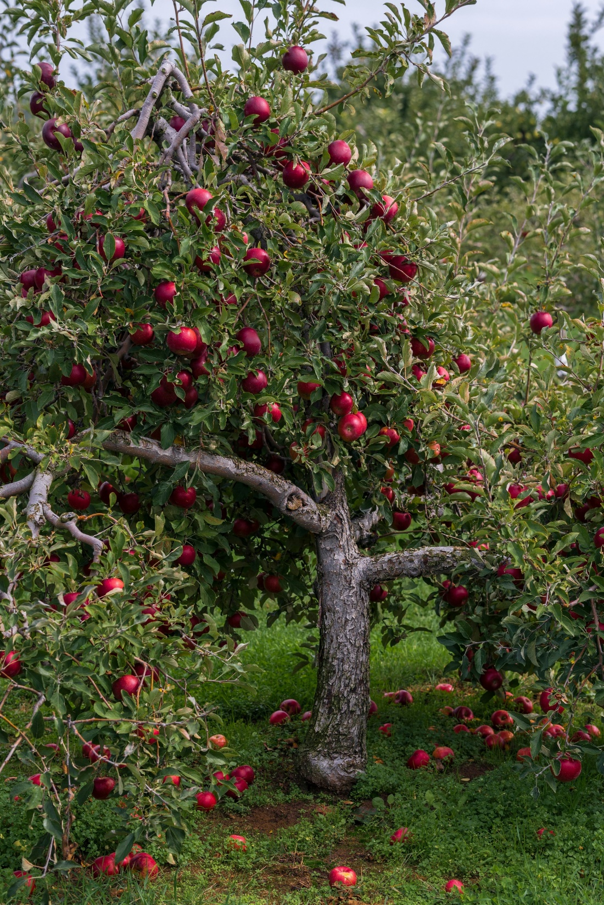
Emmalee Couturier on Unsplash

Slide 5
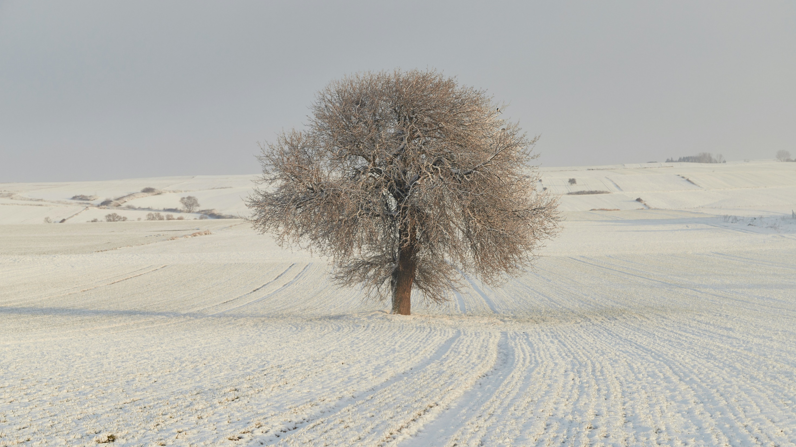

meriç tuna on Unsplash

Slide 6
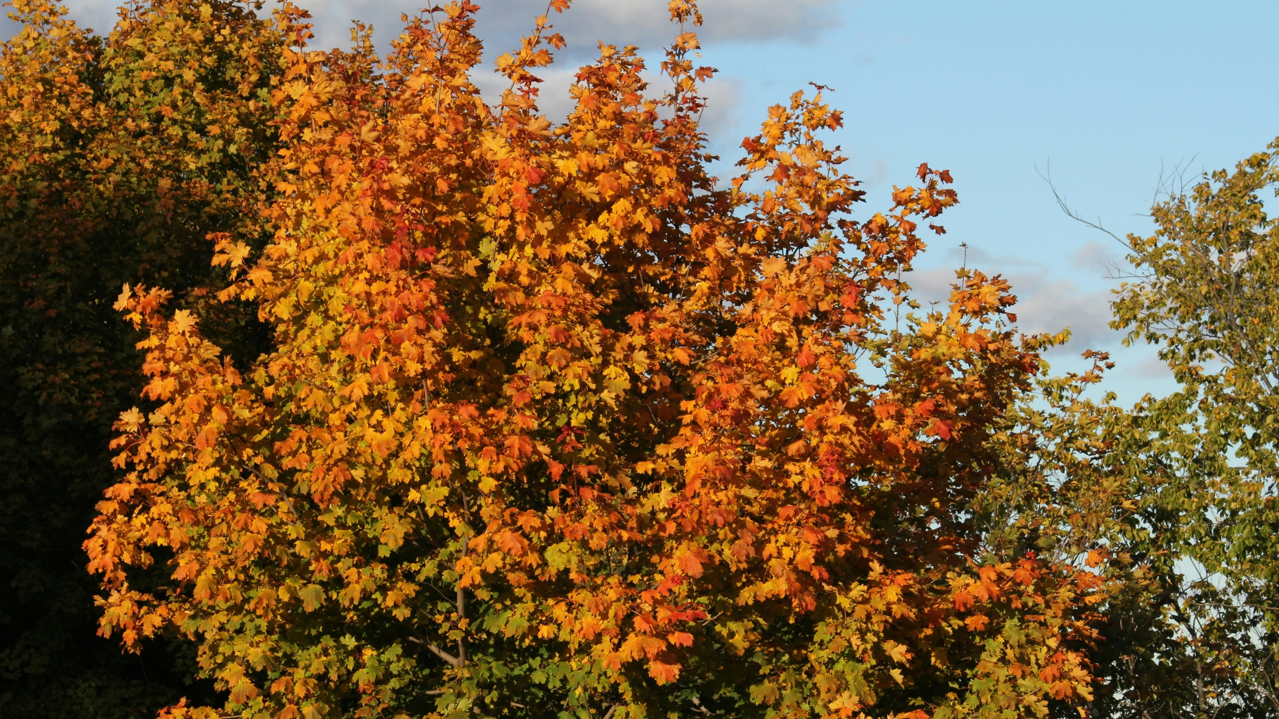
Chinmay B on Unsplash

Slide 7
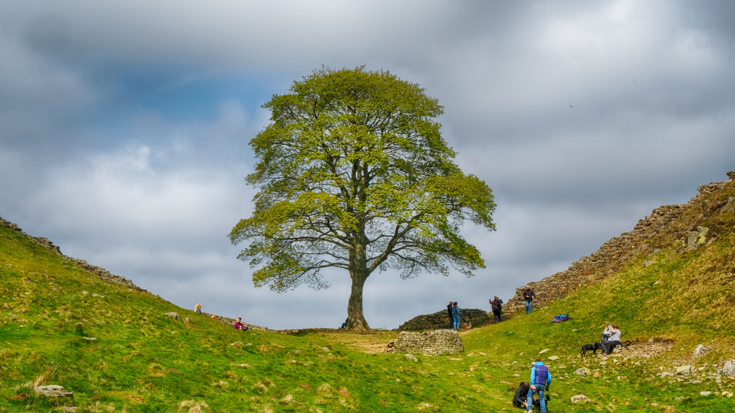
Tim Withnall on flickr

Slide 8

Credit
Manh Doi on Unsplash

Slide 9

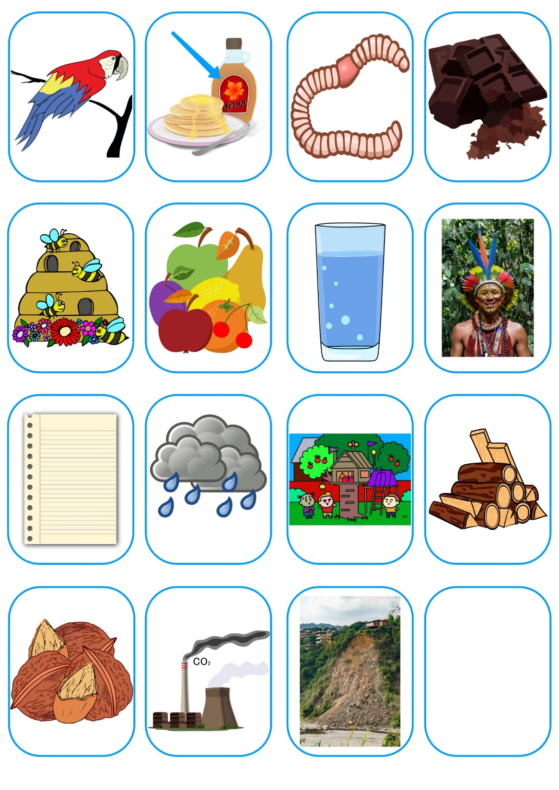
Image credits: see Teacher guide
Notes:
The slide shows the tree diagram to begin with. The cards appear on a second click.
Images and/or photos that are the copyrighted property of 123RF, its contributors or licensed partners (see Teacher guide) are used with permission under 123RF Free Image License. These images and/or photos may not be copied or downloaded without permission from 123RF.

Slide 10


Image credits: see Teacher guide
Notes:
The slide shows the tree diagram and card to begin with. The arrow to indicate the answer appears on a second click.
Images and/or photos that are the copyrighted property of 123RF, its contributors or licensed partners (see Teacher guide) are used with permission under 123RF Free Image License. These images and/or photos may not be copied or downloaded without permission from 123RF.

Slide 11
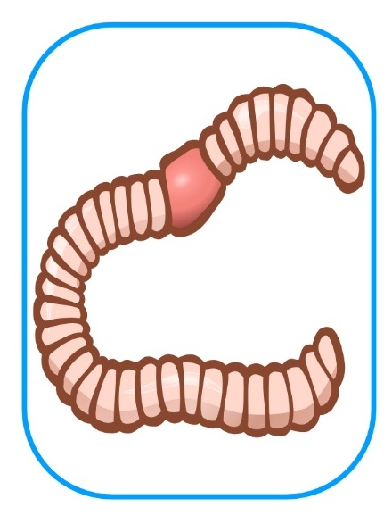
Image credits: see Teacher guide
Notes:
The slide shows the tree diagram and card to begin with. The arrow to indicate the answer appears on a second click.
Images and/or photos that are the copyrighted property of 123RF, its contributors or licensed partners (see Teacher guide) are used with permission under 123RF Free Image License. These images and/or photos may not be copied or downloaded without permission from 123RF.

Slide 12

Image credits: see Teacher guide
Notes:
The slide shows the tree diagram and card to begin with. The arrow to indicate the answer appears on a second click.
Images and/or photos that are the copyrighted property of 123RF, its contributors or licensed partners (see Teacher guide) are used with permission under 123RF Free Image License. These images and/or photos may not be copied or downloaded without permission from 123RF.

Slide 13
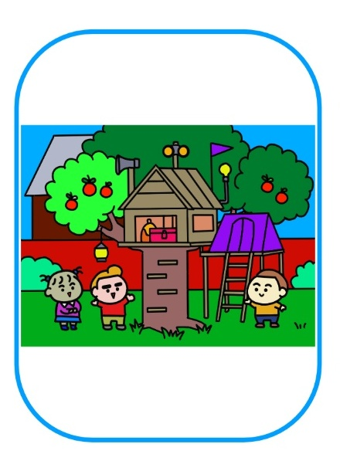
Image credits: see Teacher guide
Notes:
The slide shows the tree diagram and card to begin with. The arrow to indicate the answer appears on a second click.
Images and/or photos that are the copyrighted property of 123RF, its contributors or licensed partners (see Teacher guide) are used with permission under 123RF Free Image License. These images and/or photos may not be copied or downloaded without permission from 123RF.

Slide 14

Image credits: see Teacher guide
Notes:
The slide shows the tree diagram and card to begin with. The arrow to indicate the answer appears on a second click.
Images and/or photos that are the copyrighted property of 123RF, its contributors or licensed partners (see Teacher guide) are used with permission under 123RF Free Image License. These images and/or photos may not be copied or downloaded without permission from 123RF.

Slide 15

Image credits: see Teacher guide
Notes:
The slide shows the tree diagram and card to begin with. The arrow to indicate the answer appears on a second click.
Images and/or photos that are the copyrighted property of 123RF, its contributors or licensed partners (see Teacher guide) are used with permission under 123RF Free Image License. These images and/or photos may not be copied or downloaded without permission from 123RF.

Slide 16
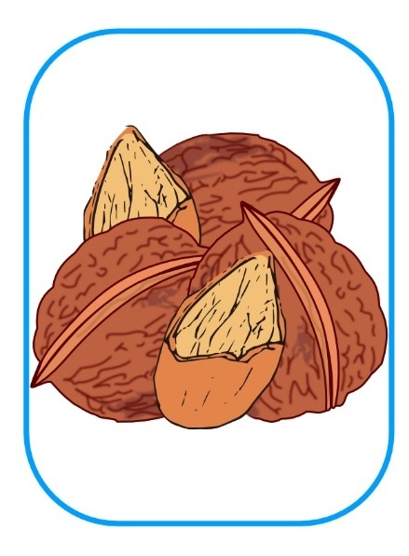
Image credits: see Teacher guide
Notes:
The slide shows the tree diagram and card to begin with. The arrow to indicate the answer appears on a second click.
Images and/or photos that are the copyrighted property of 123RF, its contributors or licensed partners (see Teacher guide) are used with permission under 123RF Free Image License. These images and/or photos may not be copied or downloaded without permission from 123RF.

Slide 17

Image credits: see Teacher guide
Notes:
The slide shows the tree diagram and card to begin with. The arrow to indicate the answer appears on a second click.
Images and/or photos that are the copyrighted property of 123RF, its contributors or licensed partners (see Teacher guide) are used with permission under 123RF Free Image License. These images and/or photos may not be copied or downloaded without permission from 123RF.

Slide 18

Image credits: see Teacher guide
Notes:
The slide shows the tree diagram and card to begin with. The arrow to indicate the answer appears on a second click.
Images and/or photos that are the copyrighted property of 123RF, its contributors or licensed partners (see Teacher guide) are used with permission under 123RF Free Image License. These images and/or photos may not be copied or downloaded without permission from 123RF.

Slide 19
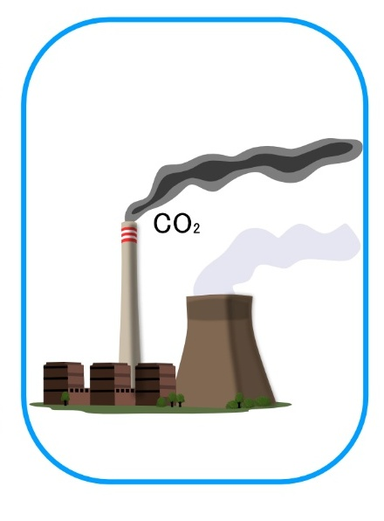
Image credits: see Teacher guide
Notes:
The slide shows the tree diagram and card to begin with. The arrow to indicate the answer appears on a second click.
Images and/or photos that are the copyrighted property of 123RF, its contributors or licensed partners (see Teacher guide) are used with permission under 123RF Free Image License. These images and/or photos may not be copied or downloaded without permission from 123RF.

Slide 20

Image credits: see Teacher guide
Notes:
The slide shows the tree diagram and card to begin with. The arrow to indicate the answer appears on a second click.
Images and/or photos that are the copyrighted property of 123RF, its contributors or licensed partners (see Teacher guide) are used with permission under 123RF Free Image License. These images and/or photos may not be copied or downloaded without permission from 123RF.

Slide 21
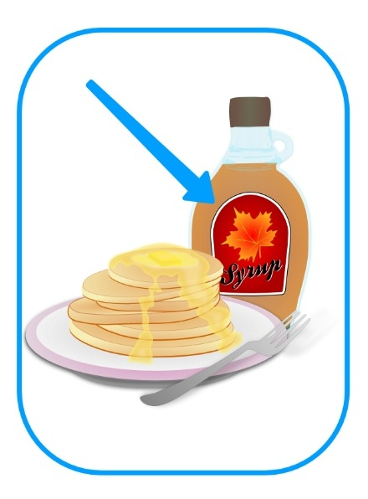
Image credits: see Teacher guide
Notes:
The slide shows the tree diagram and card to begin with. The arrow to indicate the answer appears on a second click.
Images and/or photos that are the copyrighted property of 123RF, its contributors or licensed partners (see Teacher guide) are used with permission under 123RF Free Image License. These images and/or photos may not be copied or downloaded without permission from 123RF.

Slide 22

Image credits: see Teacher guide
Notes:
The slide shows the tree diagram and card to begin with. The arrow to indicate the answer appears on a second click.
Images and/or photos that are the copyrighted property of 123RF, its contributors or licensed partners (see Teacher guide) are used with permission under 123RF Free Image License. These images and/or photos may not be copied or downloaded without permission from 123RF.

Slide 23

Image credits: see Teacher guide
Notes:
The slide shows the tree diagram and card to begin with. The arrow to indicate the answer appears on a second click.
Images and/or photos that are the copyrighted property of 123RF, its contributors or licensed partners (see Teacher guide) are used with permission under 123RF Free Image License. These images and/or photos may not be copied or downloaded without permission from 123RF.

Slide 24
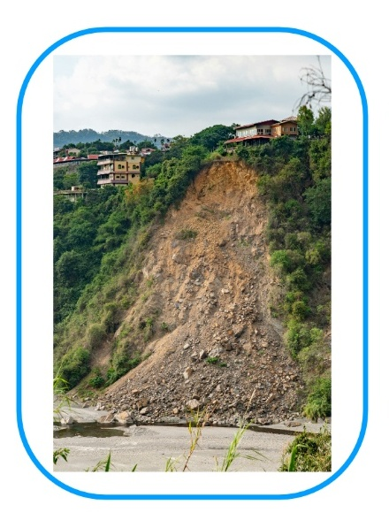
Image credits: see Teacher guide
Notes:
The slide shows the tree diagram and card to begin with. The arrow to indicate the answer appears on a second click.
Images and/or photos that are the copyrighted property of 123RF, its contributors or licensed partners (see Teacher guide) are used with permission under 123RF Free Image License. These images and/or photos may not be copied or downloaded without permission from 123RF.

Slide 25
Canopy | Trunk | Roots

Slide 26
Canopy | Trunk | Roots
Home for birds Chocolate Food for bees Fruit Clouds and rain Nuts Cleans air | Maple syrup Home for people Paper Places to play Logs and planks | Home for worms Clean water Hold soil together

Slide 27
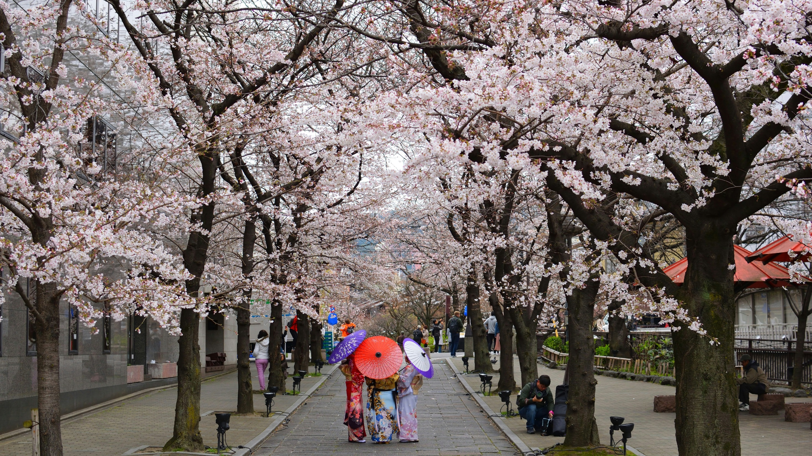
Pavlo Klein on Unsplash

Slide 28
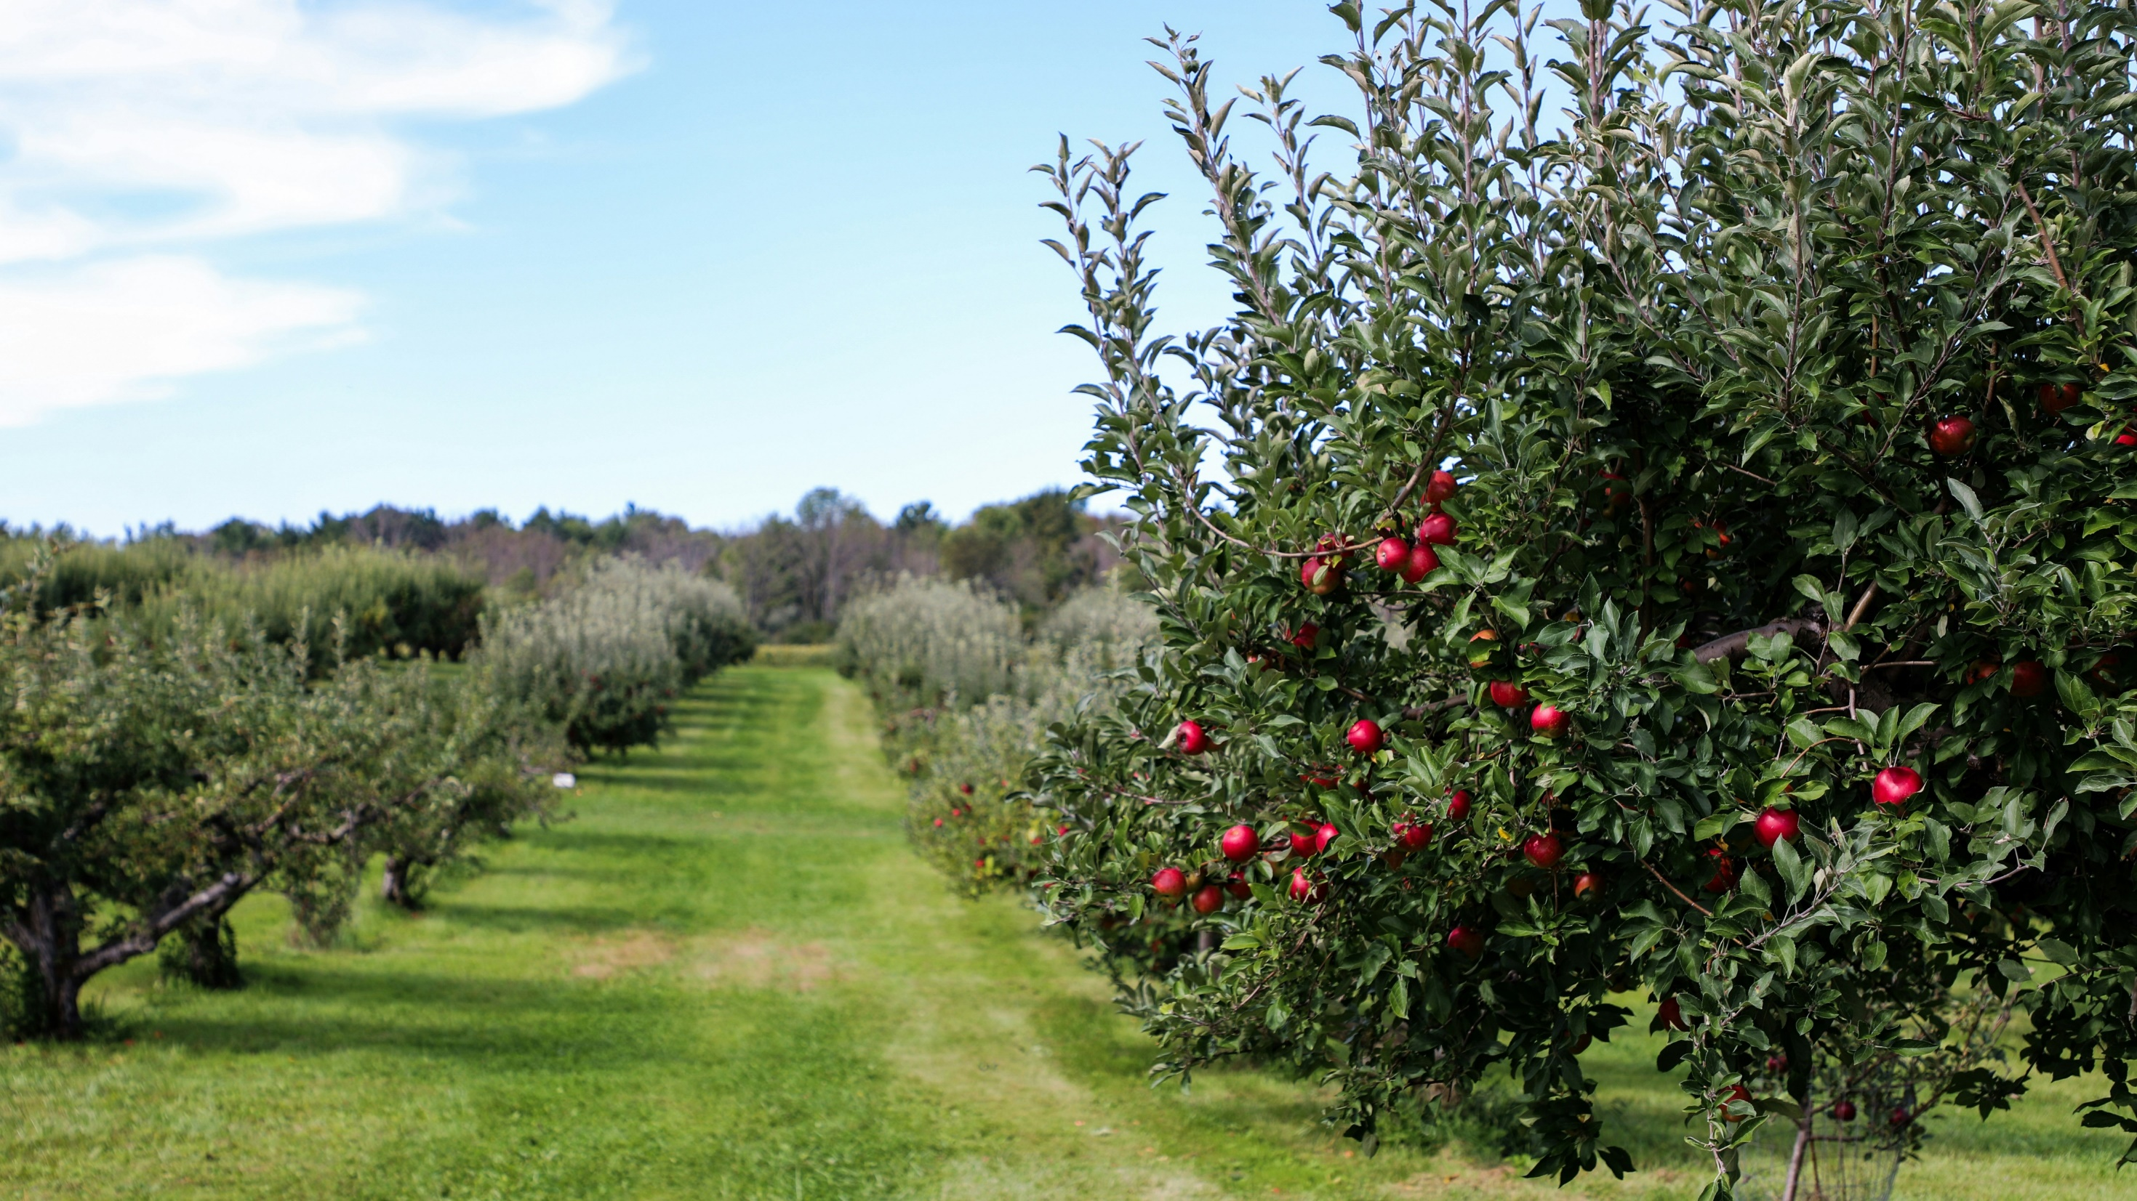
Michael & Diane Weidner on Unsplash

Slide 29
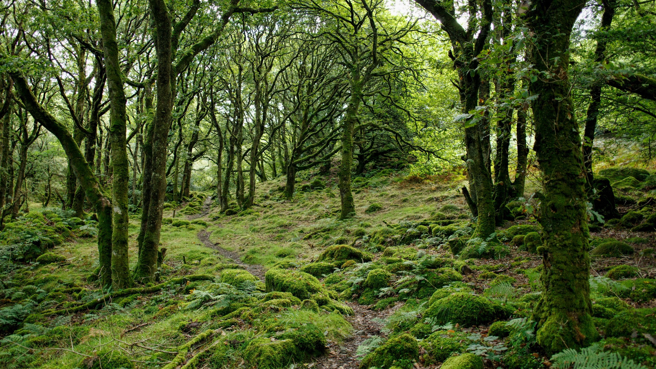
Marc Pell on Unsplash

Slide 30

J Shim on Unsplash

Slide 31
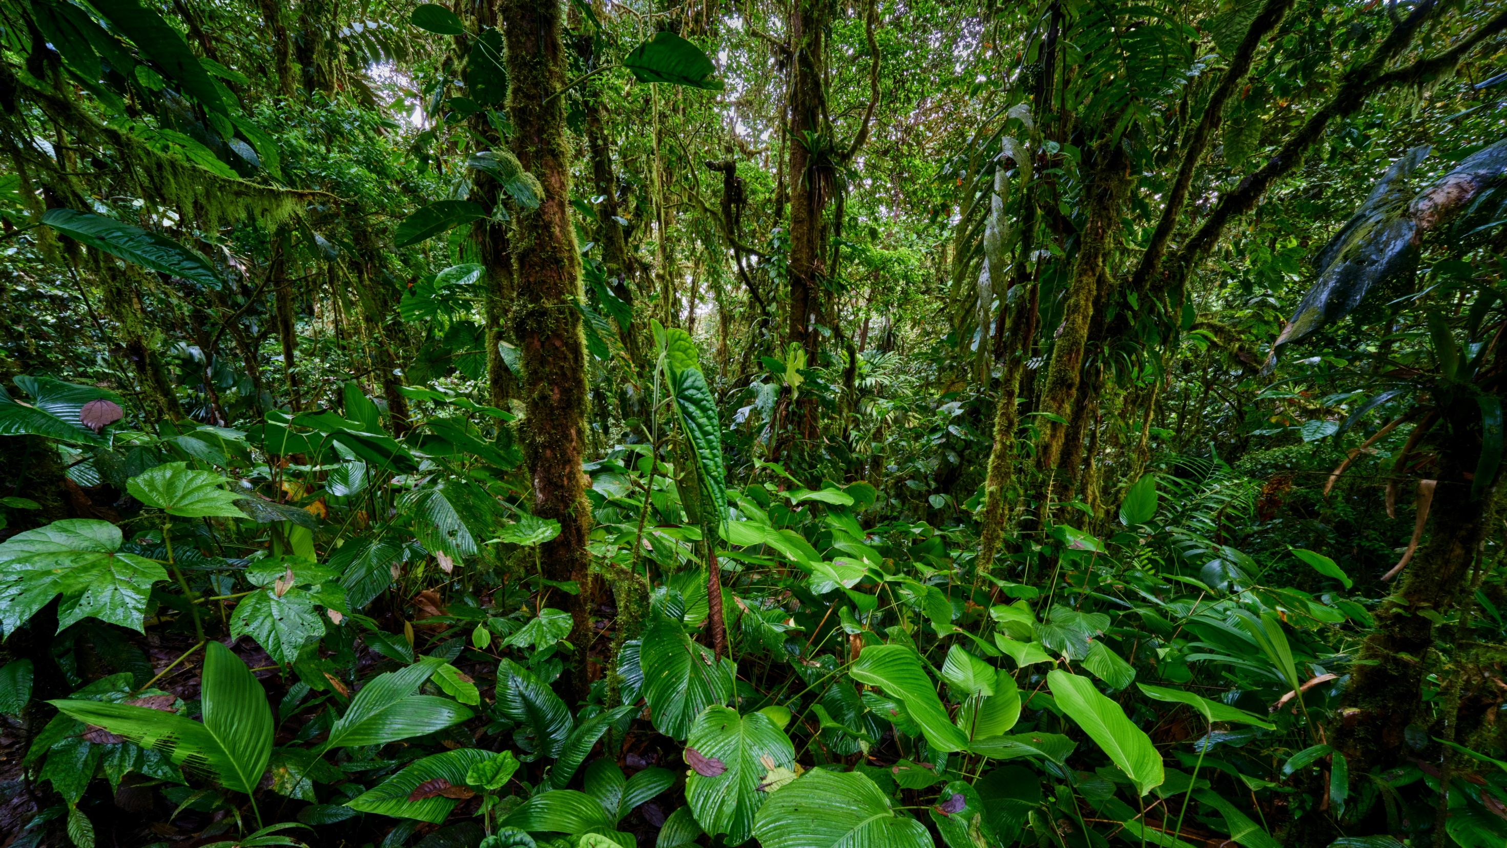
Zdeněk Macháček on Unsplash

Slide 32
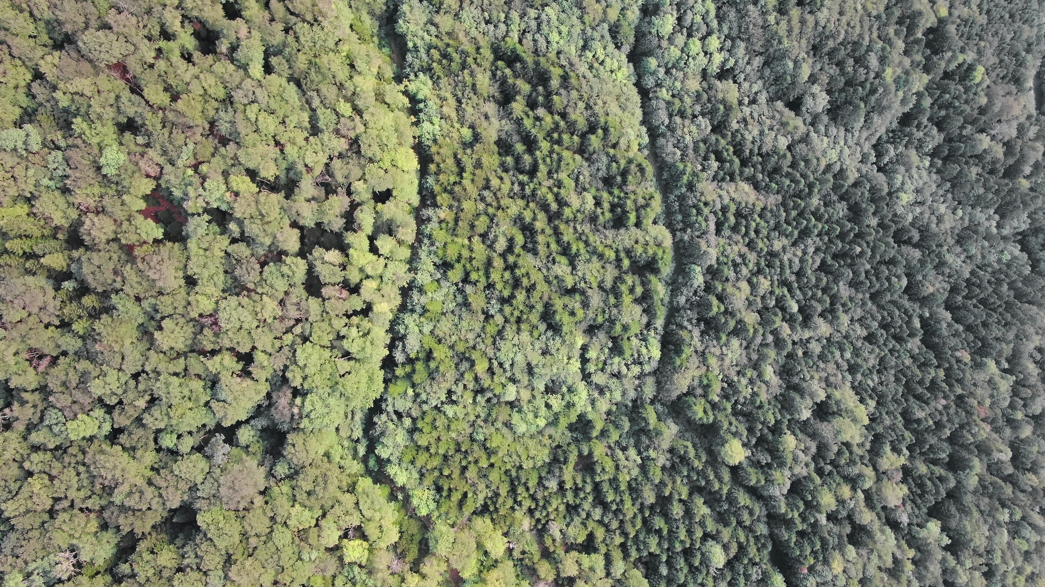
Nathan Queloz on Unsplash

Slide 33
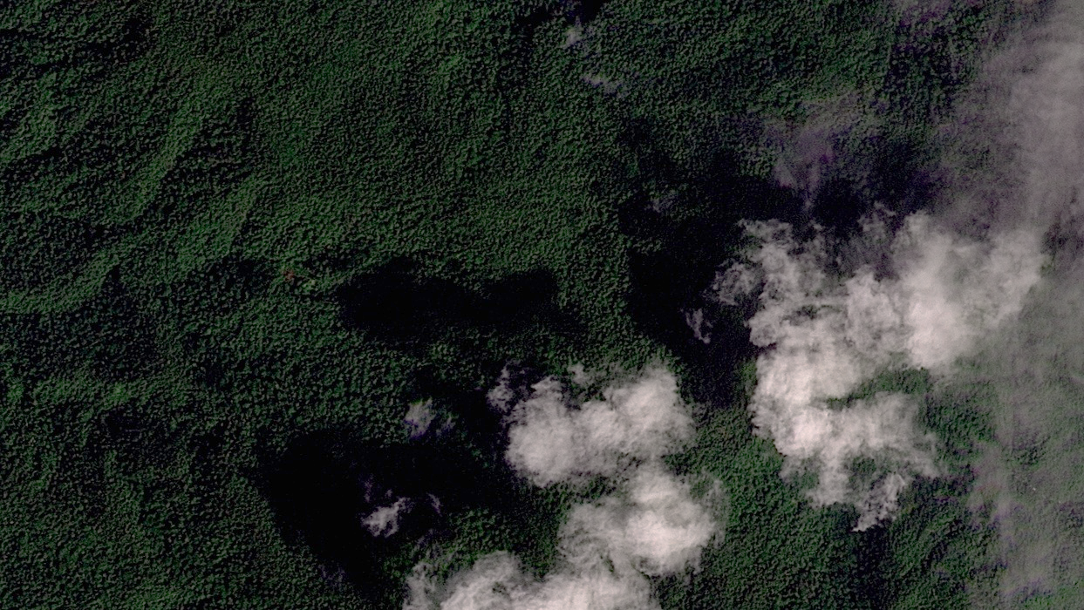
© 2025 Planet Labs

Slide 34
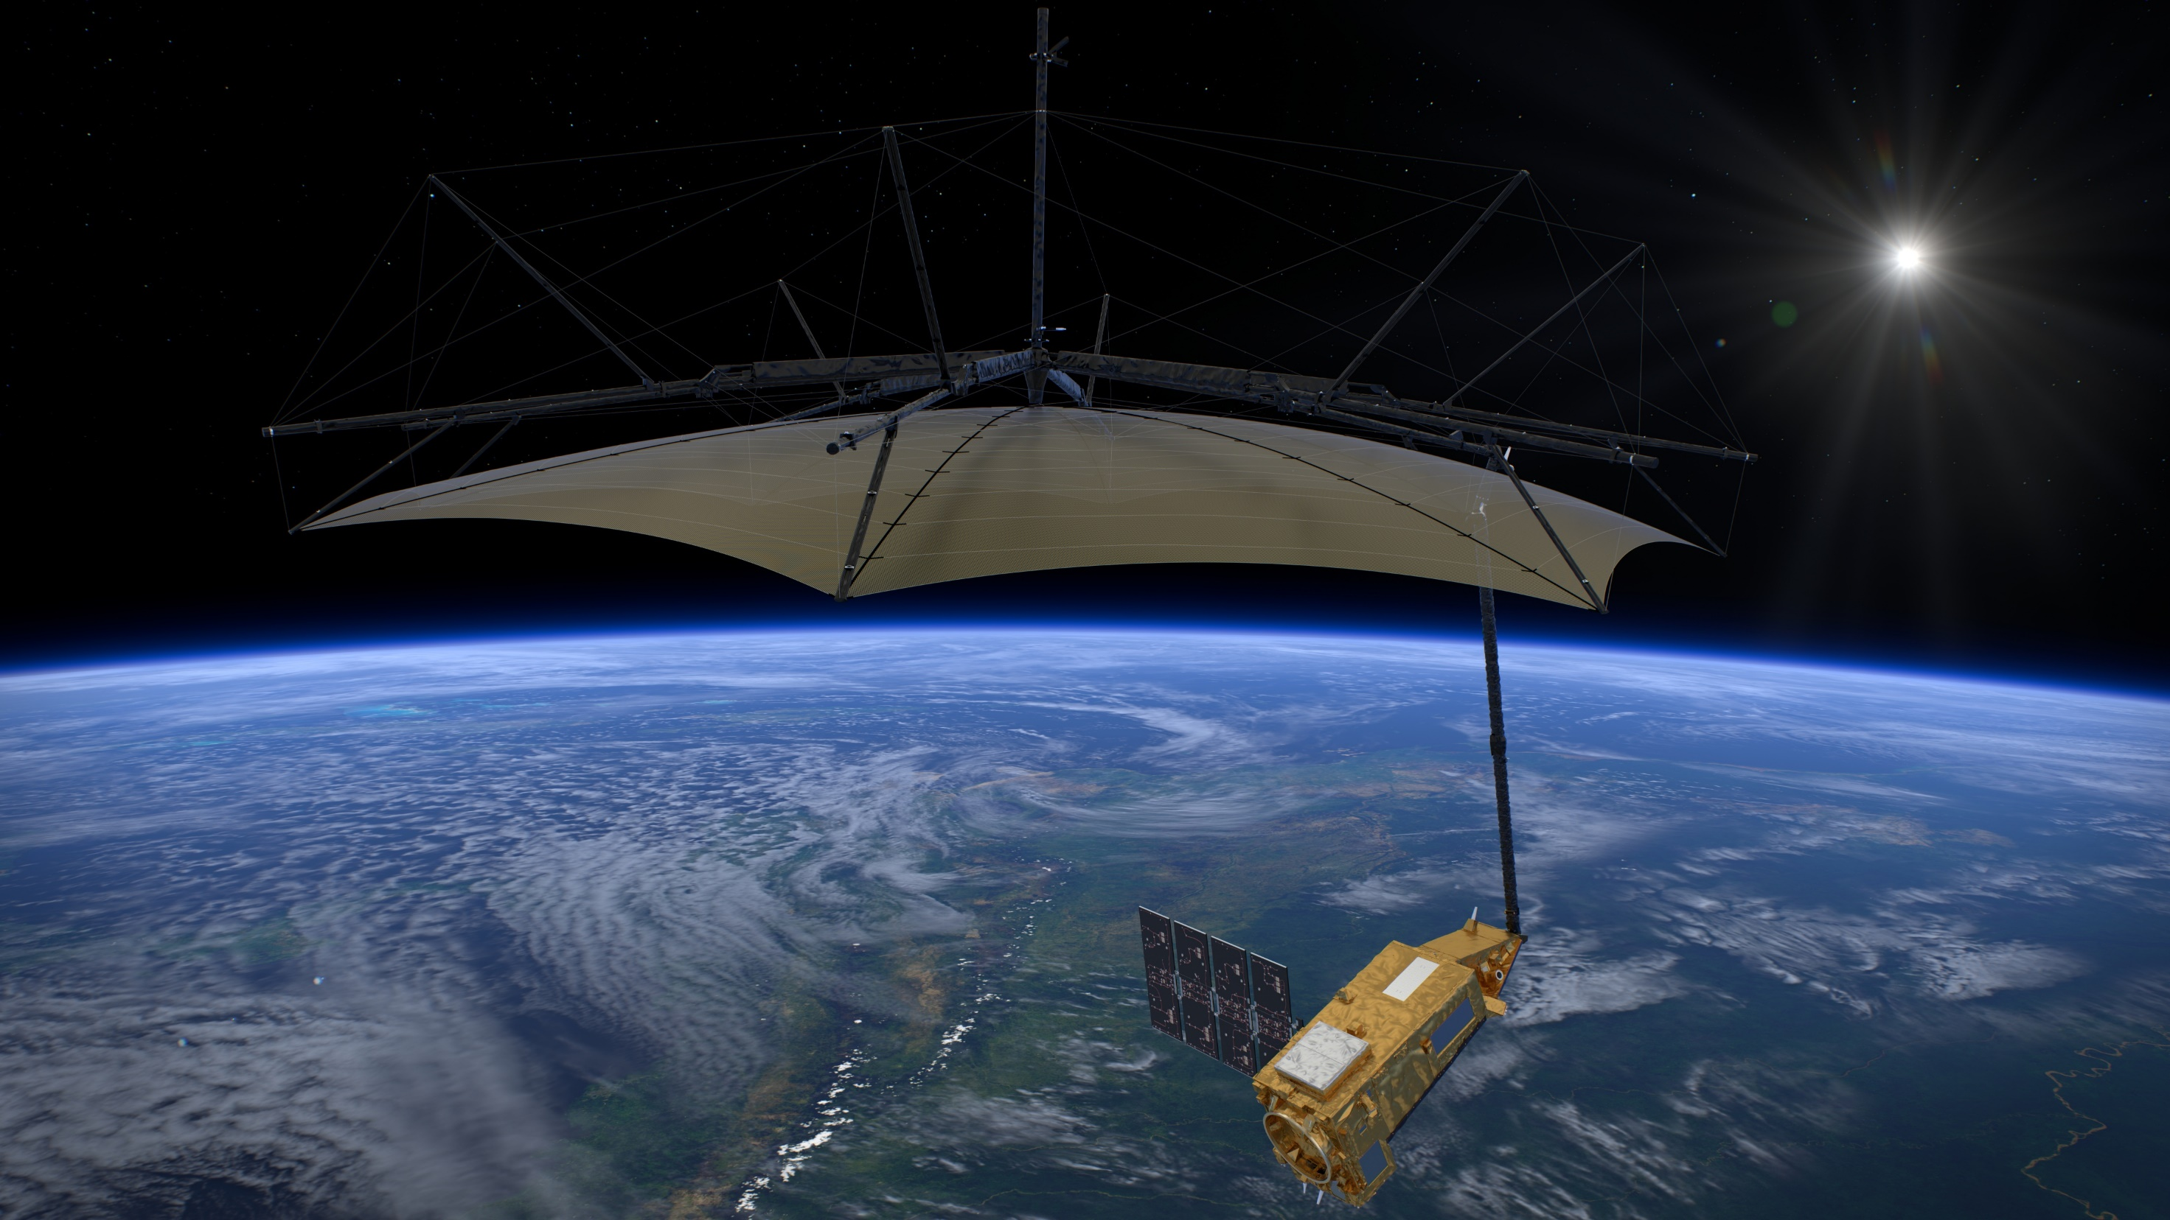
ESA/ATG medialab

Slide 35
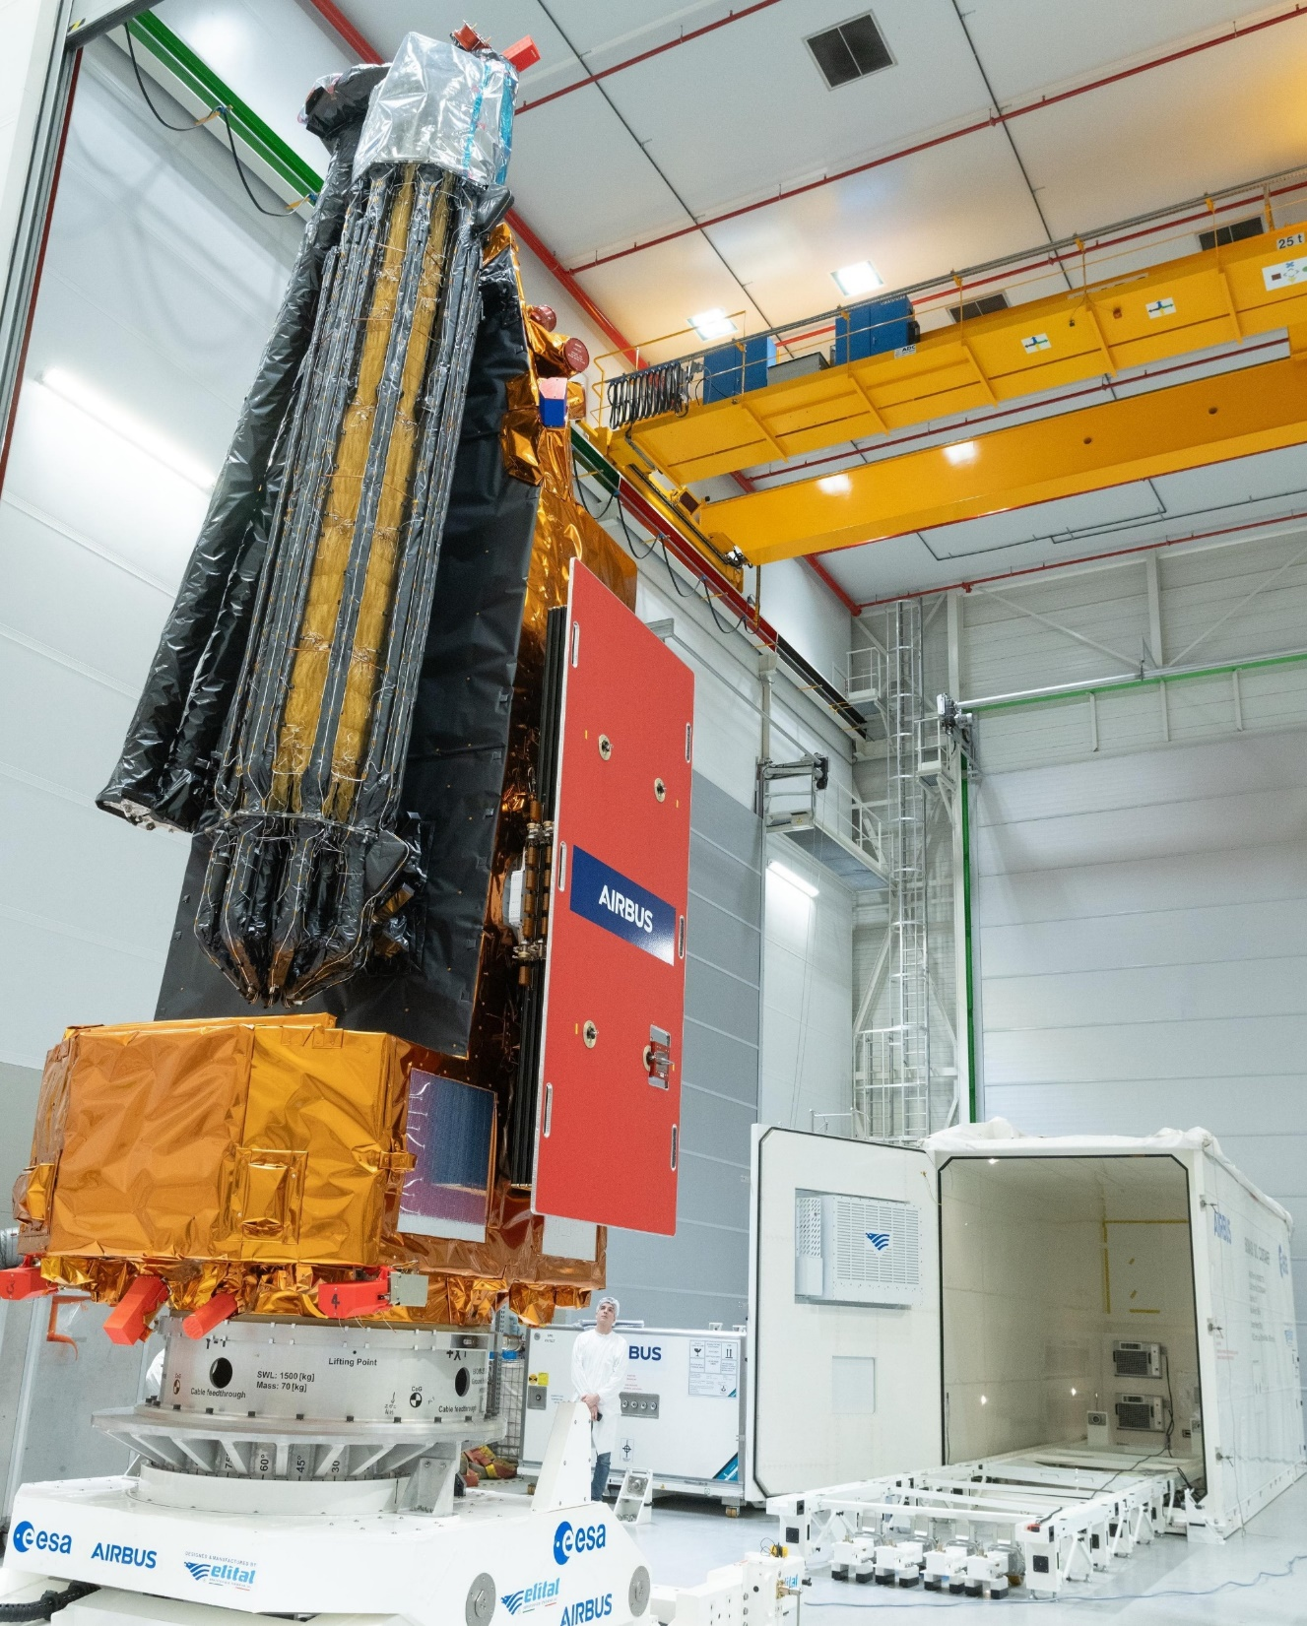

Patch: ESA Photo: ESA–P. Sebirot
Notes:
The photograph shows Biomass folded down for shipping and launch: the solar panels and reflector will unfold once it is in space.
The person in the picture gives some idea of the size of the satellite.
The ESA patch features flags of all ESA member countries. Which one is not in Europe?

Slide 36

ESA

