Slide 1
About this presentation
All slides are animated so they can be used as follows:
When the slide opens, the image and picture number are displayed. Ask students which of the descriptions they were given was the best fit.
The answer appears on the next click, followed by the name of the thing the students were asked to find in the picture.
Ask students for the/a square(s) where they found this thing. The next click (two for picture 4) gives an arrow pointing to the/an answer.
Click again and a red circle appears around (an instance of) the item listed on the back page of your answer booklet. What do students think is in the circle?
The answer is revealed on the final click.
You can find explanations or/and additional information about each image in the notes beneath each slide.

Slide 2

Be an EO Detective
Answers for the activity at
the UK Space Conference
Manchester, July 2025
Catherine Fitzsimons
NCEO / University of Leicester
Contains Copernicus Sentinel 2 data (2019) processed by ESA
Notes:
For more information about this picture see https://www.esa.int/ESA_Multimedia/Images/2019/12/Baltic_blooms

Slide 3
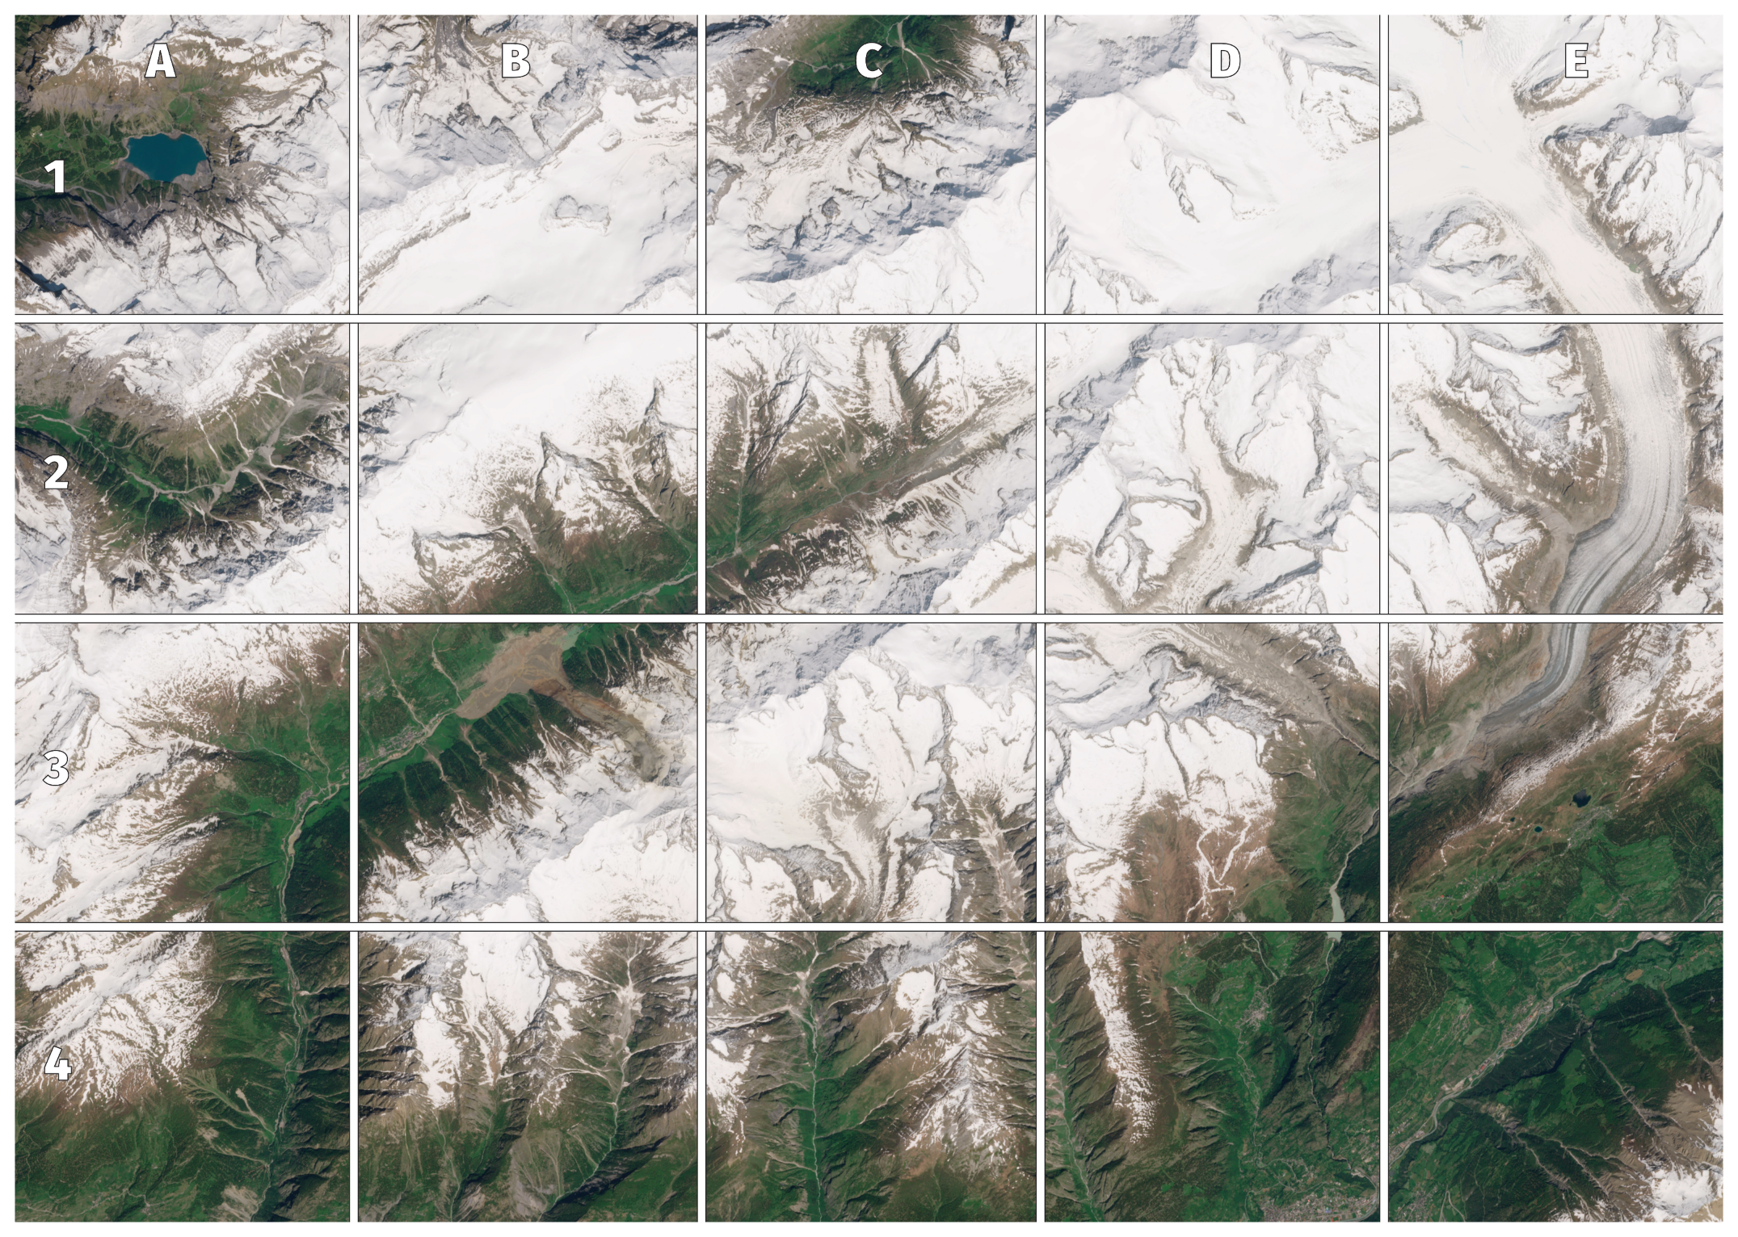
Picture 1
mountains in winter
a landslide
a glacier
Contains Modified Copernicus Sentinel 2 data (2025)
Notes:
You can see snow on the tops of the mountains, bare soil and rock high up and grass in the valleys.
(This is actually the Swiss Alps in spring, but some valleys do remain snow-free throughout the winter.)
The landslide shows as soil and rock that has spilled into a green area.
For more information about this landslide and images from ground level, see e.g. https://www.bbc.co.uk/news/resources/idt-c7f929de-96a9-45e5-b1bb-31de82fce72d
The highlighted glacier is the biggest one in the image, but there are many smaller ones too, and it was the collapse of one of these that produced the landslide.
The stripes on the glacier are moraines.

Slide 4
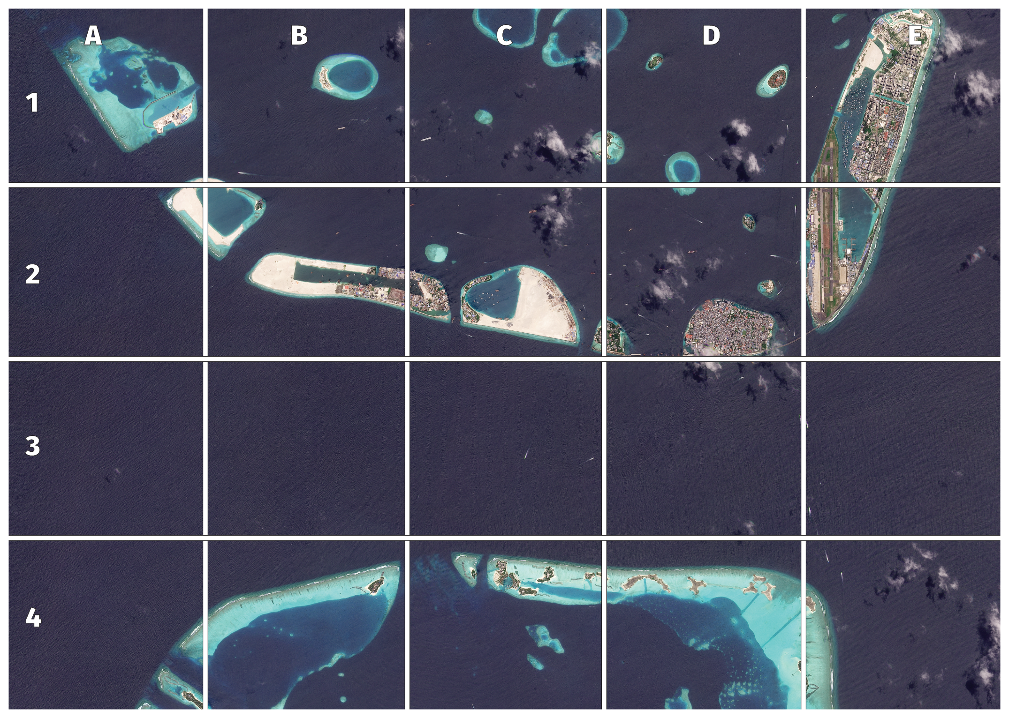
Picture 2
lots of small sandy islands
two boats and no land
a harbour or marina
© 2025 Planet Labs PBC
Notes:
Dark blue is ocean, pale blue areas are coral reefs beneath the water and whiteish areas around the islands are sand.
This is part of the Maldives: the roundish island completely covered in buildings is the capital, Male. Some of this island, and all the built-up area in E2 has been ‘reclaimed’ from the sea by filling in the lagoons (area enclosed by the reef) with rubbish, sand and rock. No land in this picture is more than a metre above sea level.
Moving boats show up well because of the wake they leave behind them.
There are lots of objects in the sea inside the circle at the end of the airport runway. These are likely to be boats so it suggests that this is a place where boats moor or are kept – a harbour or marina.

Slide 5
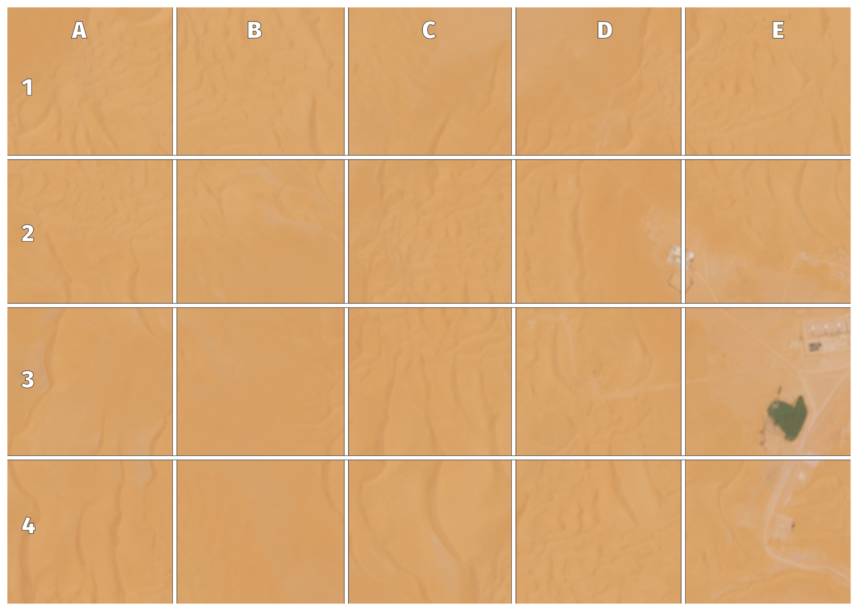
Picture 3
a desert
an oasis
buildings
Contains Modified Copernicus Sentinel 2 data (2025)
Notes:
The wavy lines are sand dunes in this almost otherwise featureless desert – the Grand Erg Occidental which is part of the Sahara in Eastern Algeria.
In spite of cartoons, an oasis may not have surface water but be an area where water is near enough to the surface for plants to grow so many are linear showing where water flows underground.
The buildings here – square shapes by straight line roads – are related to oil or gas extraction.

Slide 6
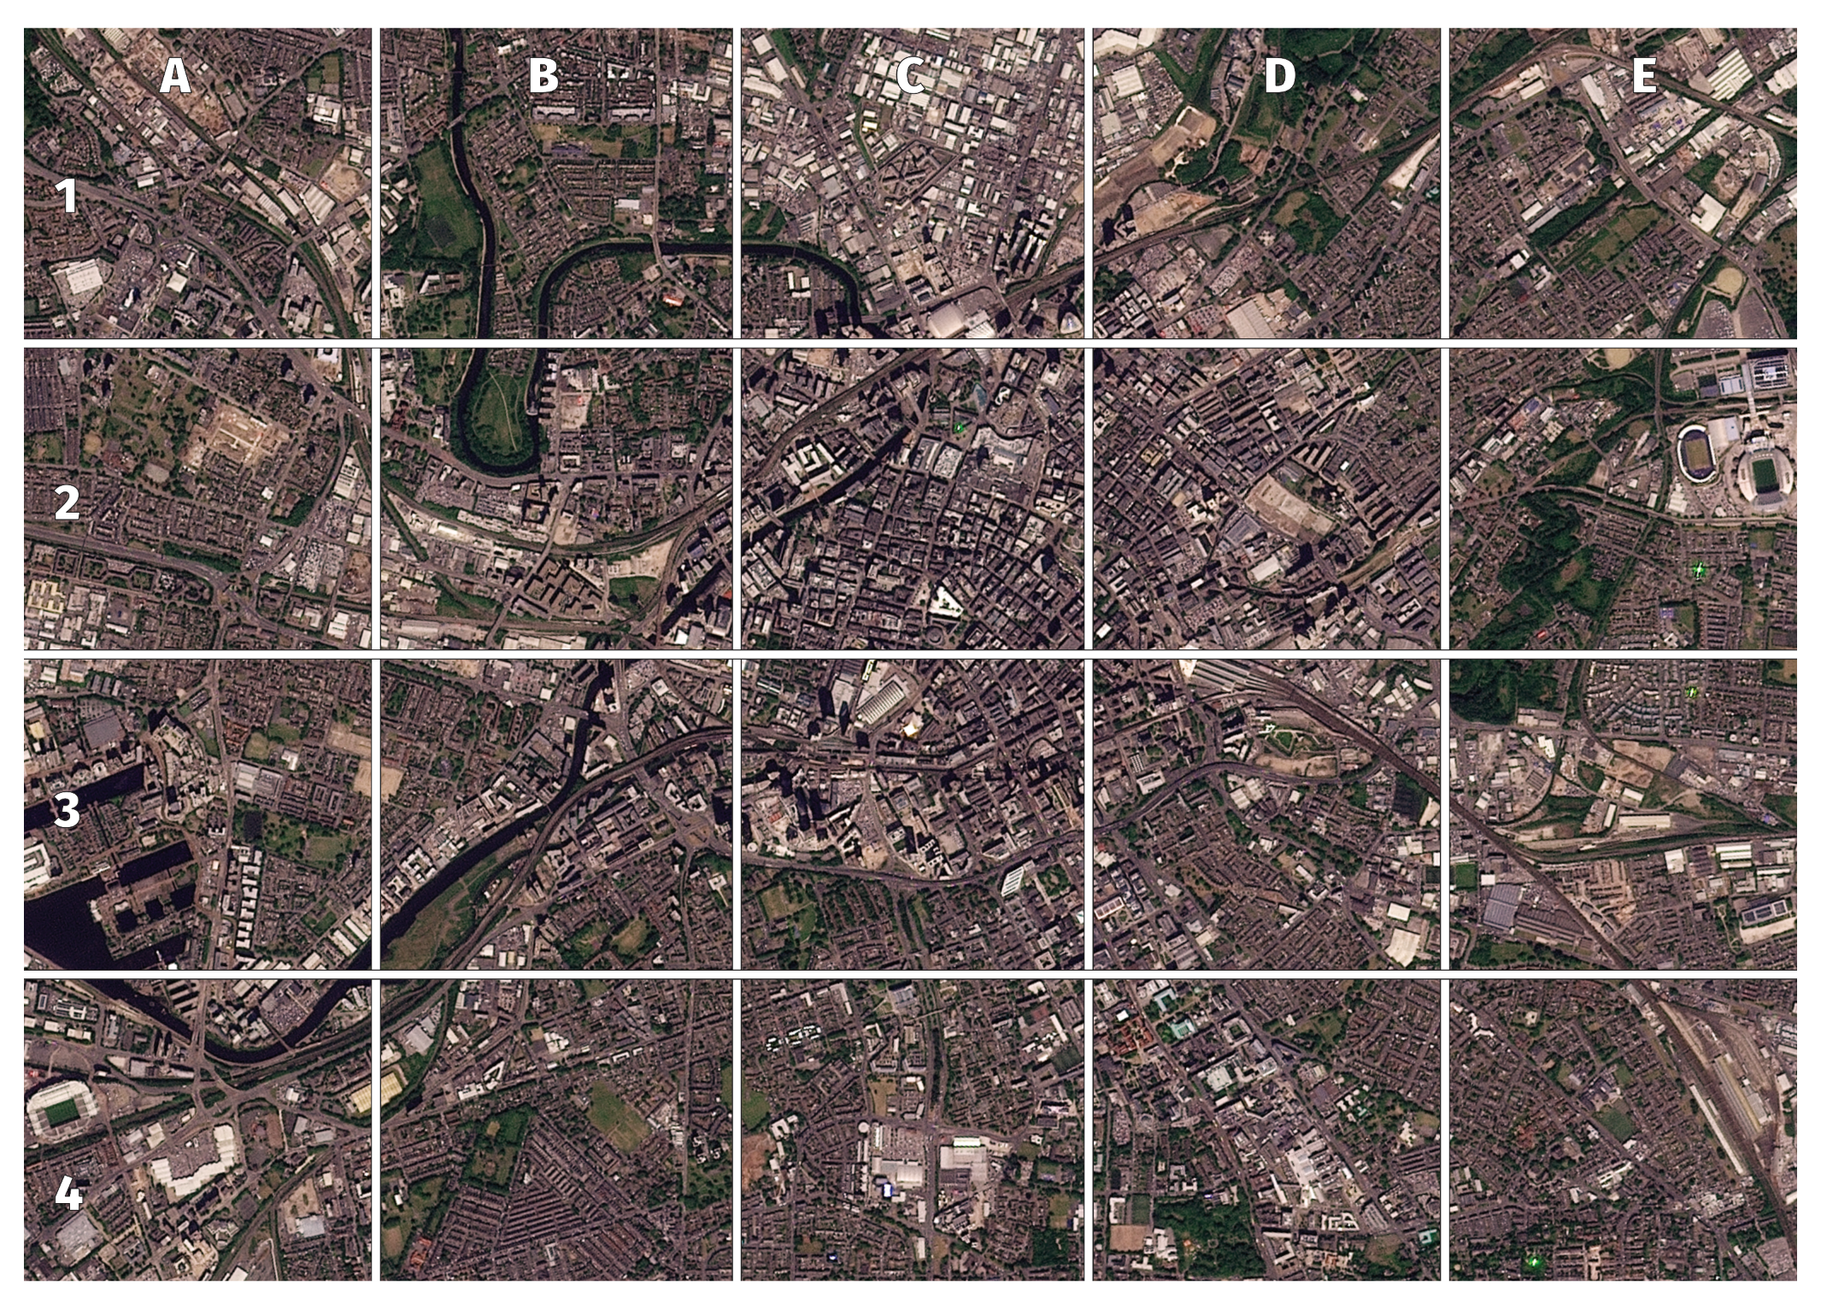
Picture 4
a big city
a football stadium
a railway station
© 2025 Planet Labs PBC
Notes:
It’s difficult to see individual houses but buildings cover nearly all of the picture so this must be a big city.
This is central Manchester between Old Trafford and the Etihad stadium – green rectangles with obvious rooves around several sides.
At the railway station you can see one broad line – two railway tracks – splitting into several smaller ones most of which head into a building.

Slide 7
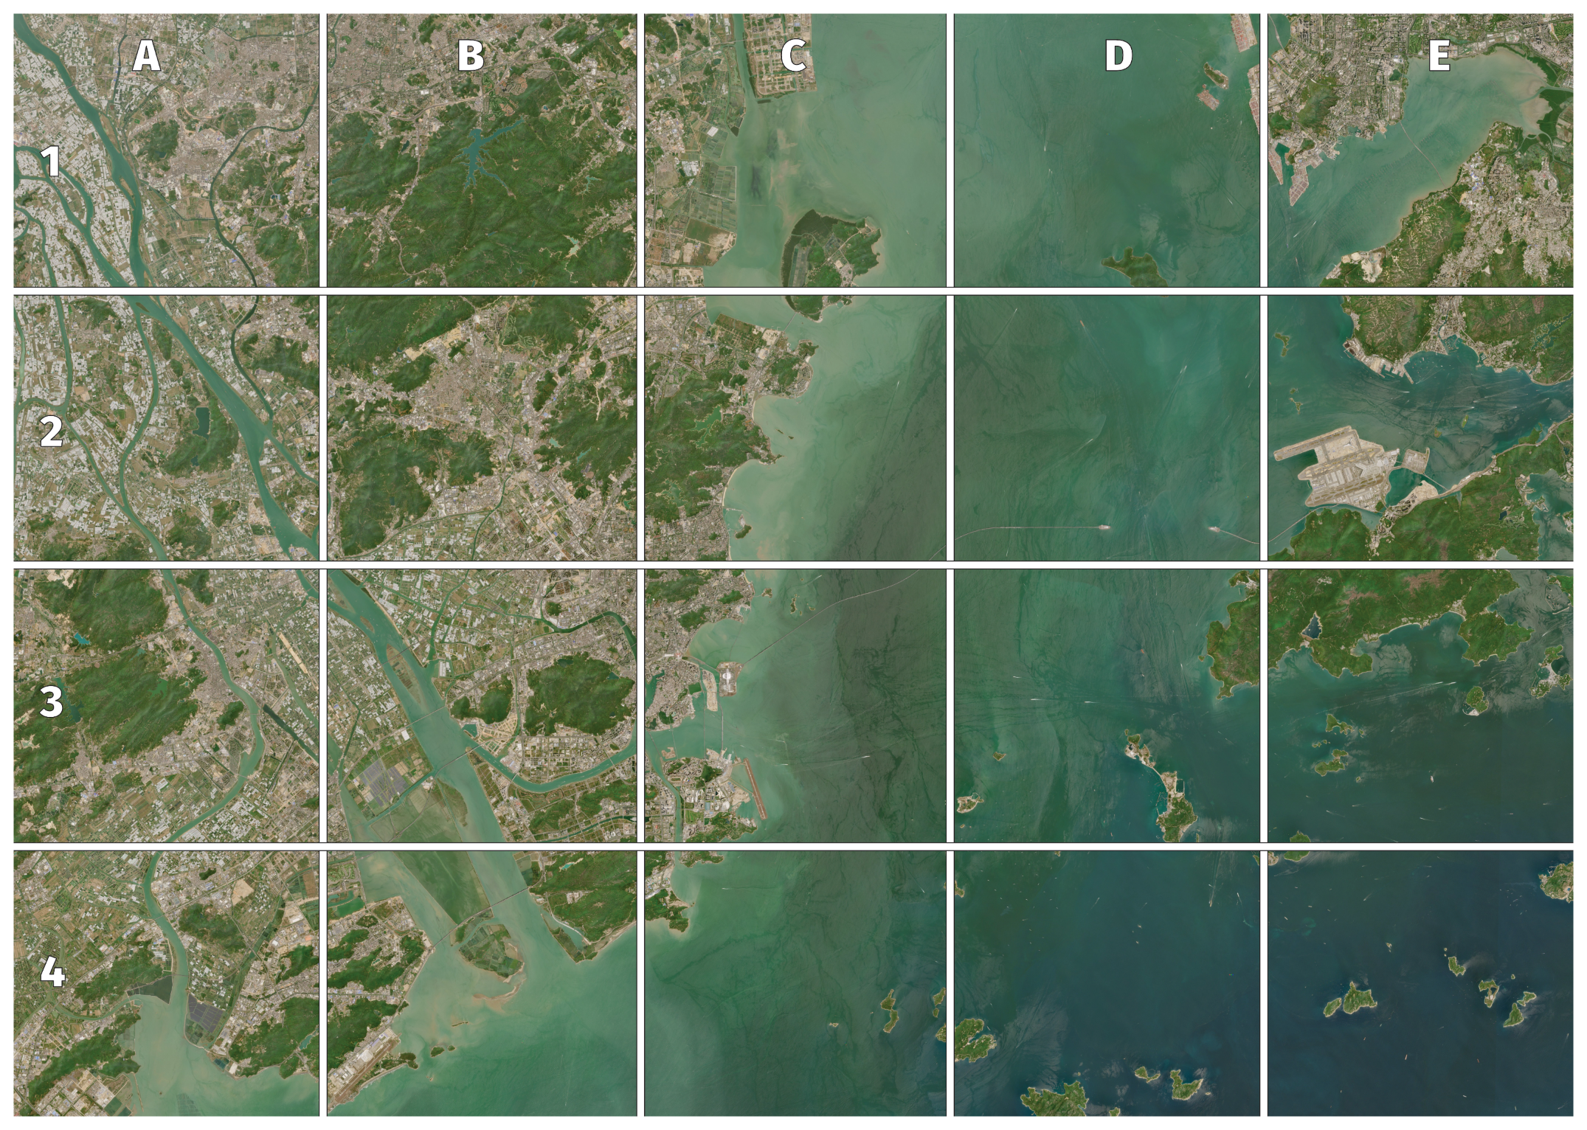
Picture 5
a big river meeting the sea
a bridge with
a gap in it
a lake
Contains Modified Copernicus Sentinel 2 data (2025)
Notes:
We know this picture covers a wide area because most individual buildings are too small to make out.
It is the main channel of the Pearl River delta with Hong Kong International airport in square E2 – although Hong Kong Island itself is not in the picture.
A bridge will normally show as a line across water joined to land at each end. However, the Hong Kong–Zhuhai–Macao Bridge goes into a tunnel for nearly 7 km (over 4 miles). https://www.bbc.co.uk/news/world-asia-china-45937924 – a story from its opening in 2019 – includes links to ground-level pictures.
The red circle is round a blue patch in the middle of an area of green, so it is a lake. In fact, it is a reservoir – and the spiky shape is a good indication of this.

Slide 8
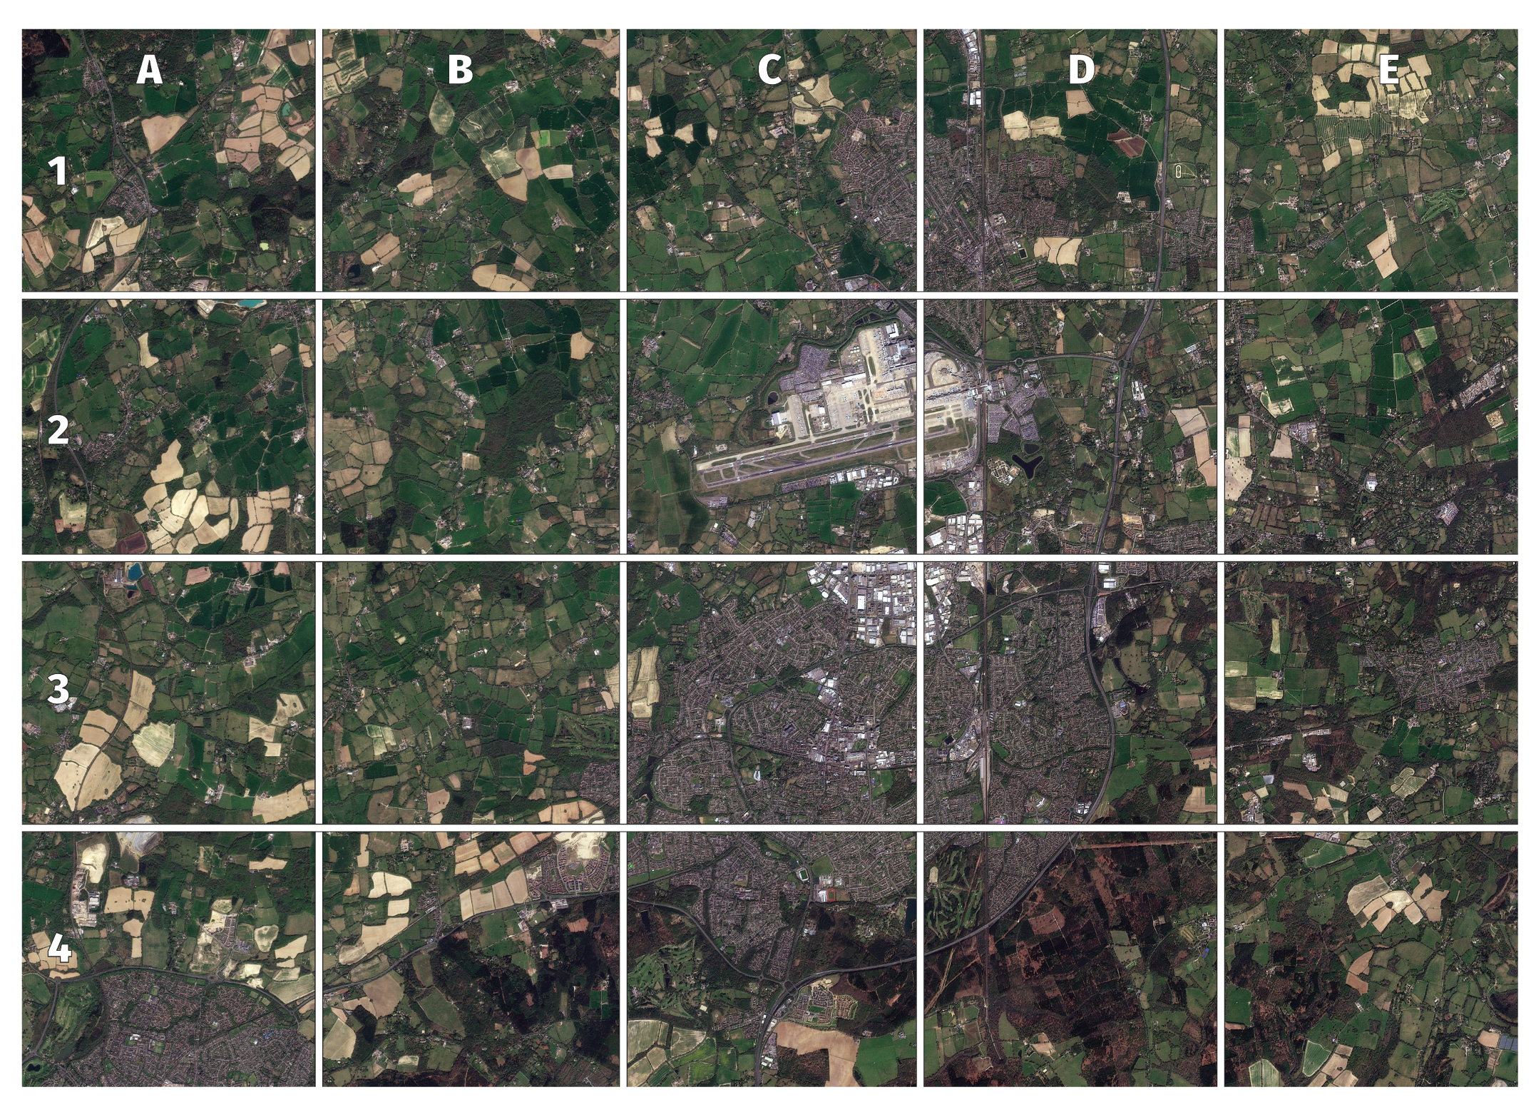
Picture 6
a town with fields around it
an airport
an industrial or/and retail park
© 2025 Planet Labs PBC
Notes:
Some of this picture is buildings – dark brown, grey and white arranged around straight and curved lines – but there are irregular shapes all around it in shades of green and brown (fields). The area covered by buildings isn’t big enough to be a city so it is likely to be a town or village. In fact, it’s Crawley.
The airport shows as a group of buildings next to straight roads (two in this case) that seem to be go nowhere. These are the runways of Gatwick airport and you might be able to make out a plane on one of the runways – though it does look rather strange …
The buildings in the circle are much bigger than most of the others in the picture (except those at the airport), so they are not houses. They are on the edge of town, so they might be a retail park, but they are also near the airport so they are more likely to be an industrial park.

Slide 9
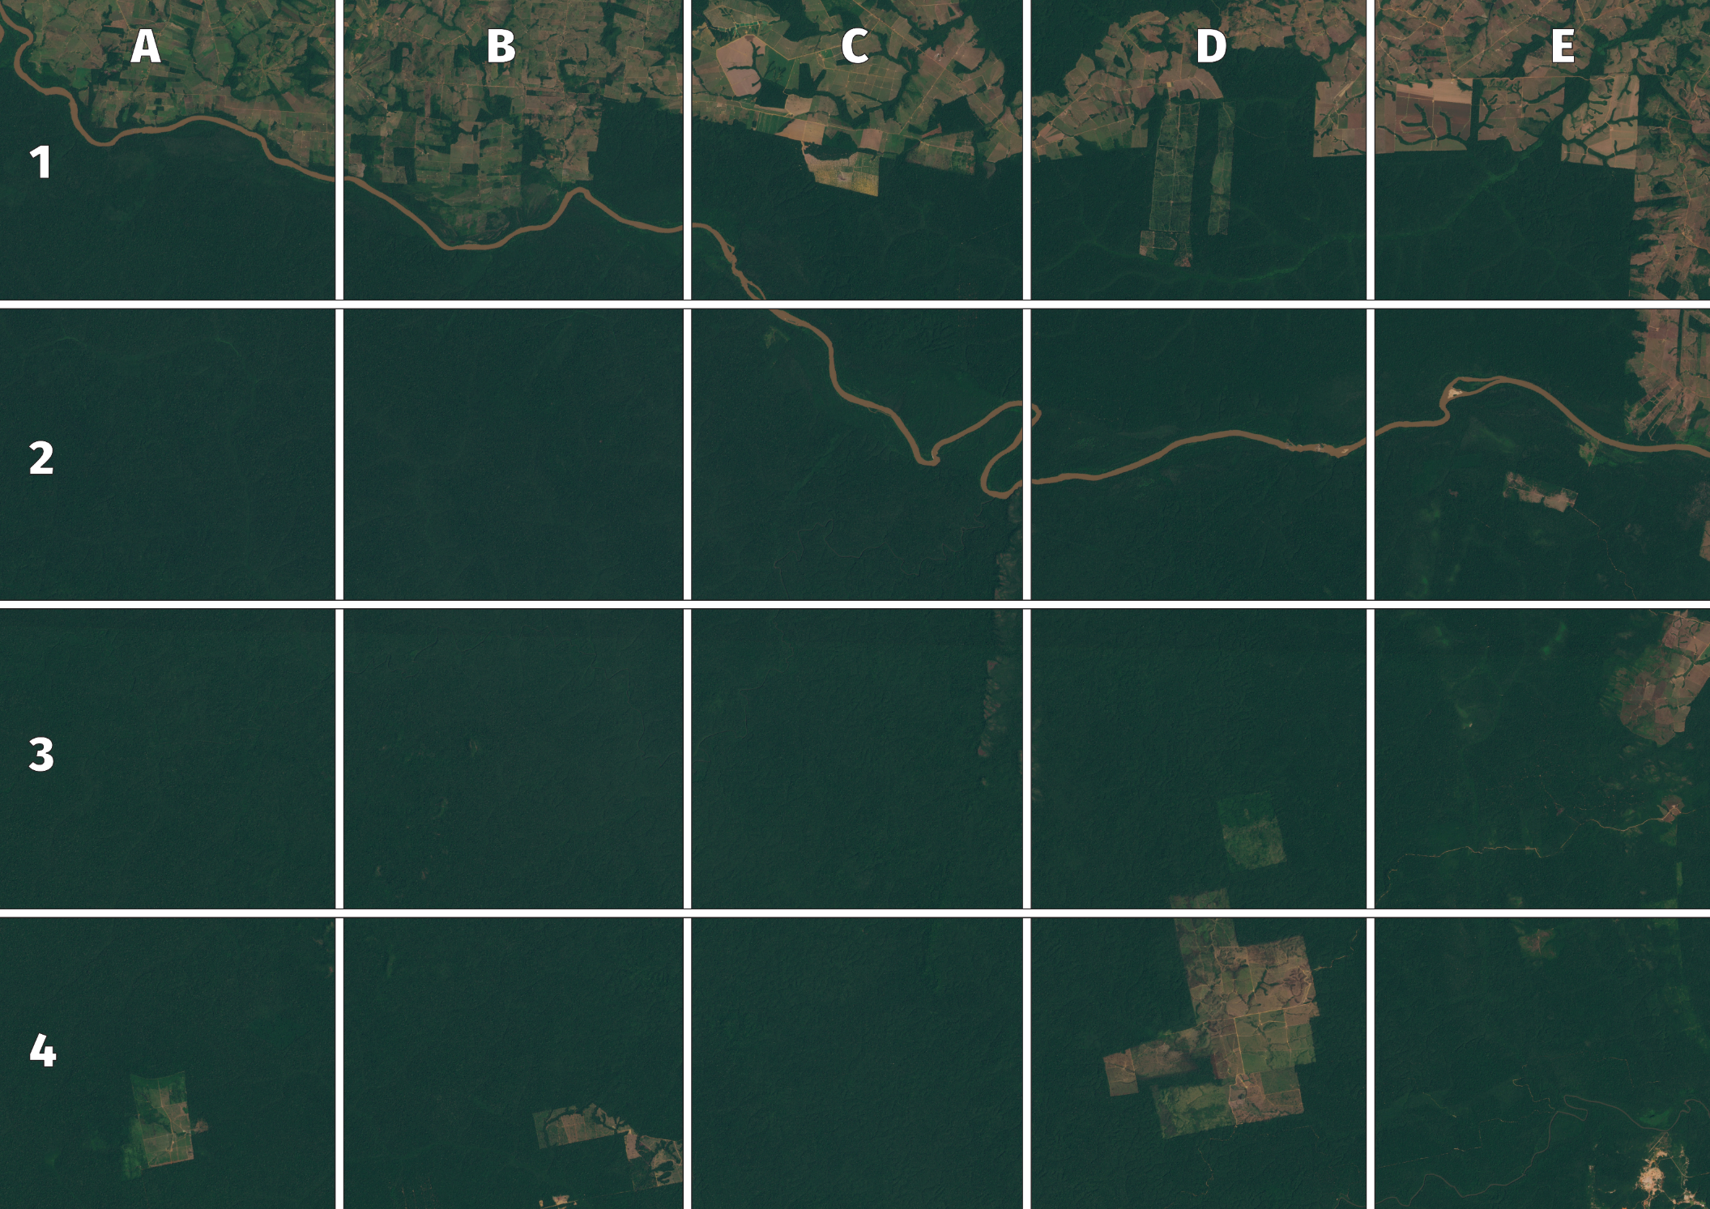
Picture 7
Rainforest in the Amazon
a place where trees have been cut down
an island in the middle of the river
Contains Modified Copernicus Sentinel 2 data (2025)
Notes:
Most of this image is green, and nearly all of it solid green (looking a bit like broccoli if you get up close), so it shows plants rather than people-made places. The wiggly brown line is a river carrying lots of sediment (a muddy river) and this is part of the Brazilian rainforest in the state of Mato Grosso.
Straight square edges are a sign that people have been doing something. Brown patches are where soil is showing through, or there are ripened crops, and paler greens are places with fewer trees, or covered with growing crops or grass. So there are lots of parts of this picture where the forest has been disturbed and the trees removed – the arrow points to just one of them.
Inside the circle is a patch of green surrounded by the river – so it is an island. If you look closely you can see there are actually two – one with trees on it and the other that doesn’t seem to have any. This is likely to be a developing island rather than one that has had trees cut down.

Slide 10
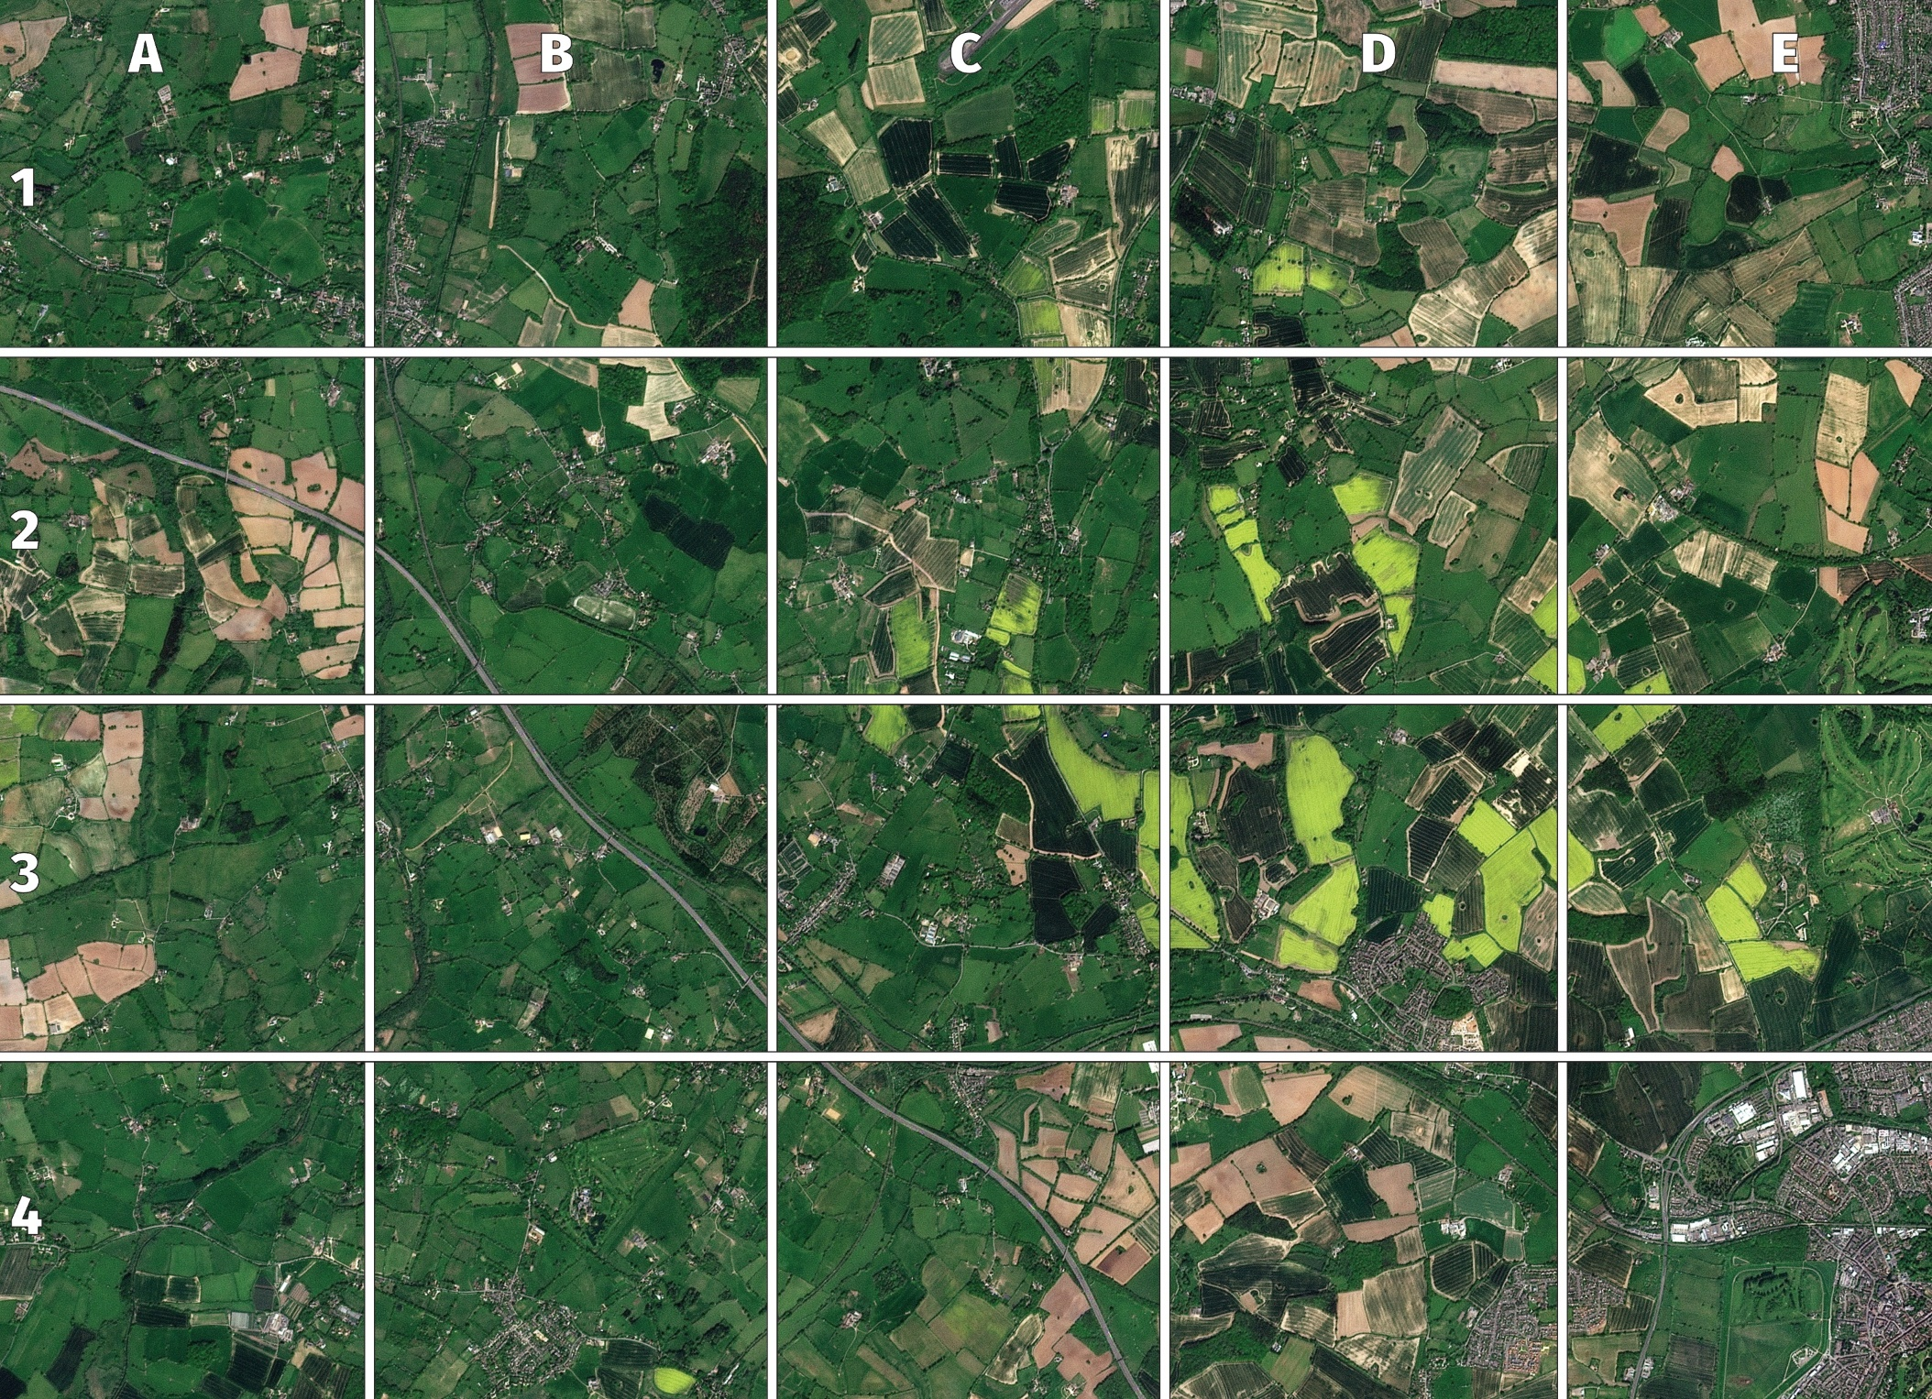
Picture 8
the countryside in spring
a motorway
a golf course
© 2025 Planet Labs PBC
Notes:
Lots of green fields where things are already growing, brown fields where things have not yet started to grow and some where crops planted in lines are just beginning to grow. Other fields are yellowish because of the yellow flowers of rapeseed so we know this is springtime.
A motorway is wider than other roads so shows up as a wide grey line (railways tend to be darker and narrower). Individual cars are too small to see.
The area in the circle has got trees and grass with the grass growing in a series of long thin shapes. These are the fairways of a golf course.
Also in the picture – but VERY hard to make out – are two castles (Warwick and Kenilworth).

Slide 11
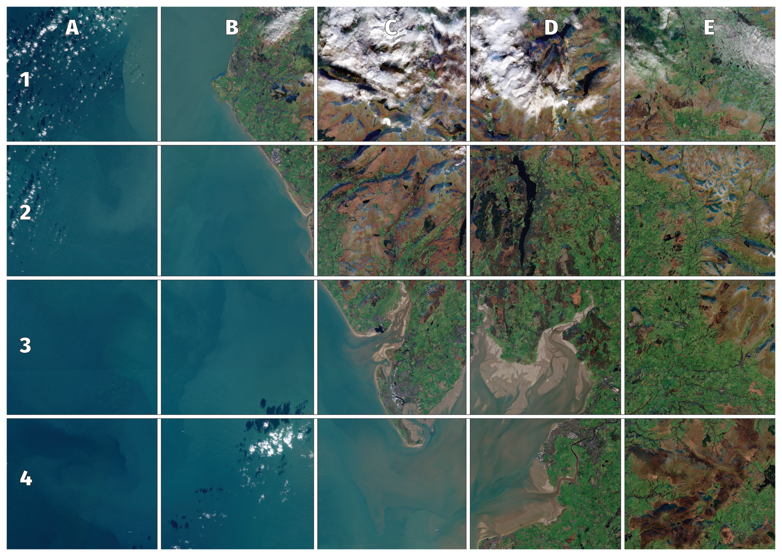
Picture 9
mountains and sea
a wind farm
clouds
Contains Modified Copernicus Sentinel 2 data (2024)
Notes:
Mountains show up as spiky brown shapes where not much grows at the time of year this image was collected (November), and the sea is mostly shades of blue although it is brown where rivers empty into it carrying lots of sediment.
The windfarms are in the sea. Each turbine shows up as a tiny bright dot, but their shadows are lines pointing up the page (almost North because the picture was taken near noon, so the Sun is in the south). This would make them almost impossible to spot but the two smaller windfarms in this area each have 30 turbines arranged in a regular pattern. The Walney wind farm has 189 turbines over its three phases.
The fluffy white bits in the red ellipse are, of course, clouds. Notice how you can see the shadow of clouds on the sea (especially clear in B4) and how, in C1 & D 1 it is difficult to tell the difference between clouds in the sky and snow on the tops of the Lake District mountains.

Slide 12
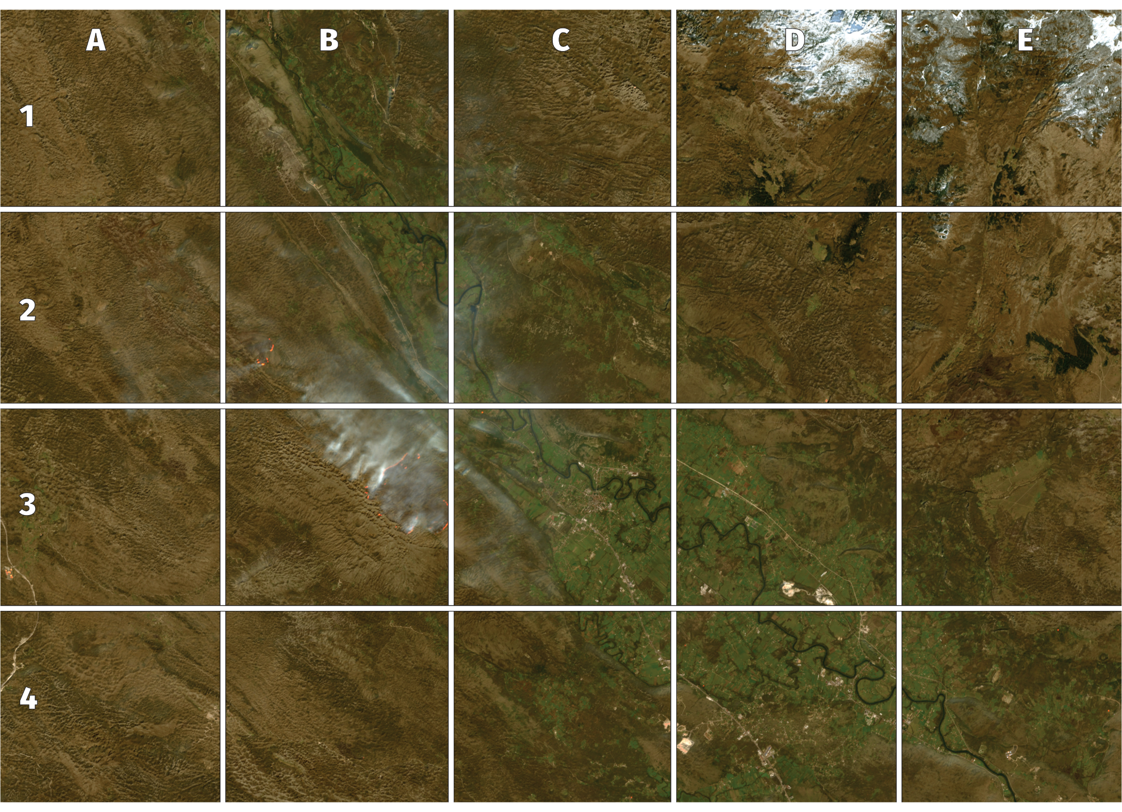
Picture 10
a river in
a valley
a fire
snow
© 2025 Planet Labs PBC
Notes:
This is possibly the trickiest – the dark green river is running through a paler green valley, but it is hard to see that the brown land on either side is slopes of mountain covered with bracken.
You can see the smoke from the fires where the bracken is burning. The ‘flames’ are not quite this visible from space: the orange and red colours are actually used to show where the instrument on the satellite was detecting heat.
Snow will look white and, as we saw in the last picture, can be trickly to tell from cloud. We know this snow because of the way the edges match shapes on the ground and it is in the part of the picture furthest from the valley so probably highest up.

