Slide 1


Introducing an EO-driven Dengue Fever Forecasting System for Vietnam
Barbara Hofmann, Felipe Colon, Alison Hopkin & the D-MOSS Team b.hofmann@hrwallingford.com
Dengue forecasting Model Satellite-based System
    Aedes mosquito
NCEO 2019
Nottingham 02-05.09.2019
Notes:
Sponsored by UK Space Agency

Slide 2
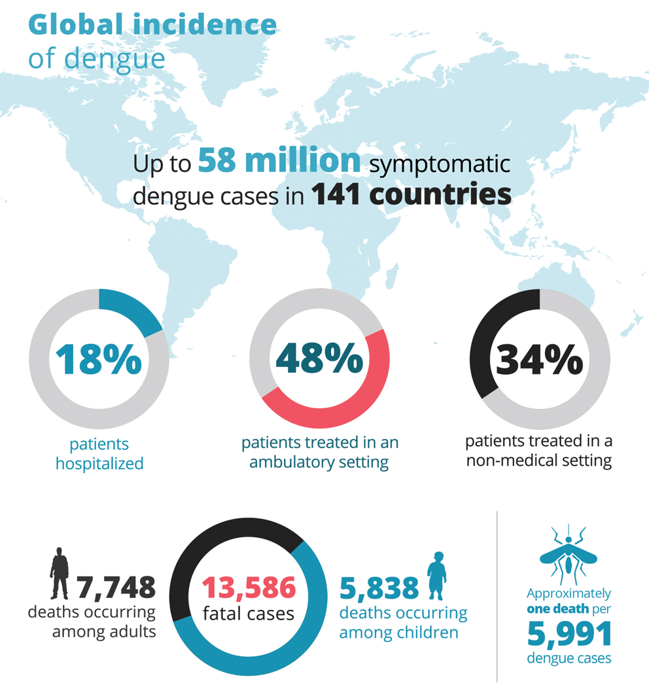
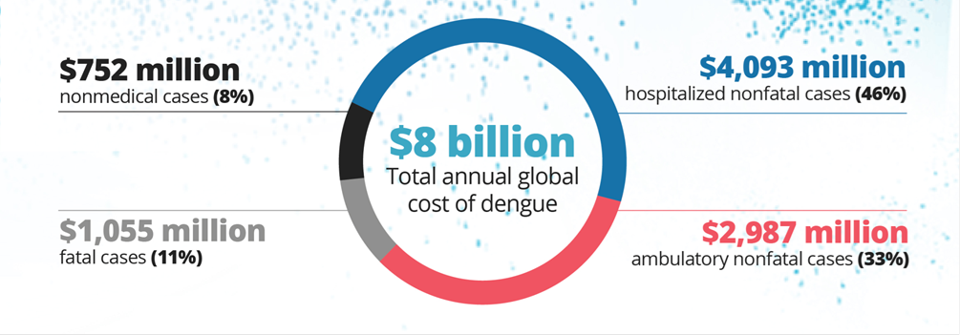
The Impact of Dengue Fever
Source: Booth, 2016; Shepard et al, 2016
Notes:
Last summer’s outbreak in Hanoi

Slide 3
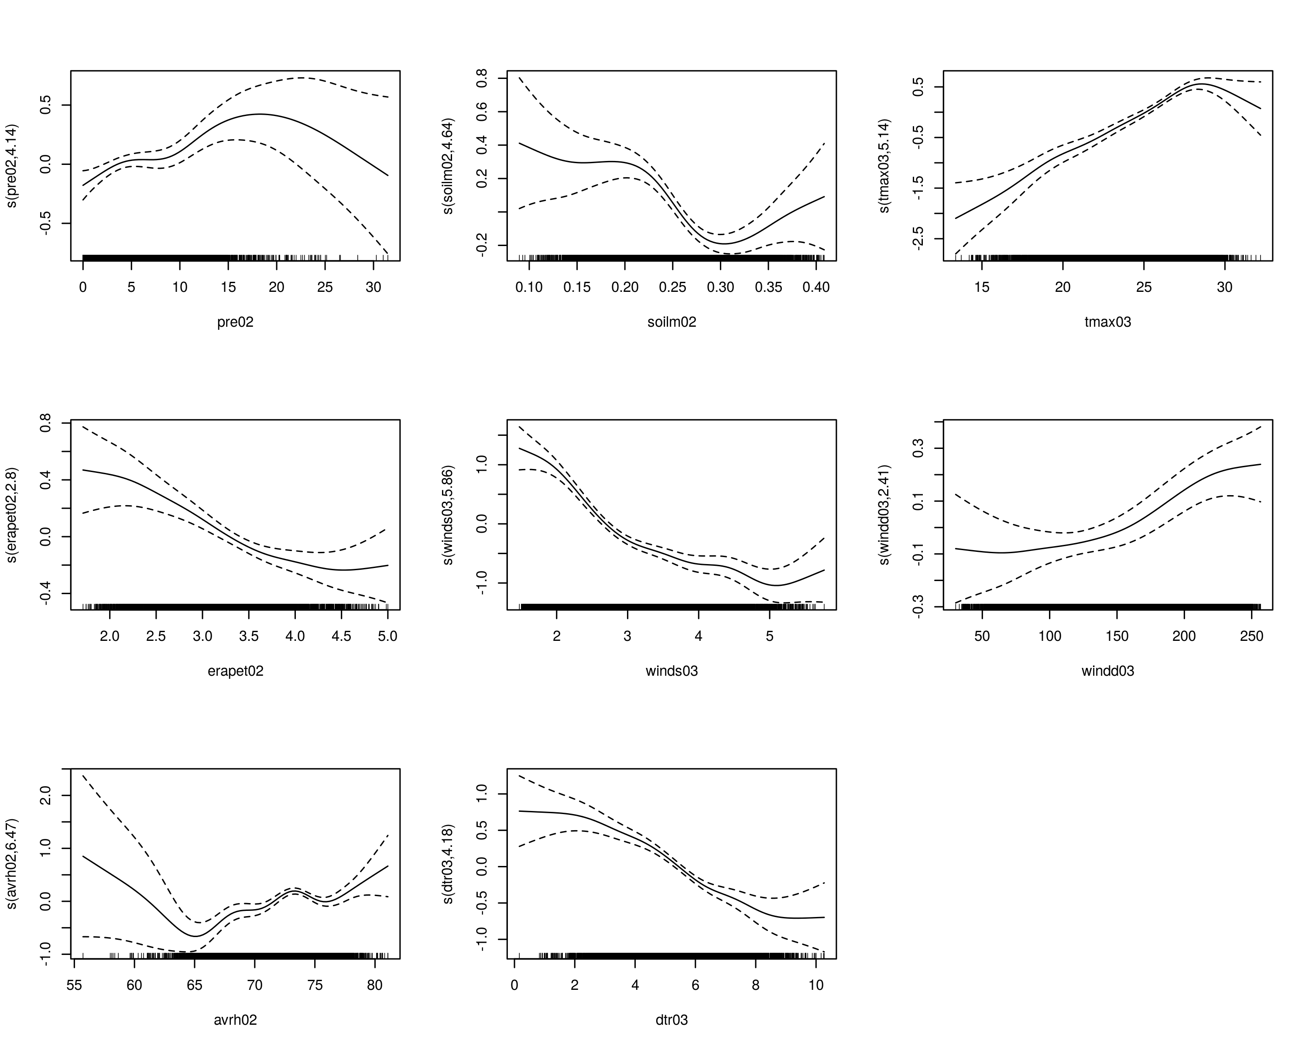
Dengue and climate
Temperature
    Influences development times of the mosquito and the virus,
    Mosquito survival and
    Adult size
    Egg-laying (oviposition) cycle
Precipitation
    Create/destroy breeding sites
Humidity
    Mosquito survival
Wind speed
    Movement of mosquito across space
Dengue risk
Rainfall
Dengue risk
Temperature

Slide 4
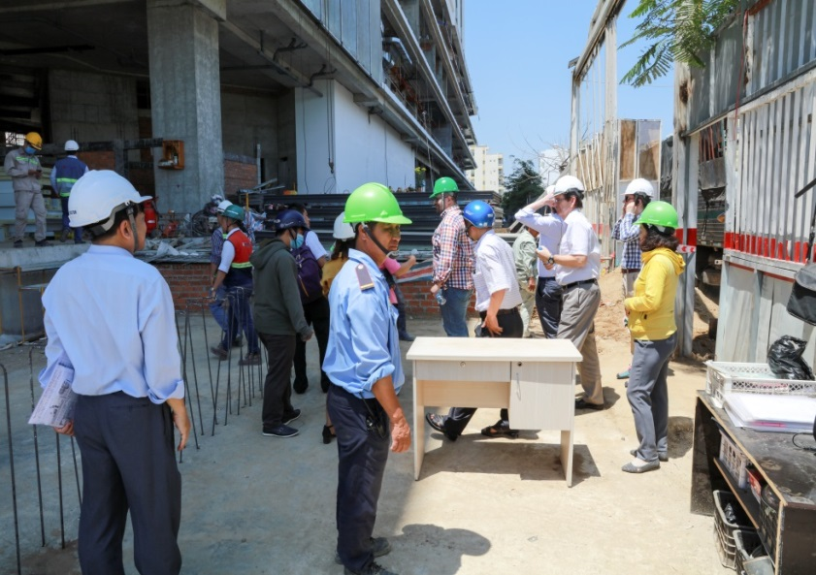
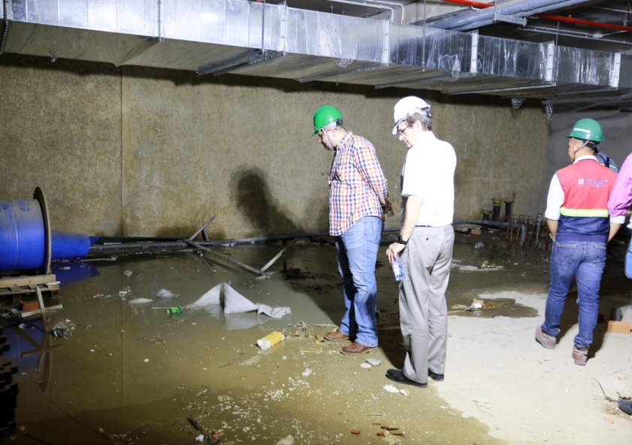
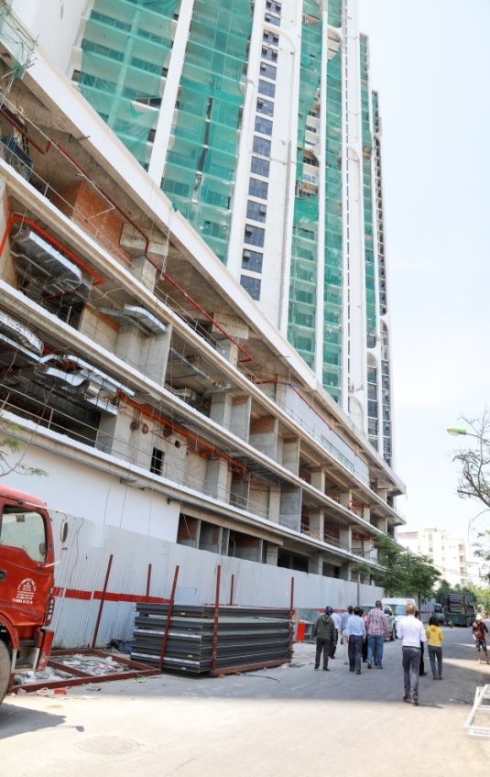

The human factor
Proxi data sets
Landcover
  Urban
  Periurban
  Rural
Population
Existing dengue cases

Slide 5

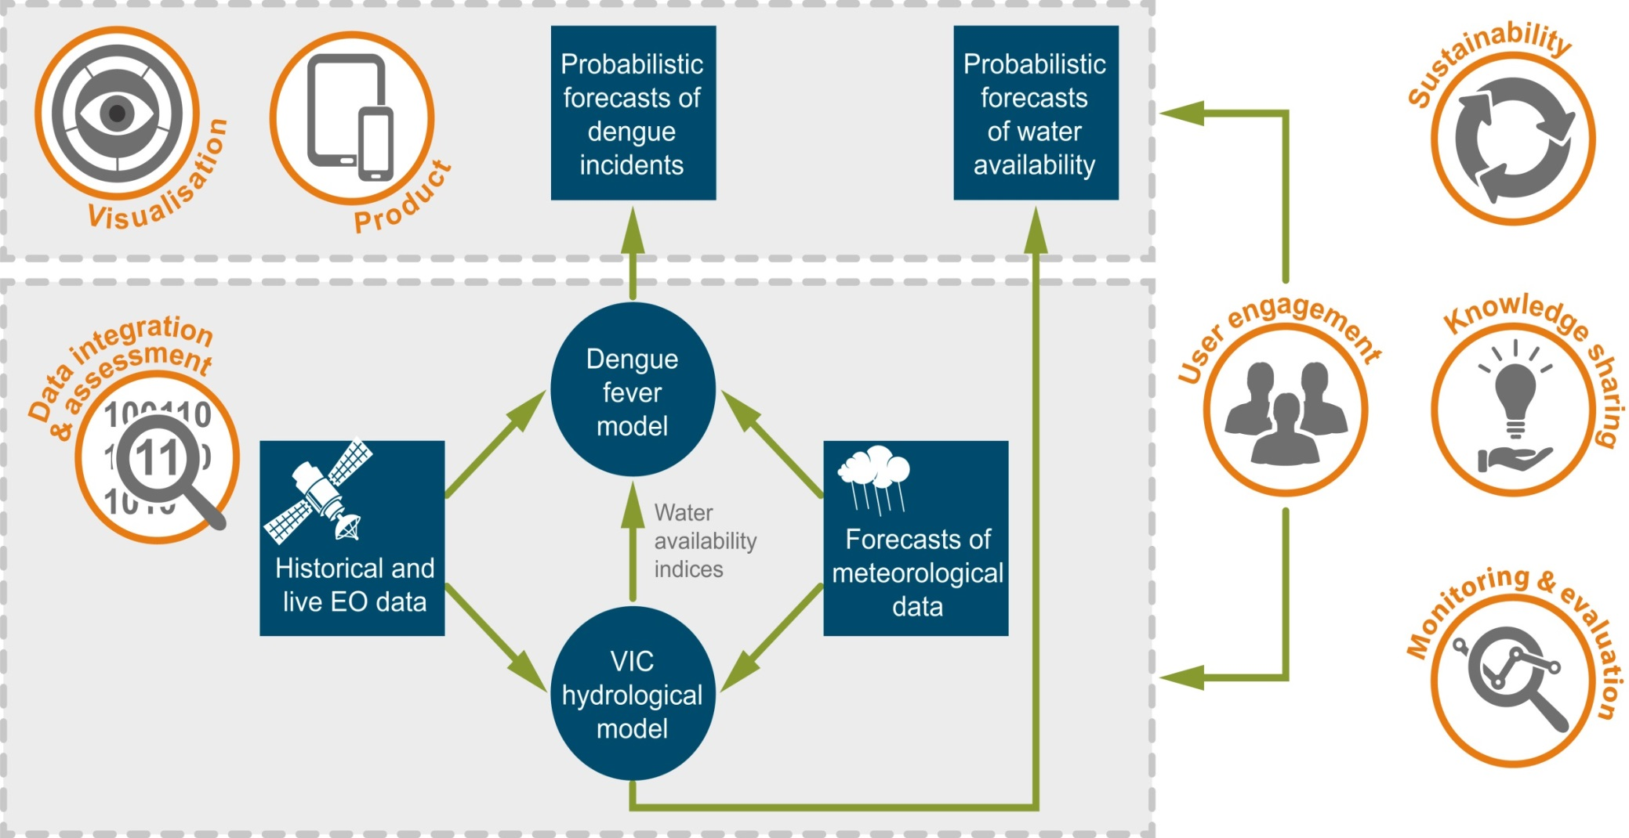

Slide 6
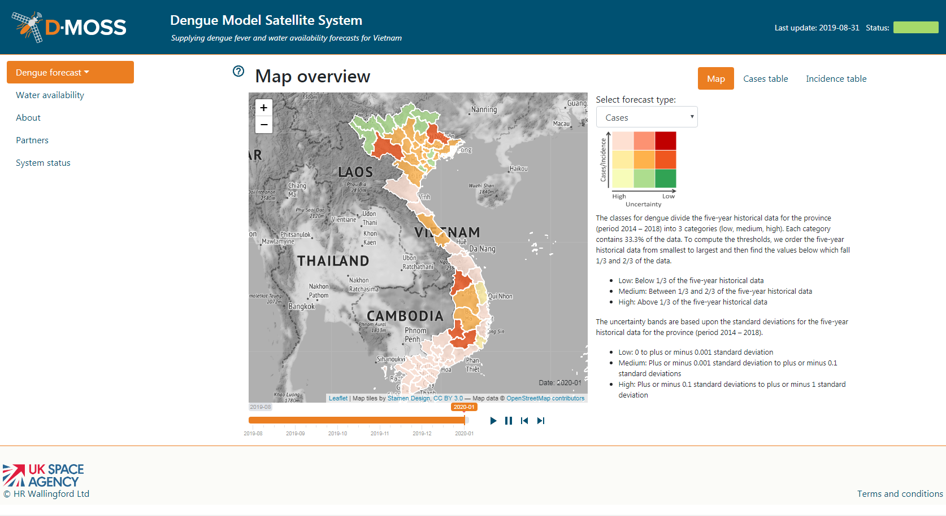

Slide 7
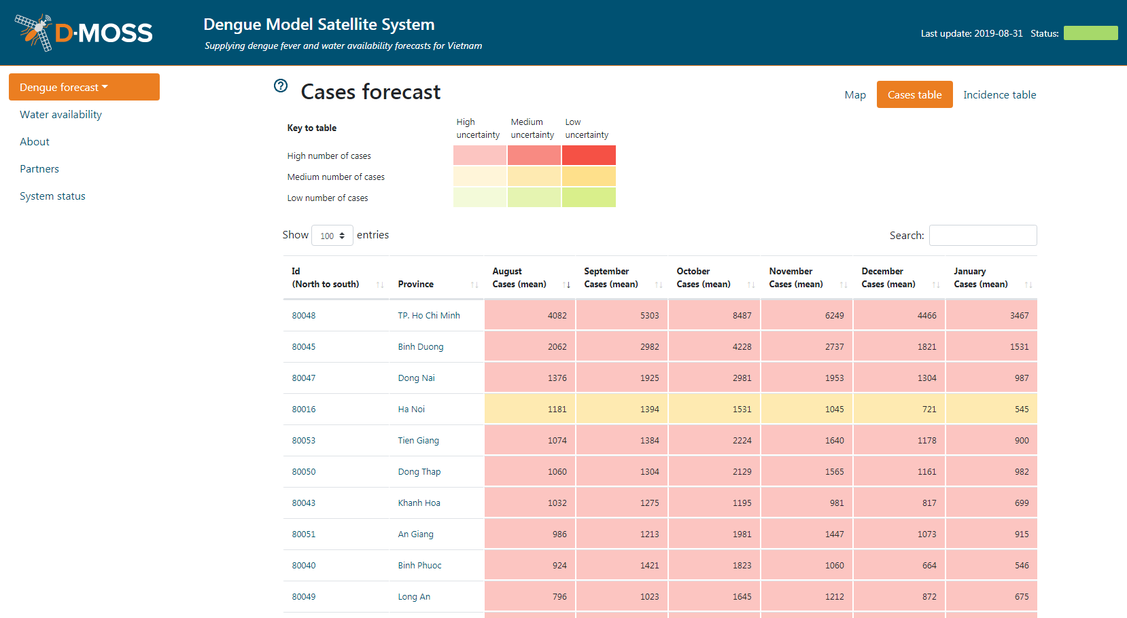

Slide 8
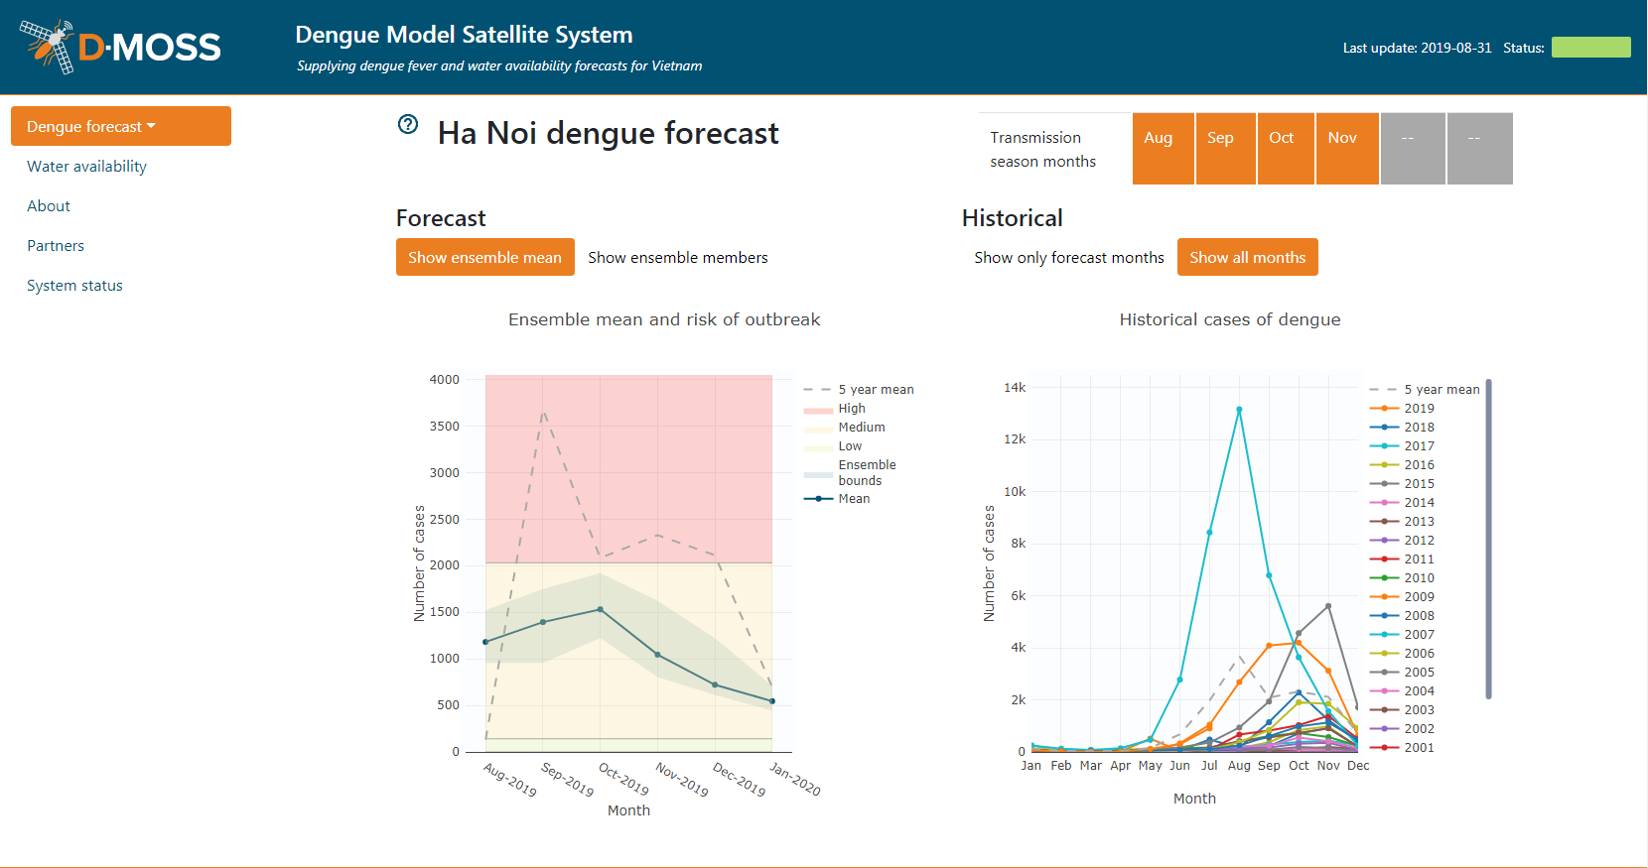

Slide 9
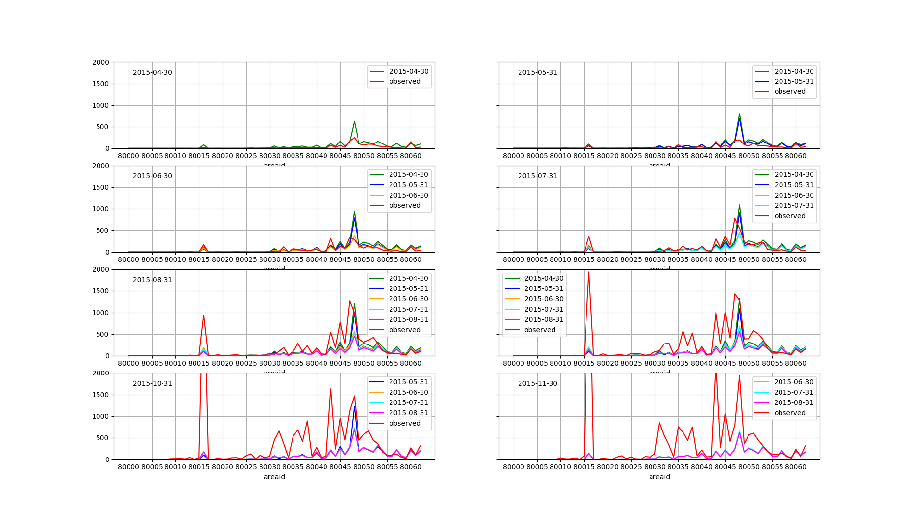
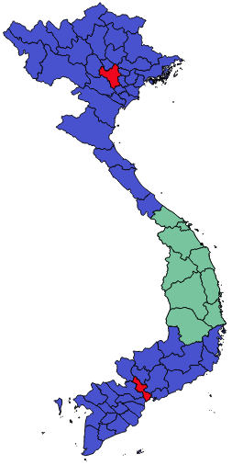
Hanoi
Ho Chi Minh City
Dengue Cases
N S

Slide 10

Summary
Preliminary results
    Operational since July 2019
    Automatic AWS based system
    Shape but not always magnitude
    Regional discrepancies
Next steps
    Glosea5 bias correction
    Skill assessment
    Dengue model improvements
    Website updates
    Test influence of different data sets
    Expansion to SE Asia

Slide 11











Project team

Slide 12
To help with
  Budget Setting (long term)
  Budget Distribution (medium term)
  Community Action (medium term)
  Immediate Response (short term)
    Site Specific Spraying
    Inspection
    Area Spraying
  Planning and policy changes

